Slide 1


Q4 2024 MAP TO THE MARKETS
By:
Rush Zarrabian, CFA
Carmen Dello Iacono, CFA Connor Becton, CFP®
MAP TO THE MARKETS
Q3 2023
By:
Rush Zarrabian, CFA
Carmen Dello Iacono, CFA Harrison Burdge
For Investment Professional Use Only
For Internal Fidelity Use Only –
Not for Client Distribution

Slide 2


Timely Updates and Studies
© 2024 Corbett Road Wealth Management

Slide 3
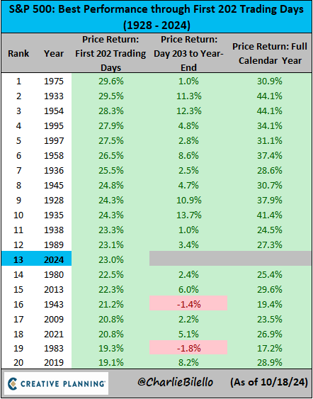
Strong Markets Tend to Finish the Year Strong
Source: Charlie Bilello
© 2024 Corbett Road Wealth Management

Slide 4
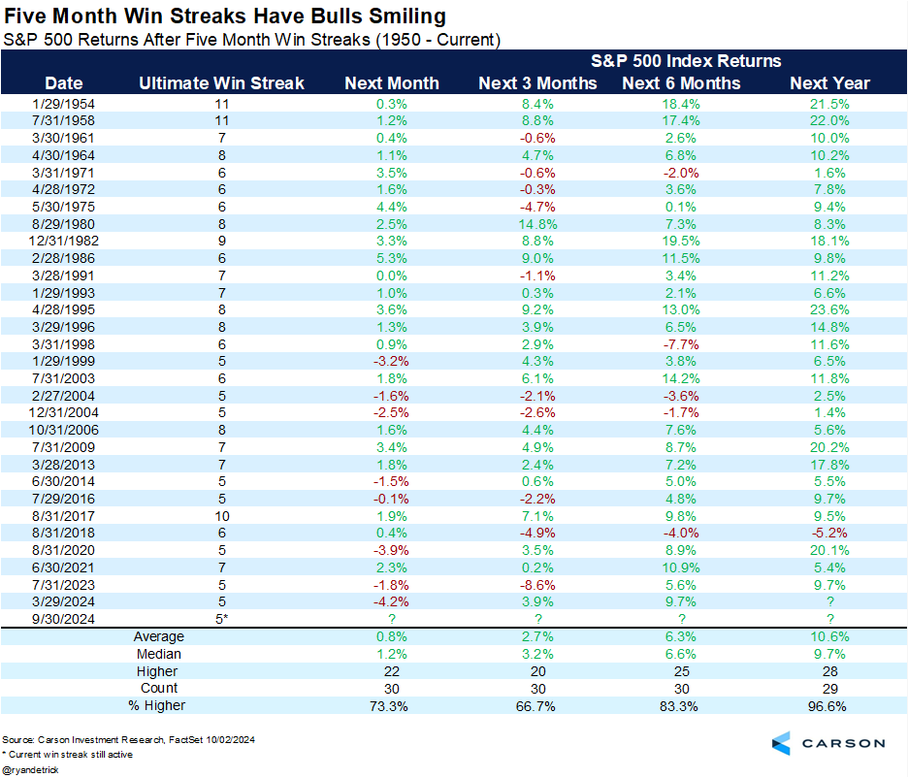
5 Month Win Streaks Tend to Lead to Further Gains
Source: Carson Group
© 2024 Corbett Road Wealth Management

Slide 5
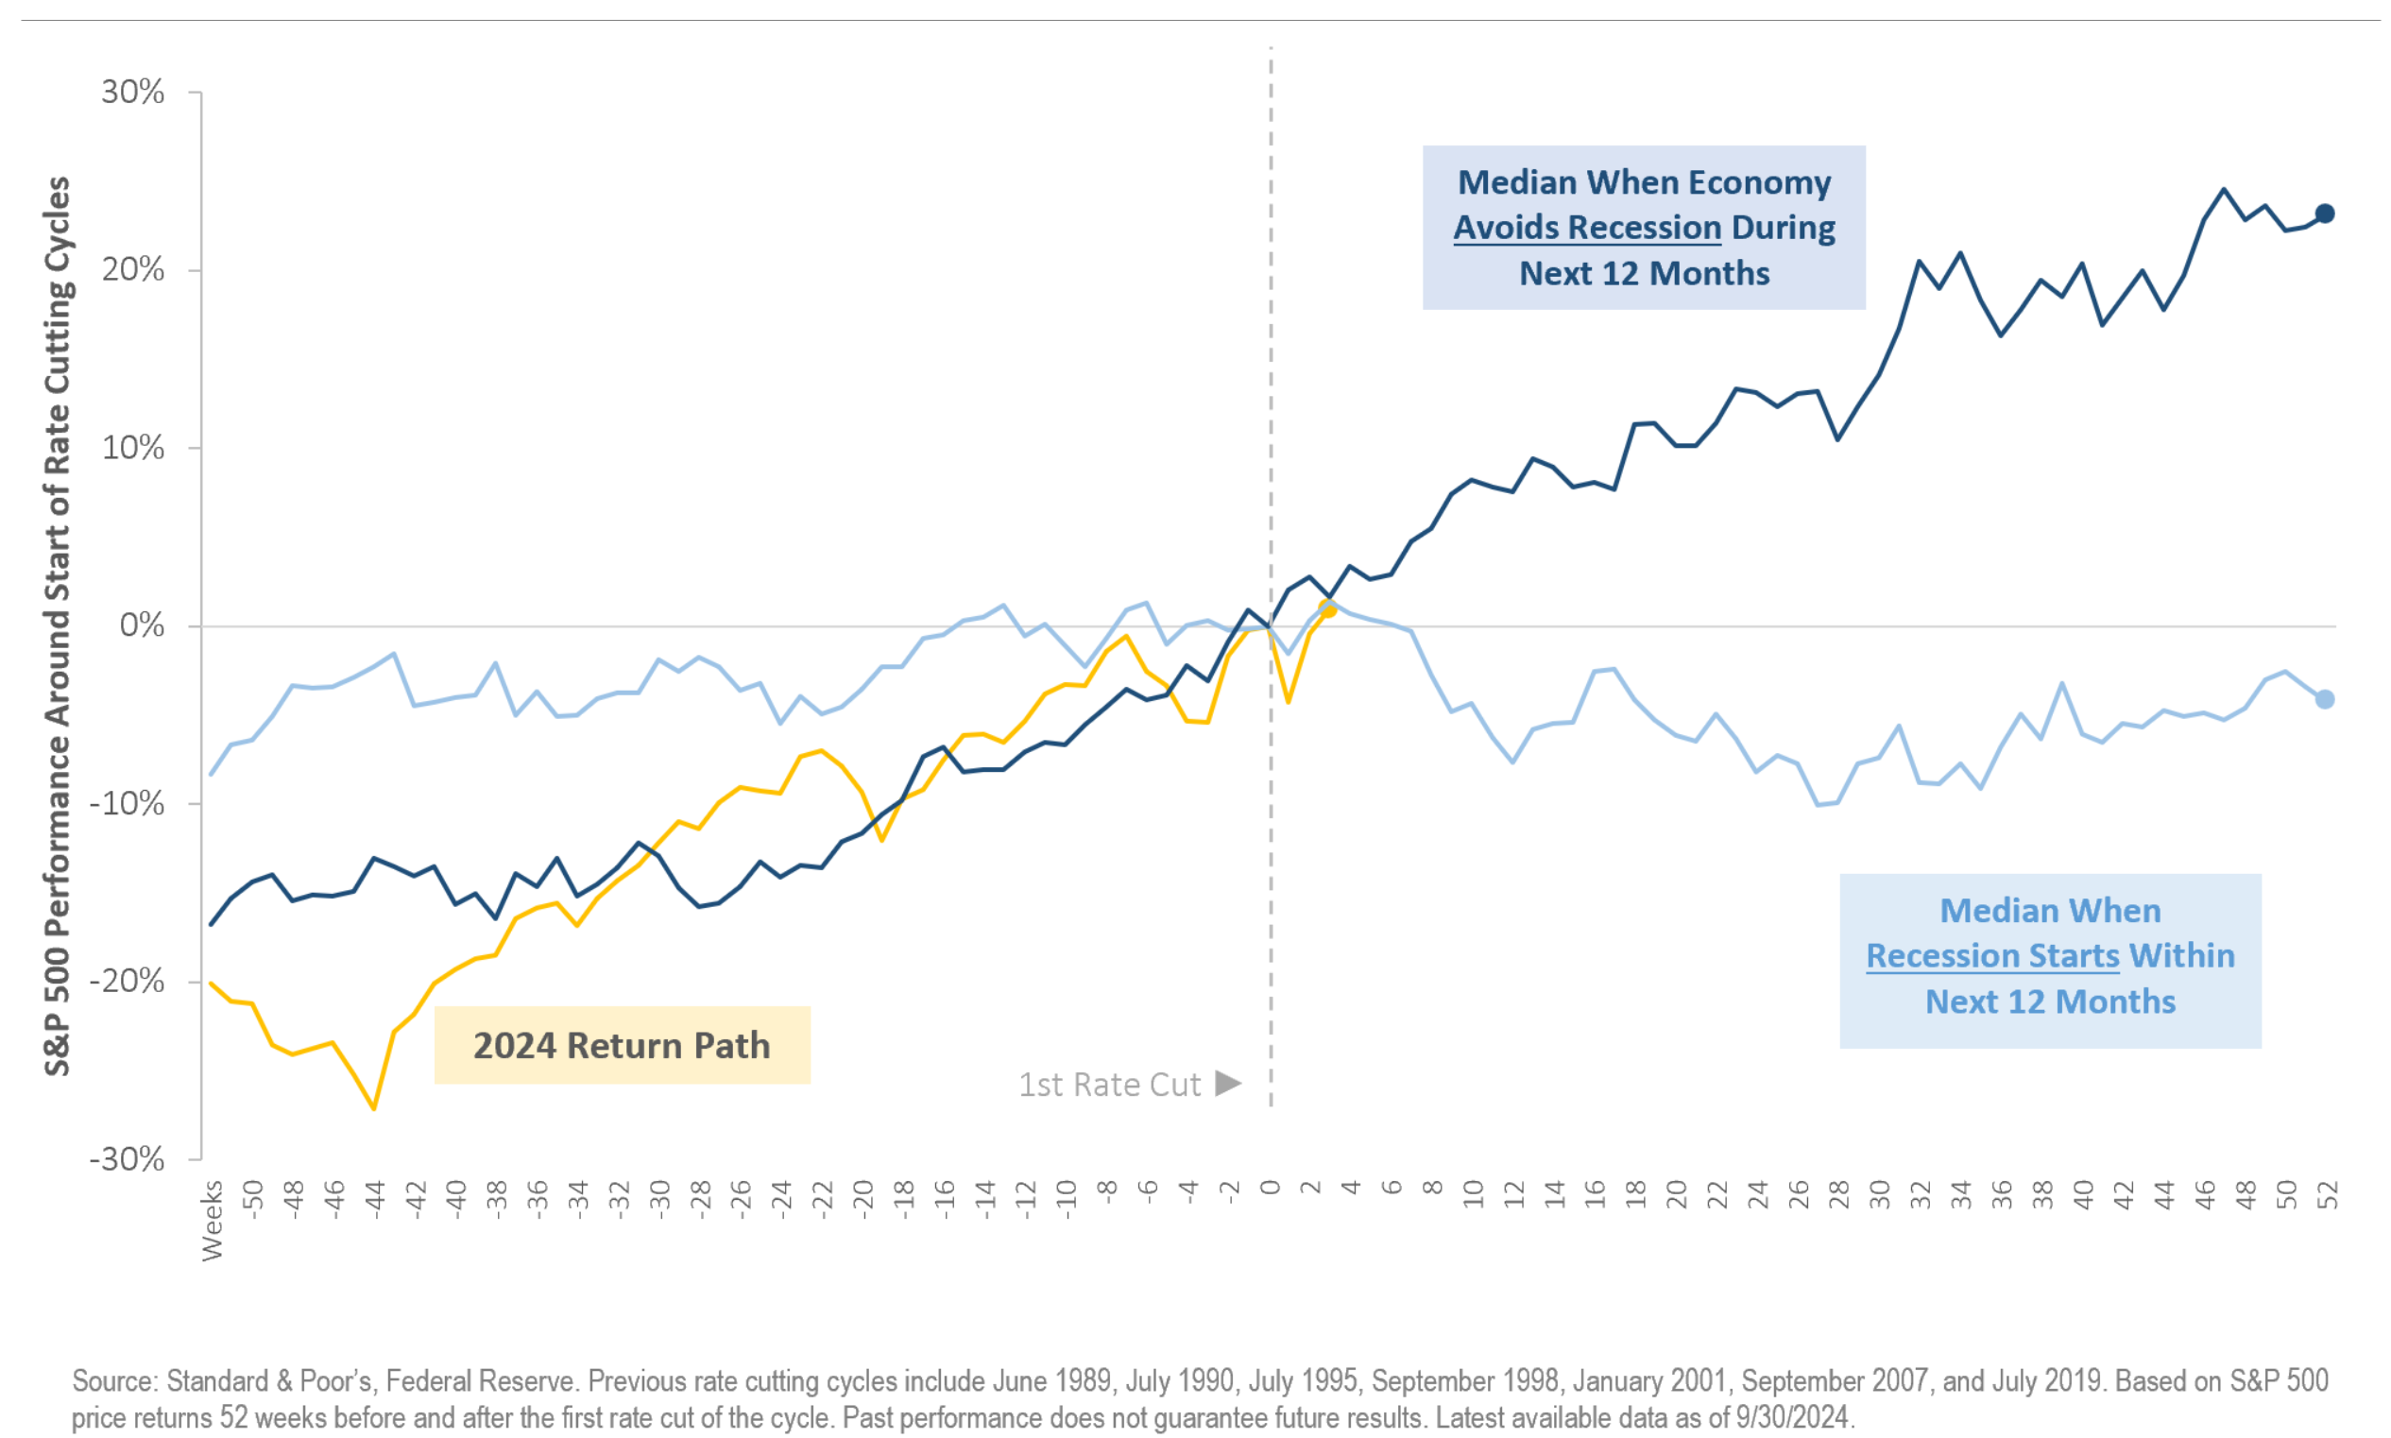
Rate Cuts Historically Precede Market Gains
Source: Bloomberg
© 2024 Corbett Road Wealth Management

Slide 6
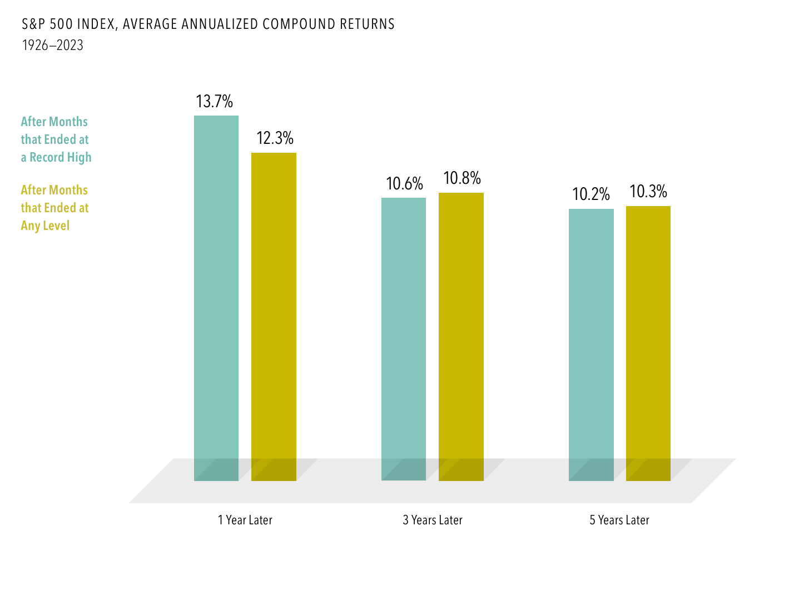
Returns from All-Time Highs Match Other Periods
Source: DFA
© 2024 Corbett Road Wealth Management

Slide 7
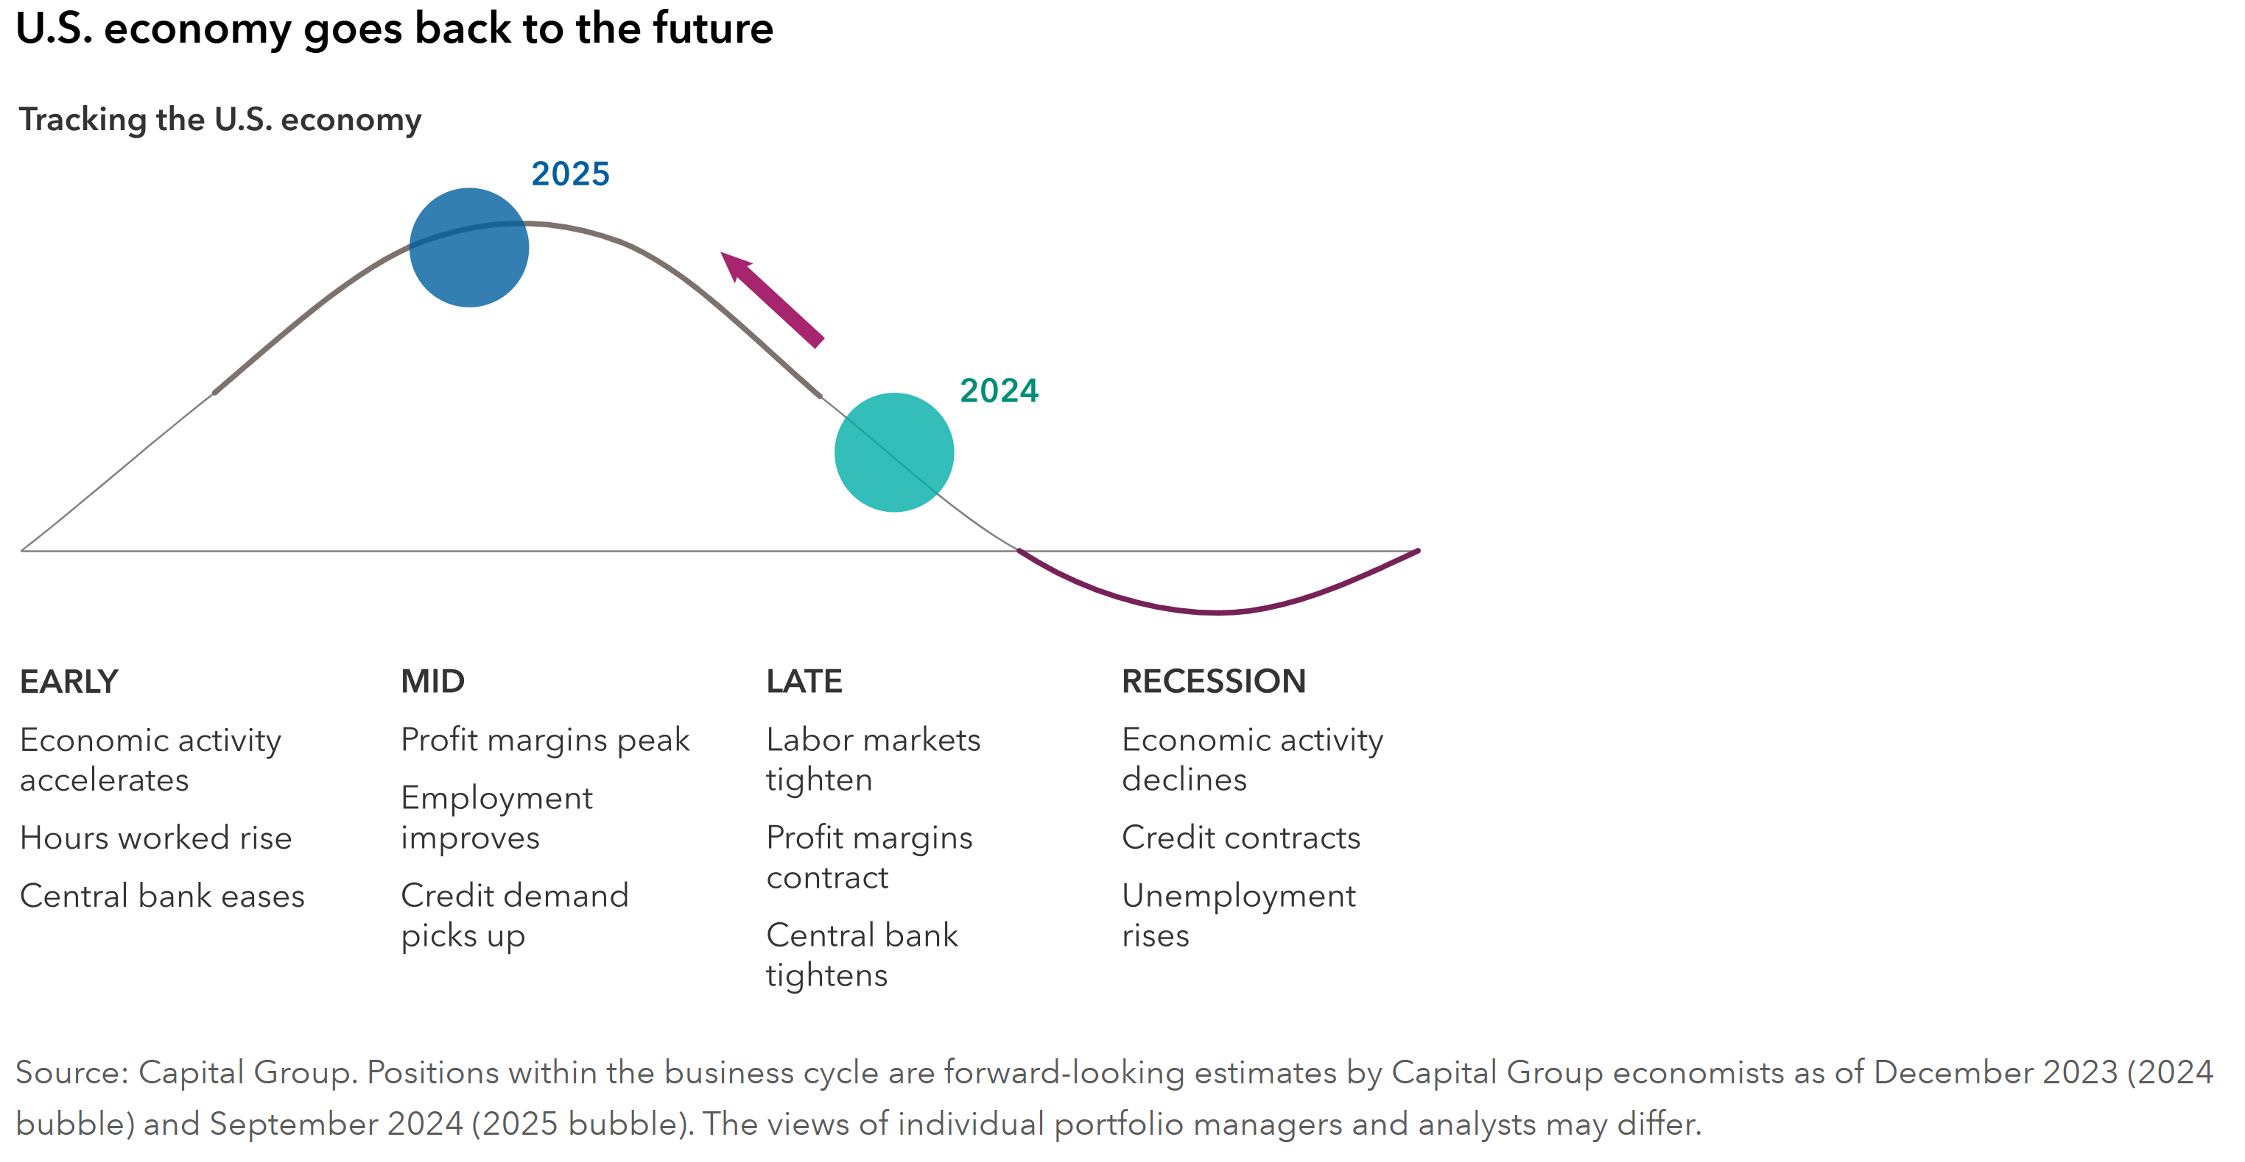
A Soft Landing Implies the Economy is Likely Mid Cycle
Source: Capital Group
© 2024 Corbett Road Wealth Management

Slide 8
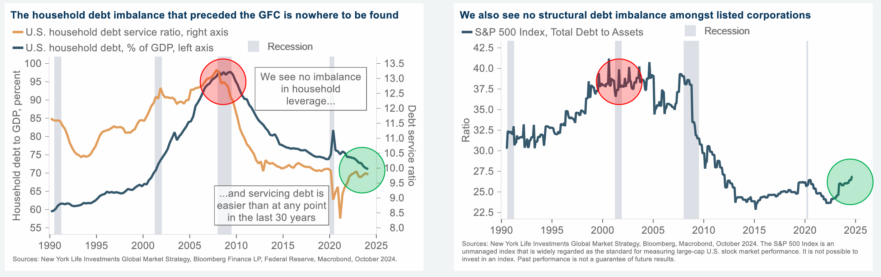
Both Corporate and Household Balance Sheets are in Excellent Shape
Source: New York Life
© 2024 Corbett Road Wealth Management

Slide 9
Valuation
© 2024 Corbett Road Wealth Management

Slide 10
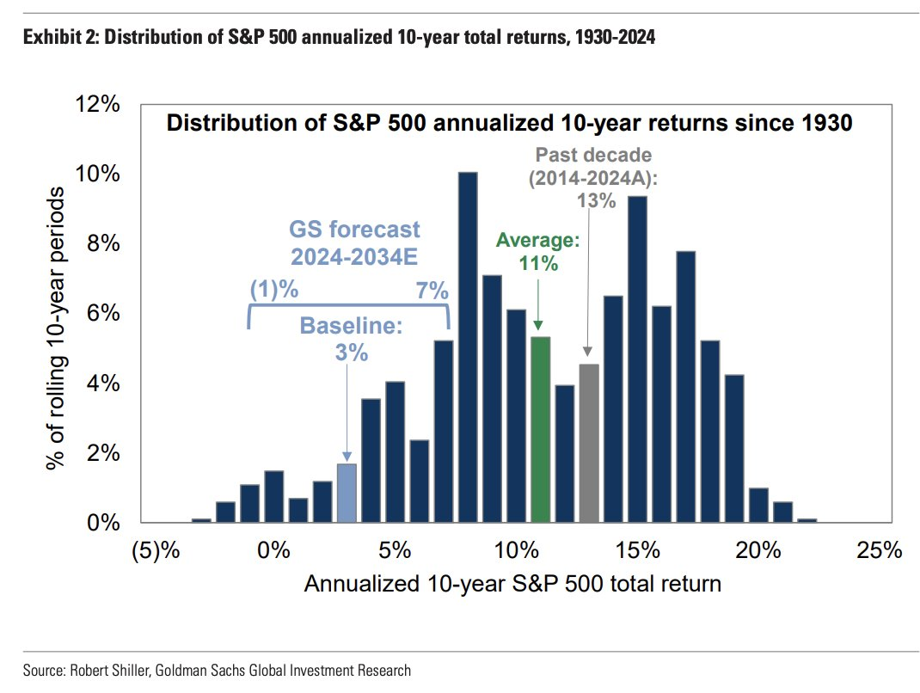
Recently, Goldman Sachs Projected Only 3% Returns for the Next Decade
Source: Goldman Sachs
© 2024 Corbett Road Wealth Management

Slide 11
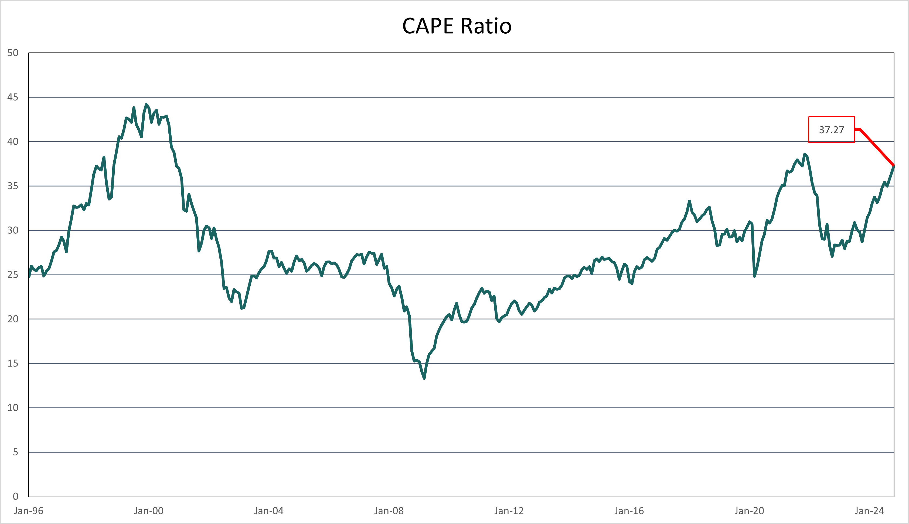
CAPE (Shiller P/E) Ratio – Where We are Today
Source: Corbett Road via Multpl
© 2024 Corbett Road Wealth Management

Slide 12
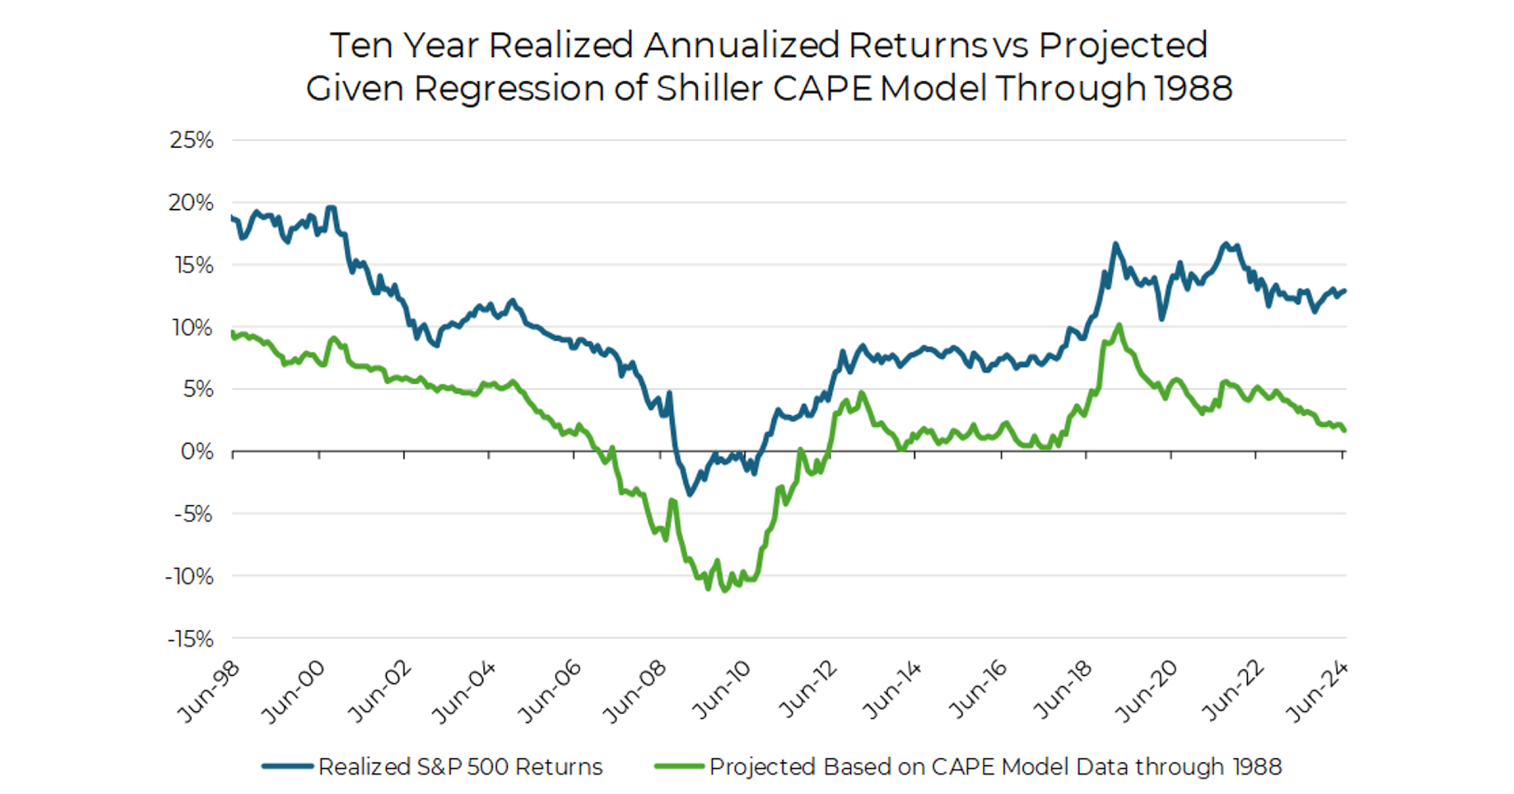
But the Shiller Ratio Has Done a Poor Job of Predicting Future Returns
Source: Aptus Capital via Yale.EDU
© 2024 Corbett Road Wealth Management

Slide 13
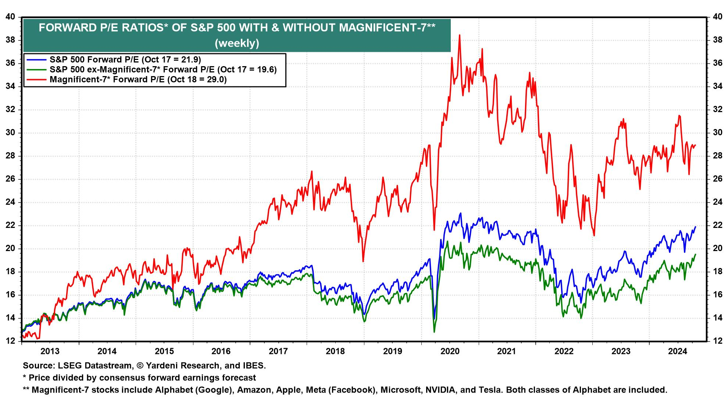
Optically High Valuations
Source: Yardeni
© 2024 Corbett Road Wealth Management

Slide 14
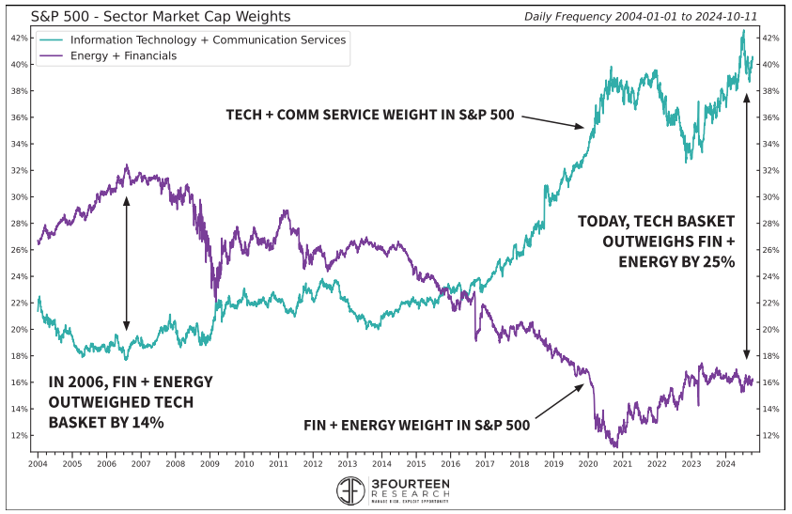
Structural Factors Explaining High Valuations
Index Composition
% of Higher Growth, Higher Quality Tech ↑ = P/Es ↑
Source: 3Fourteen Research
© 2024 Corbett Road Wealth Management

Slide 15
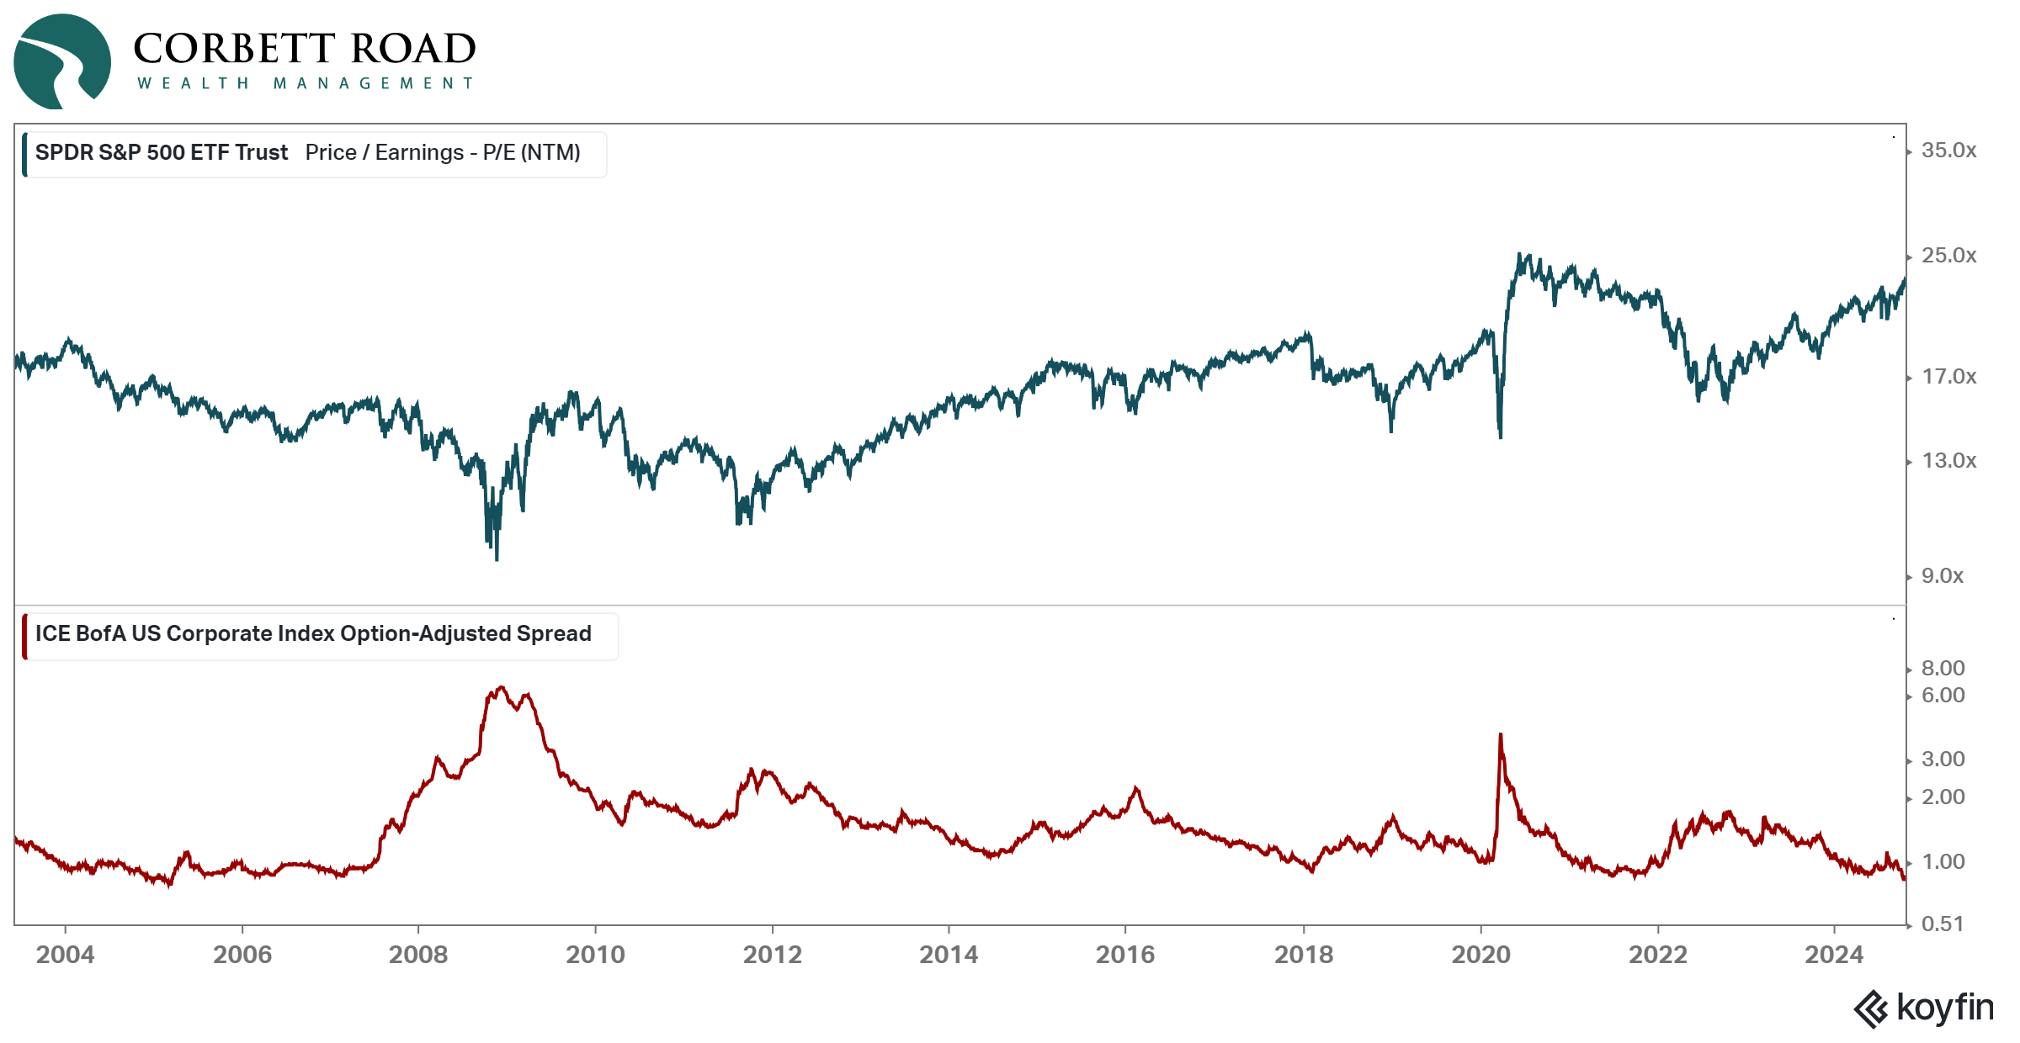
Structural Factors Explaining High Valuations (Continued)
Low Credit Spreads
Credit Risk ↓ = P/Es ↑
Source: Koyfin
© 2024 Corbett Road Wealth Management

Slide 16
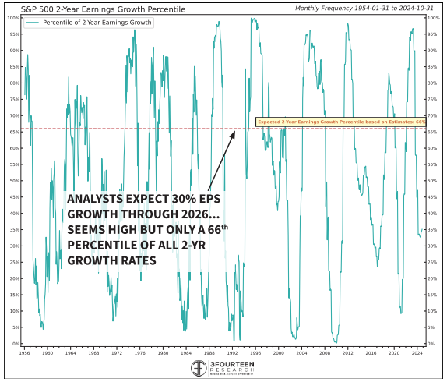
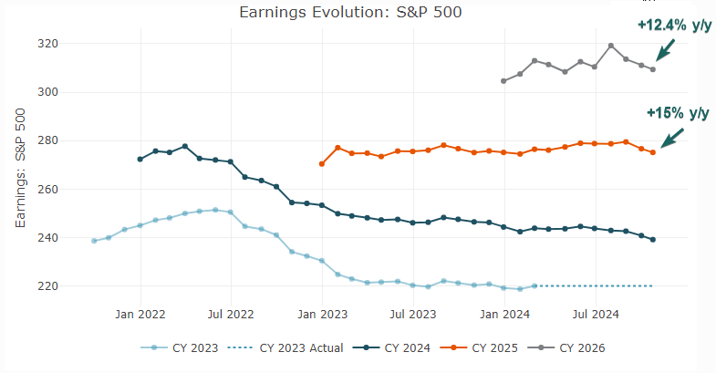
Assessing the Earnings Growth Outlook
Currently, analysts expect S&P 500 earnings to grow at a double-digit pace in 2025 / 2026, increasing by nearly ~30% over the next two years.
While these estimates may appear aggressive on the surface, adding historical context to the growth rate shows that the forecast is actually only in the 66th percentile of all 2-year growth rates.
Source: Piper Sandler (left); 3Fourteen Research (right)
© 2024 Corbett Road Wealth Management

Slide 17
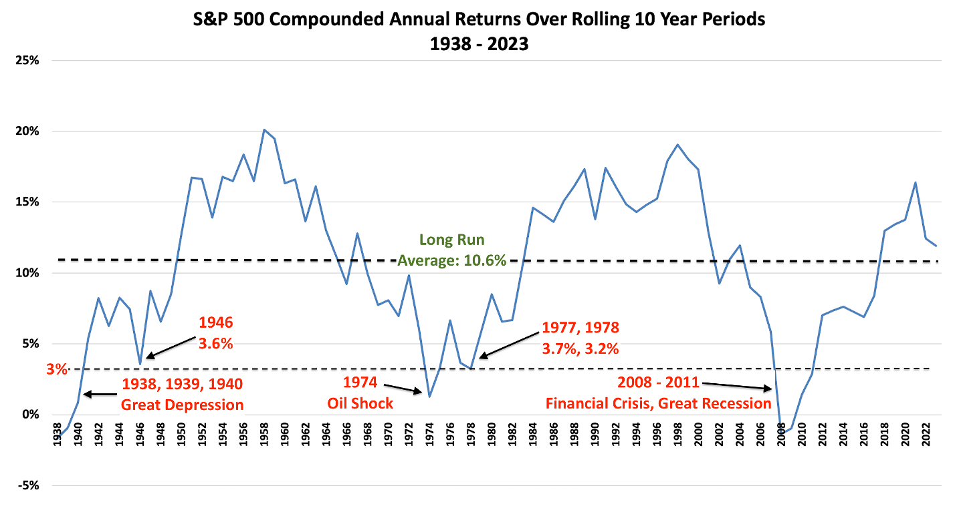
Negative 10-Year Returns are Rare, but When They Do Happen, It’s Usually Because of a Significant Crisis.
Source: DataTrek Research
© 2024 Corbett Road Wealth Management

Slide 18
Elections vs Markets
Source: LPL Financial
© 2024 Corbett Road Wealth Management

Slide 19
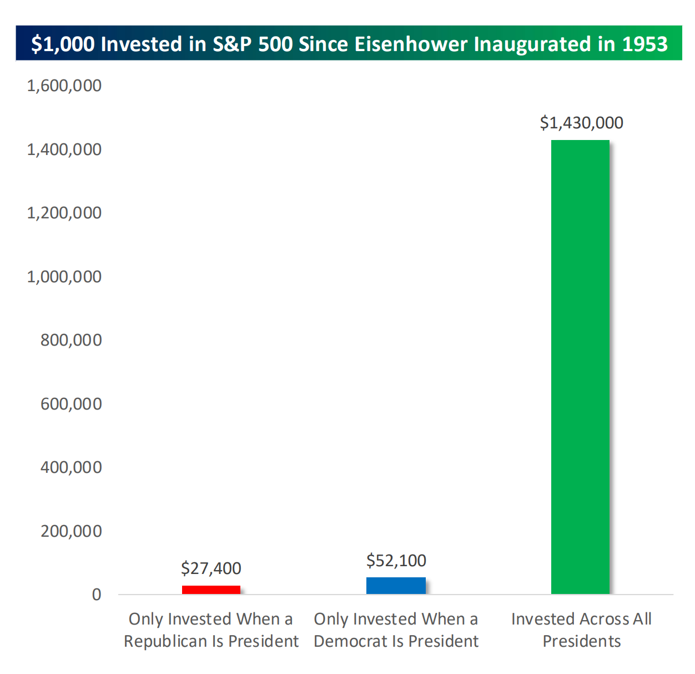
The Market Performs Better in Democratic AND Republican Administrations
Source: Charles Schwab
© 2024 Corbett Road Wealth Management

Slide 20
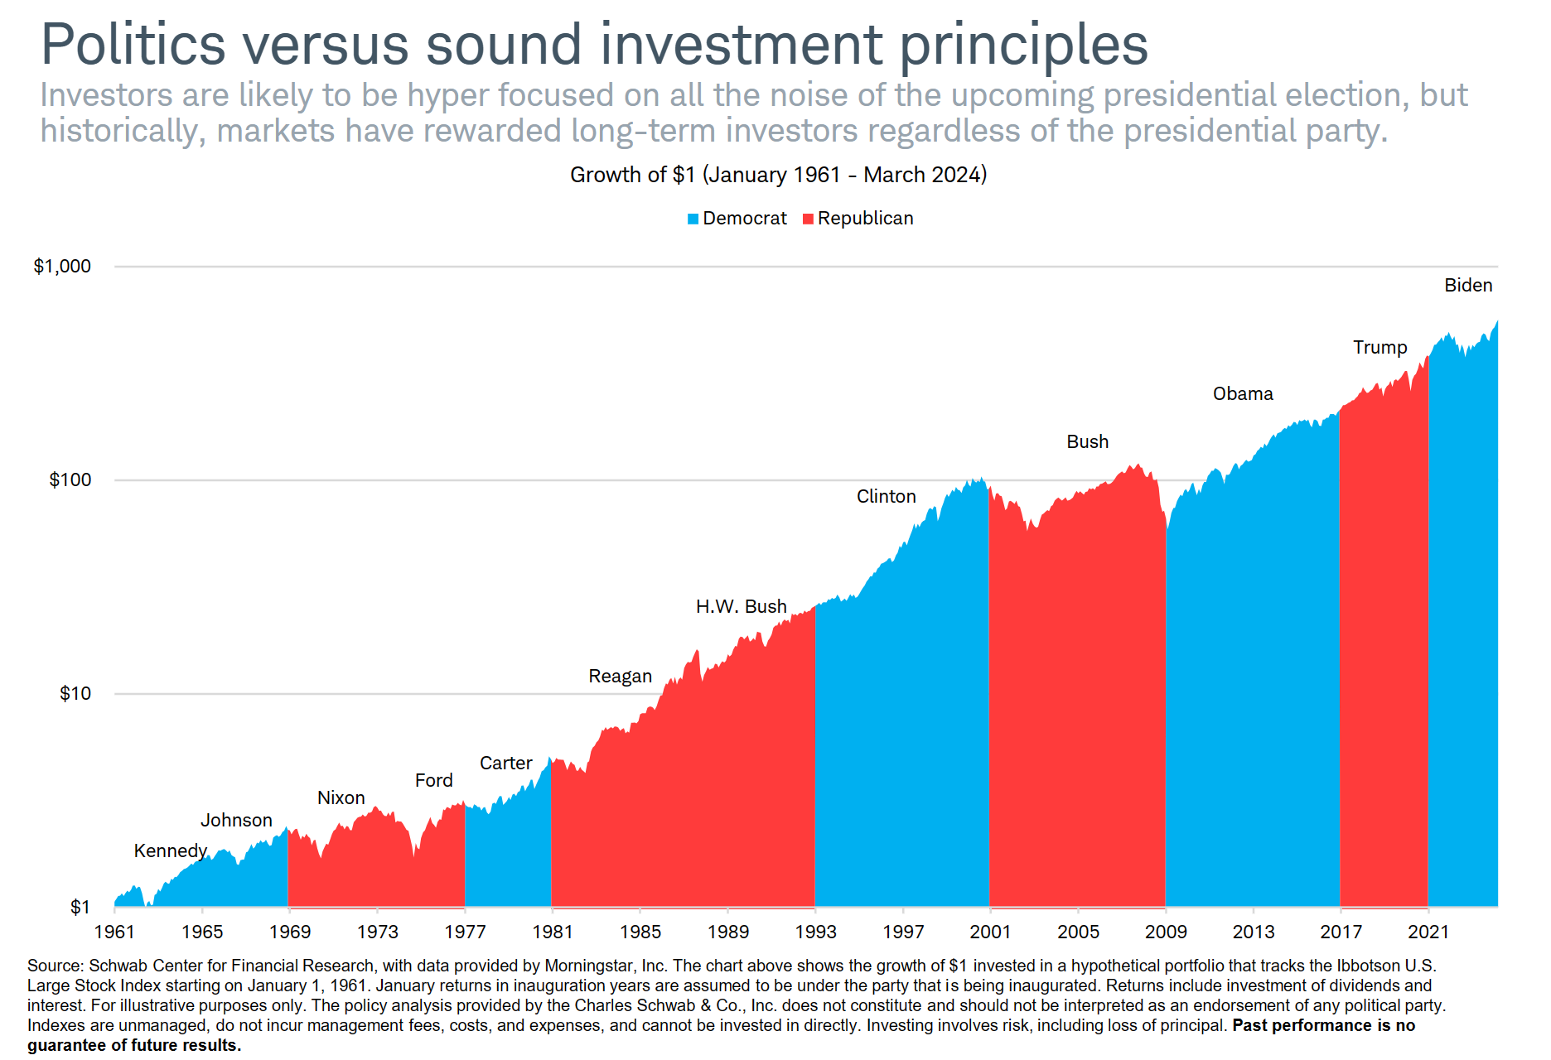
Presidential Party vs US Stocks
Source: Charles Schwab
© 2024 Corbett Road Wealth Management

Slide 21
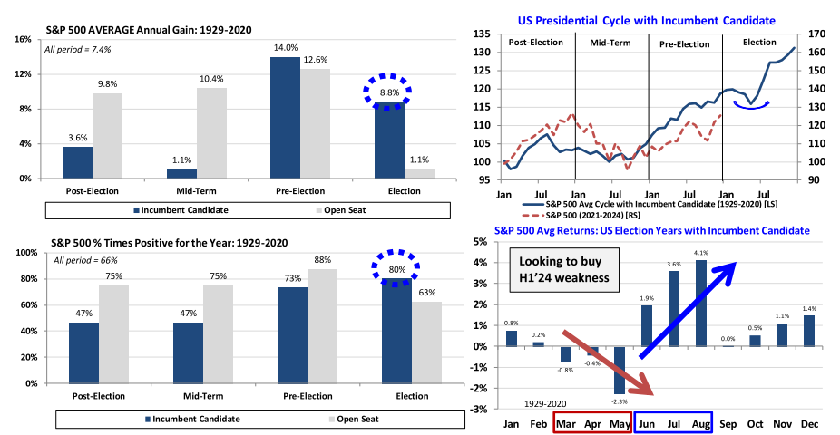
Market Performance During the Presidential Cycle
Source: Oppenheimer
© 2024 Corbett Road Wealth Management

Slide 22
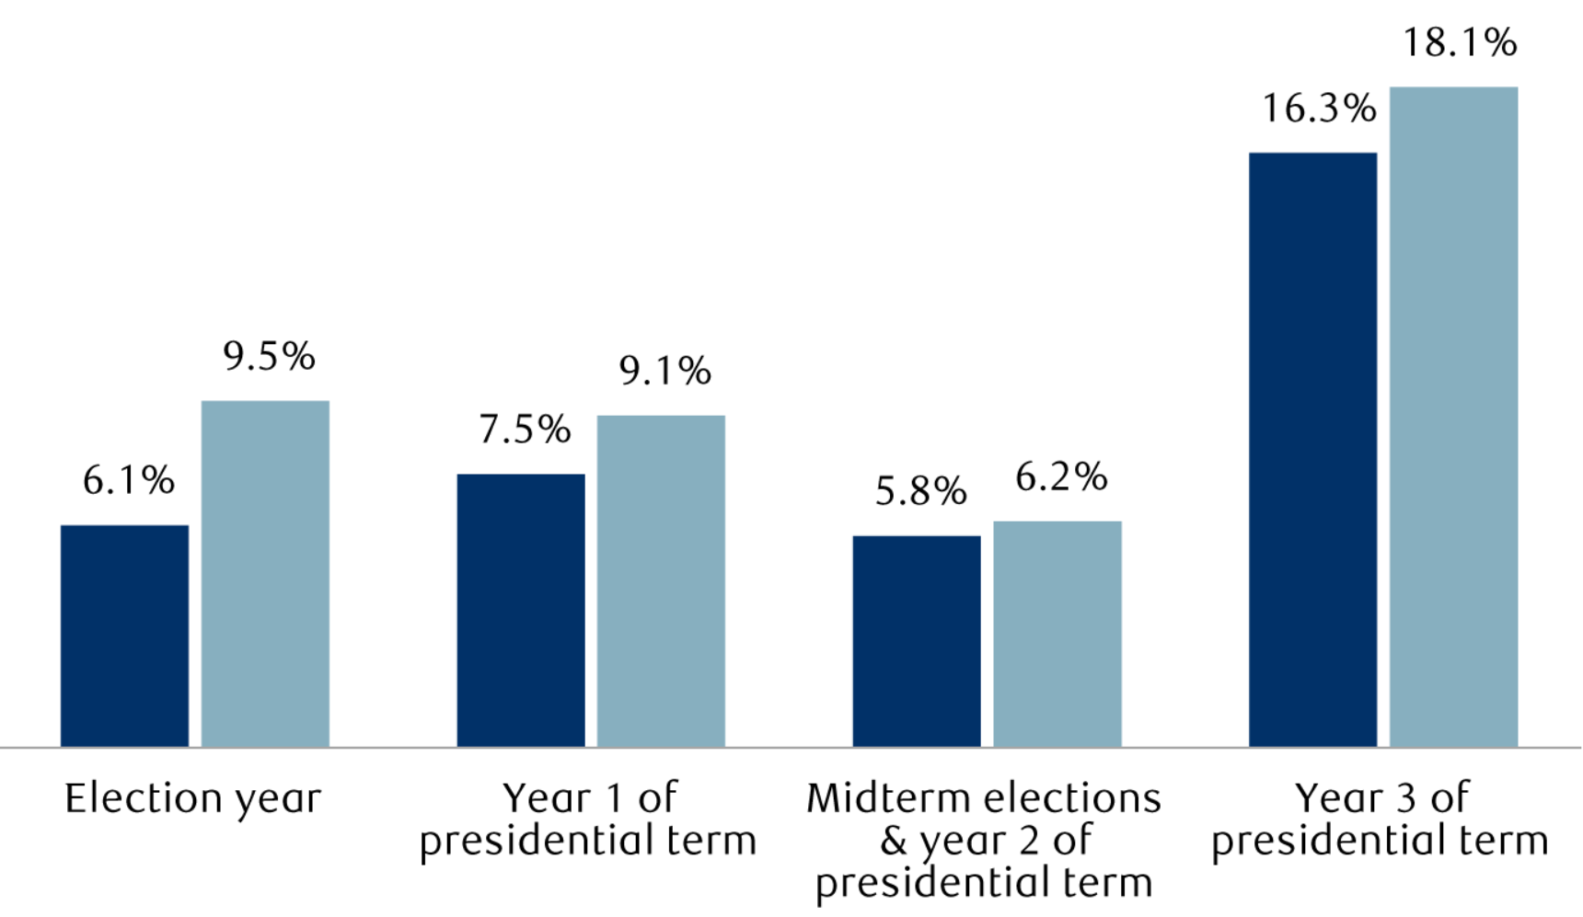
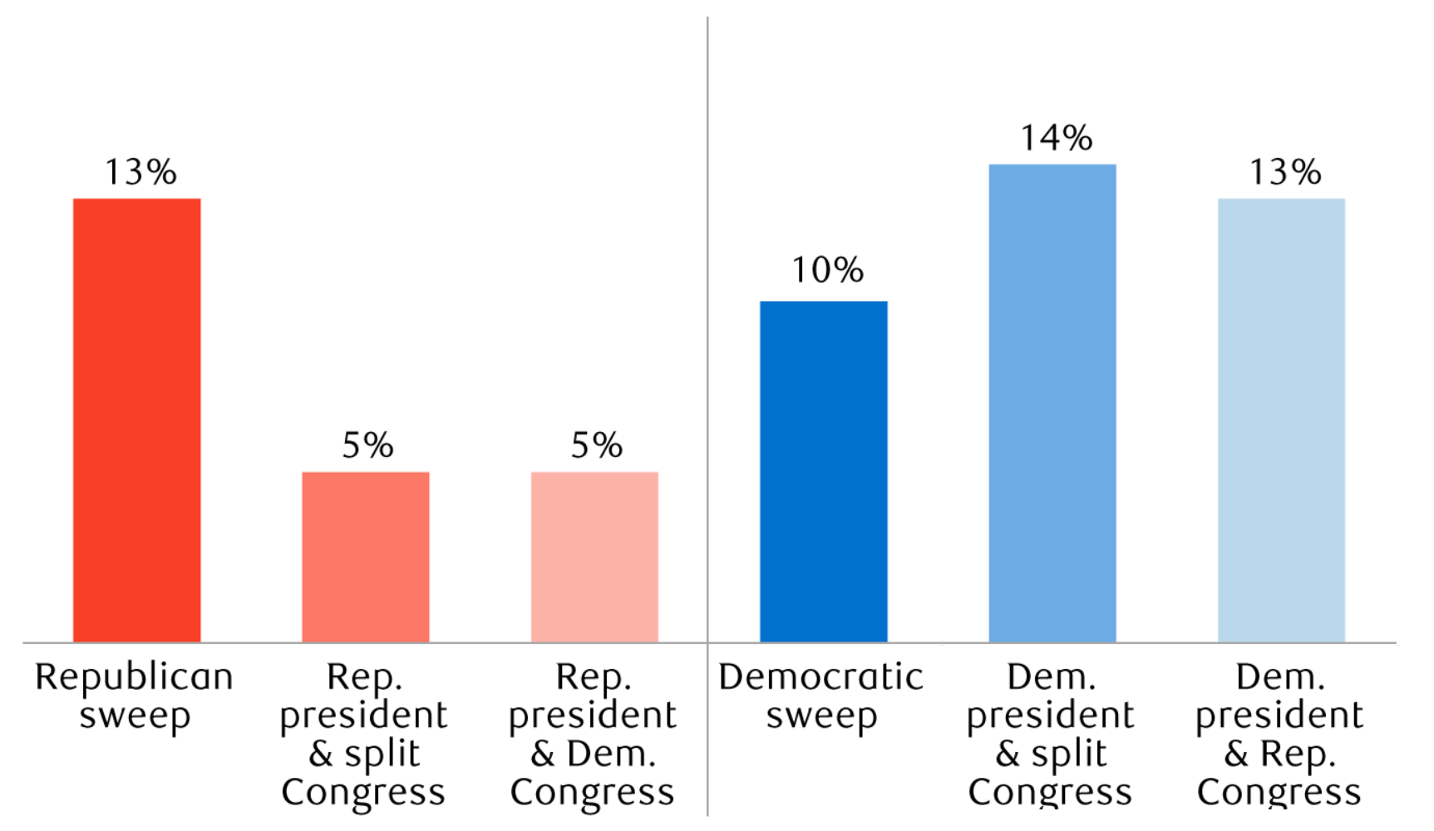
Election Cycles & Government Composition
S&P 500 Performance During Election Cycles (Since 1932)
Average Annual S&P 500 Returns by Government Makeup (Since 1932)
Source: RBC
© 2024 Corbett Road Wealth Management

Slide 23
Market Performance & Asset Class Returns
© 2024 Corbett Road Wealth Management

Slide 24
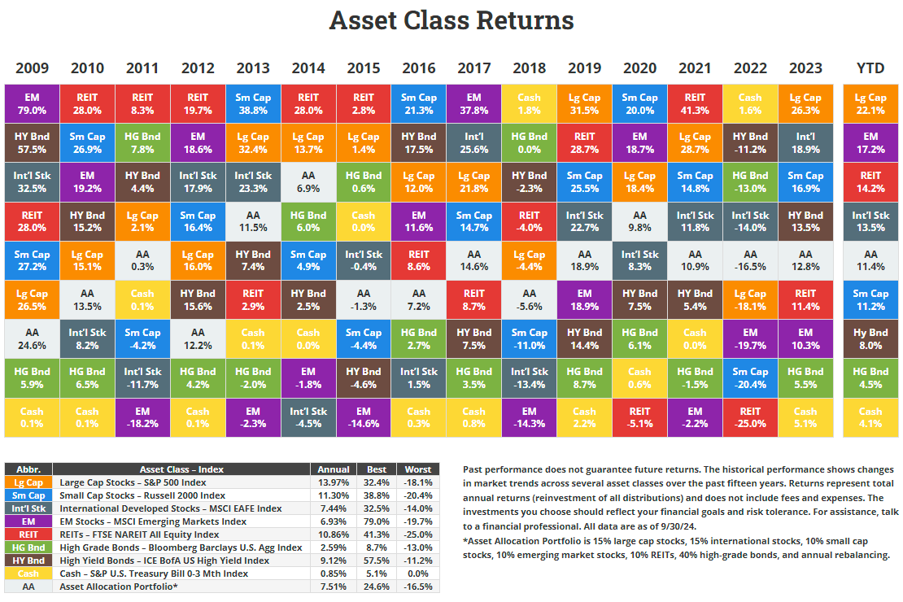
Historical Asset Class Returns
Source: Novel Investor
© 2024 Corbett Road Wealth Management

Slide 25
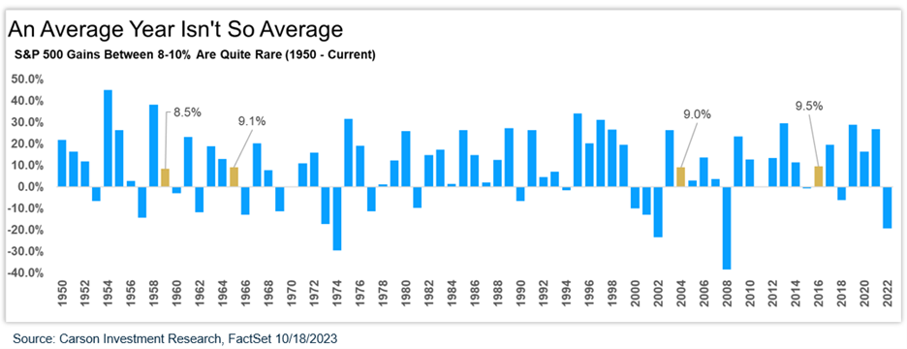
The Market Rarely Sees Average Returns in a Calendar Year
Source: Carson Group
© 2024 Corbett Road Wealth Management

Slide 26
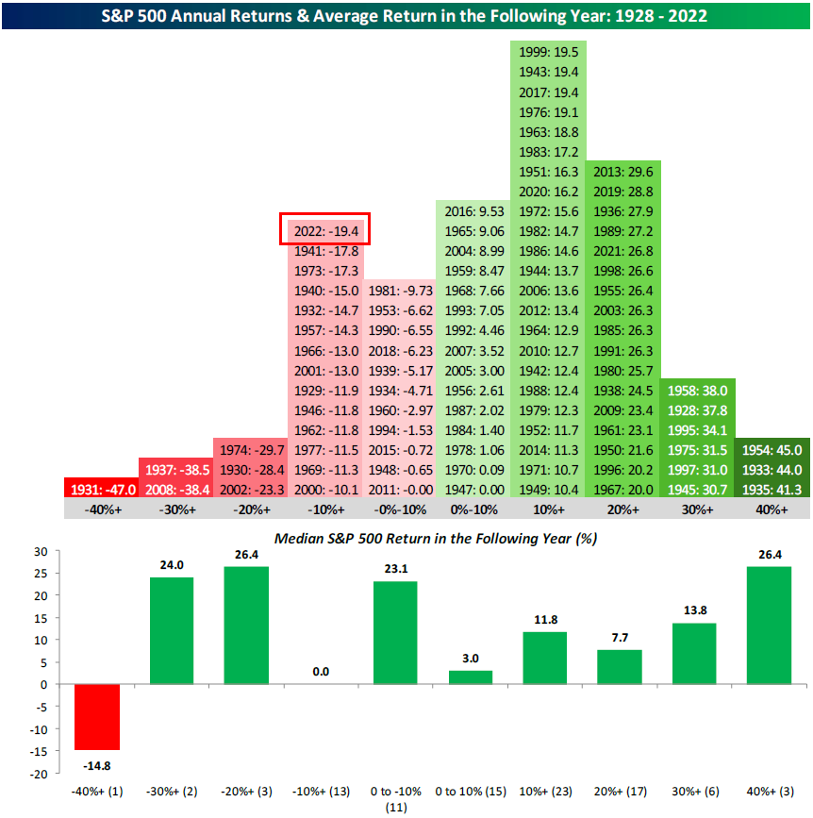
Distribution of S&P 500 Returns
2023
Source: Bespoke Investment Group
© 2024 Corbett Road Wealth Management

Slide 27
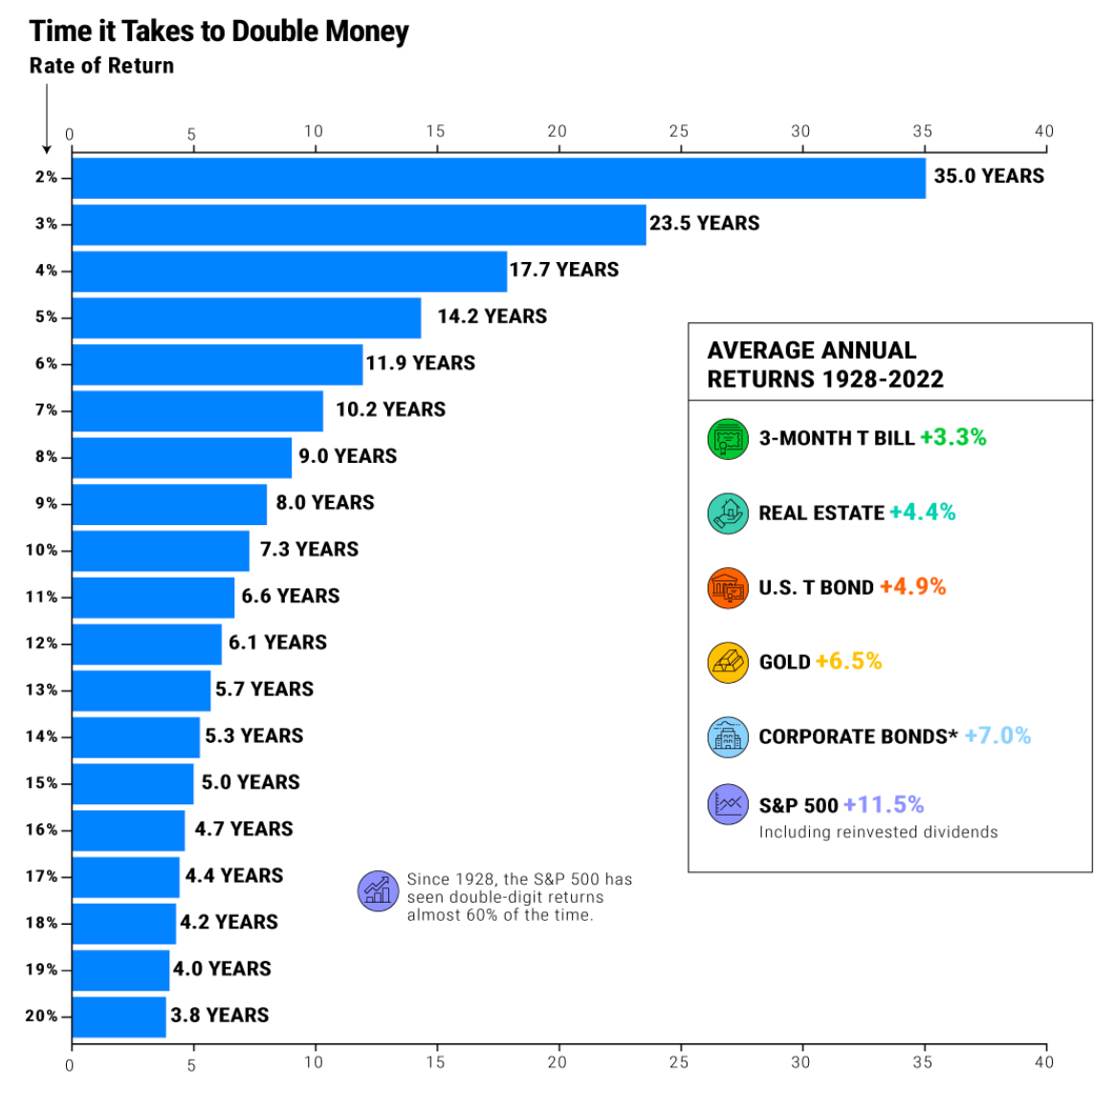
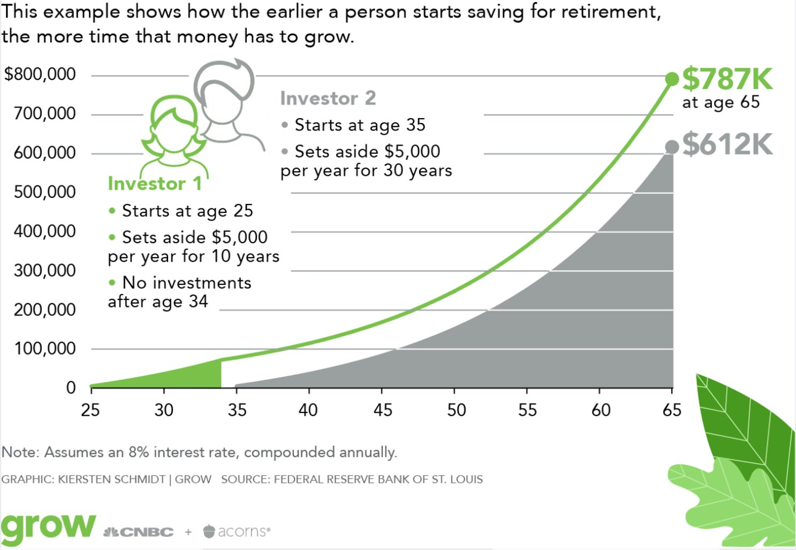
Power of Compounding
Source: Visual Capitalist (Left), Kiersten Schmidt (Grow) & Federal Reserve
© 2024 Corbett Road Wealth Management

Slide 28
Drawdowns
© 2024 Corbett Road Wealth Management

Slide 29
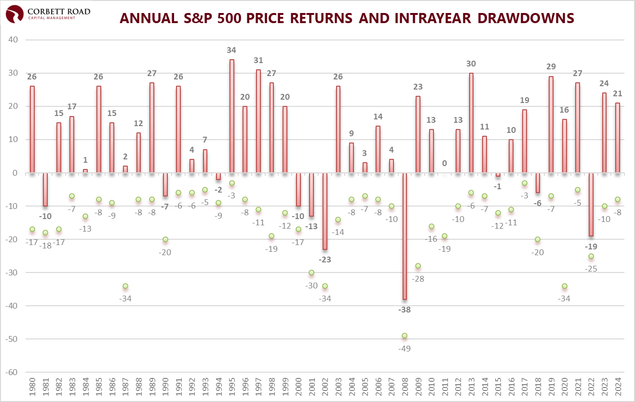
Market Corrections Happen Every Year
The average drop is 14%, but the market has been positive 75% of all calendar years since 1980.
Source: CRCM, S&P. 2024 data through 9/30/2024
© 2024 Corbett Road Wealth Management

Slide 30
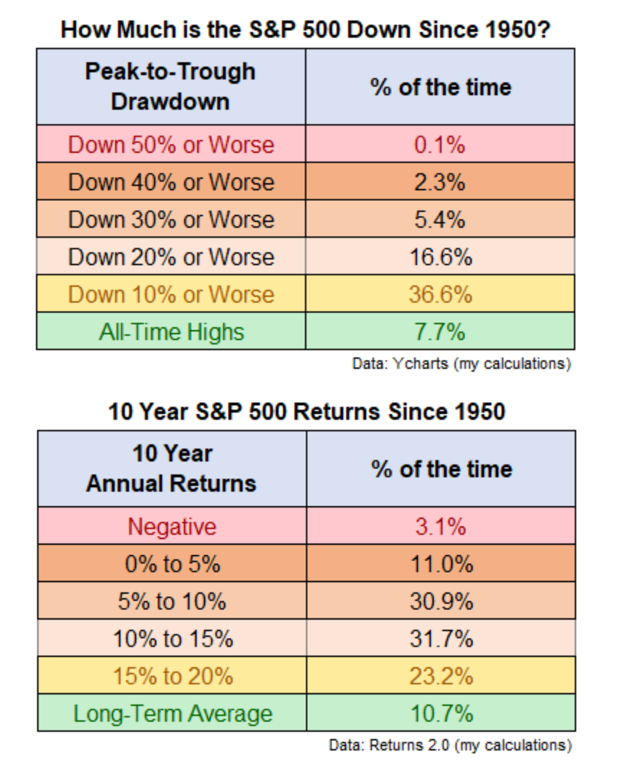
The Market Has Rarely Spent Time in a Major Drawdown
Source: Ben Carlson
© 2024 Corbett Road Wealth Management

Slide 31
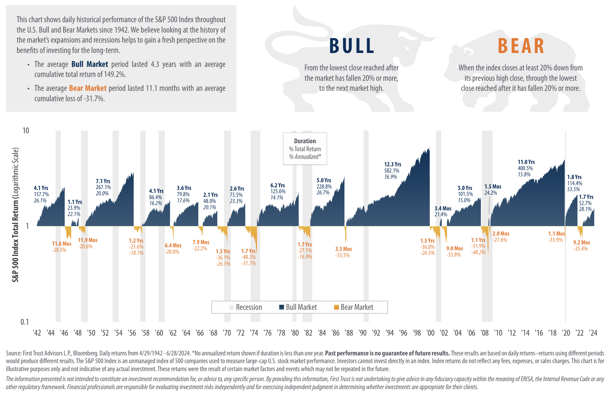
Bull Markets Tend to Last Longer than Bear Markets
Source: First Trust
© 2024 Corbett Road Wealth Management

Slide 32
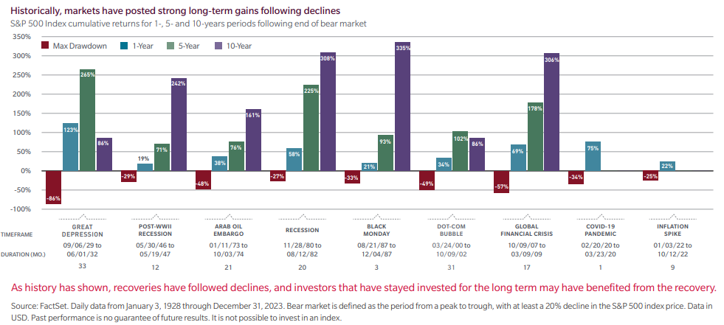
The Largest Drawdowns vs Forward Returns
Source: MFS Investment Management
© 2024 Corbett Road Wealth Management

Slide 33
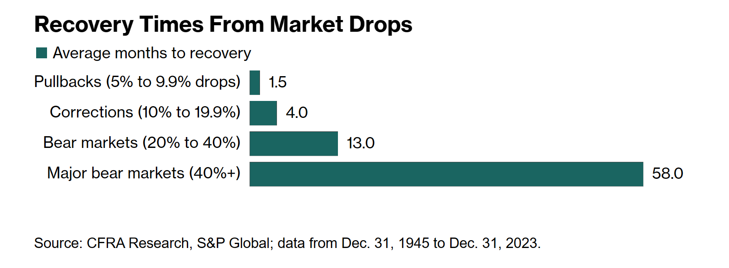
Most Market Pullbacks Resolve Within a Couple of Months
Source: Bloomberg
© 2024 Corbett Road Wealth Management

Slide 34
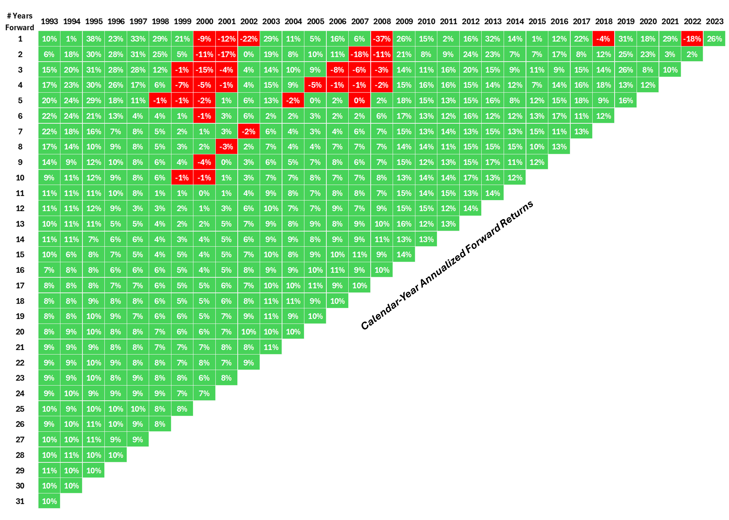
Time in the Market Matters:
Stocks Rarely Down When Held For 10+ Years
Source: A Wealth of Common Sense
© 2024 Corbett Road Wealth Management

Slide 35
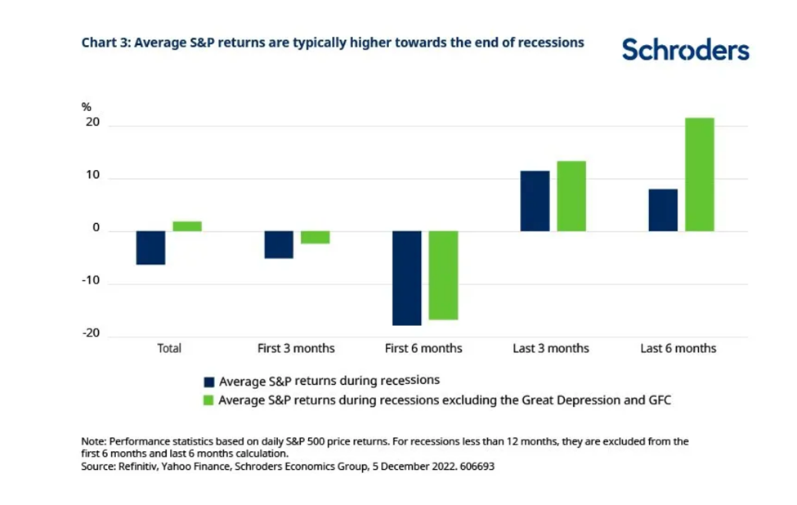
Market Returns During Recessions
Source: Schroders
© 2024 Corbett Road Wealth Management

Slide 36
Corbett Road Risk Models
© 2024 Corbett Road Wealth Management

Slide 37
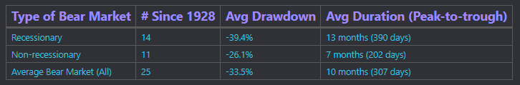
Recessionary vs
Non-Recessionary Bear Markets
Source: Corbett Road
© 2024 Corbett Road Wealth Management

Slide 38
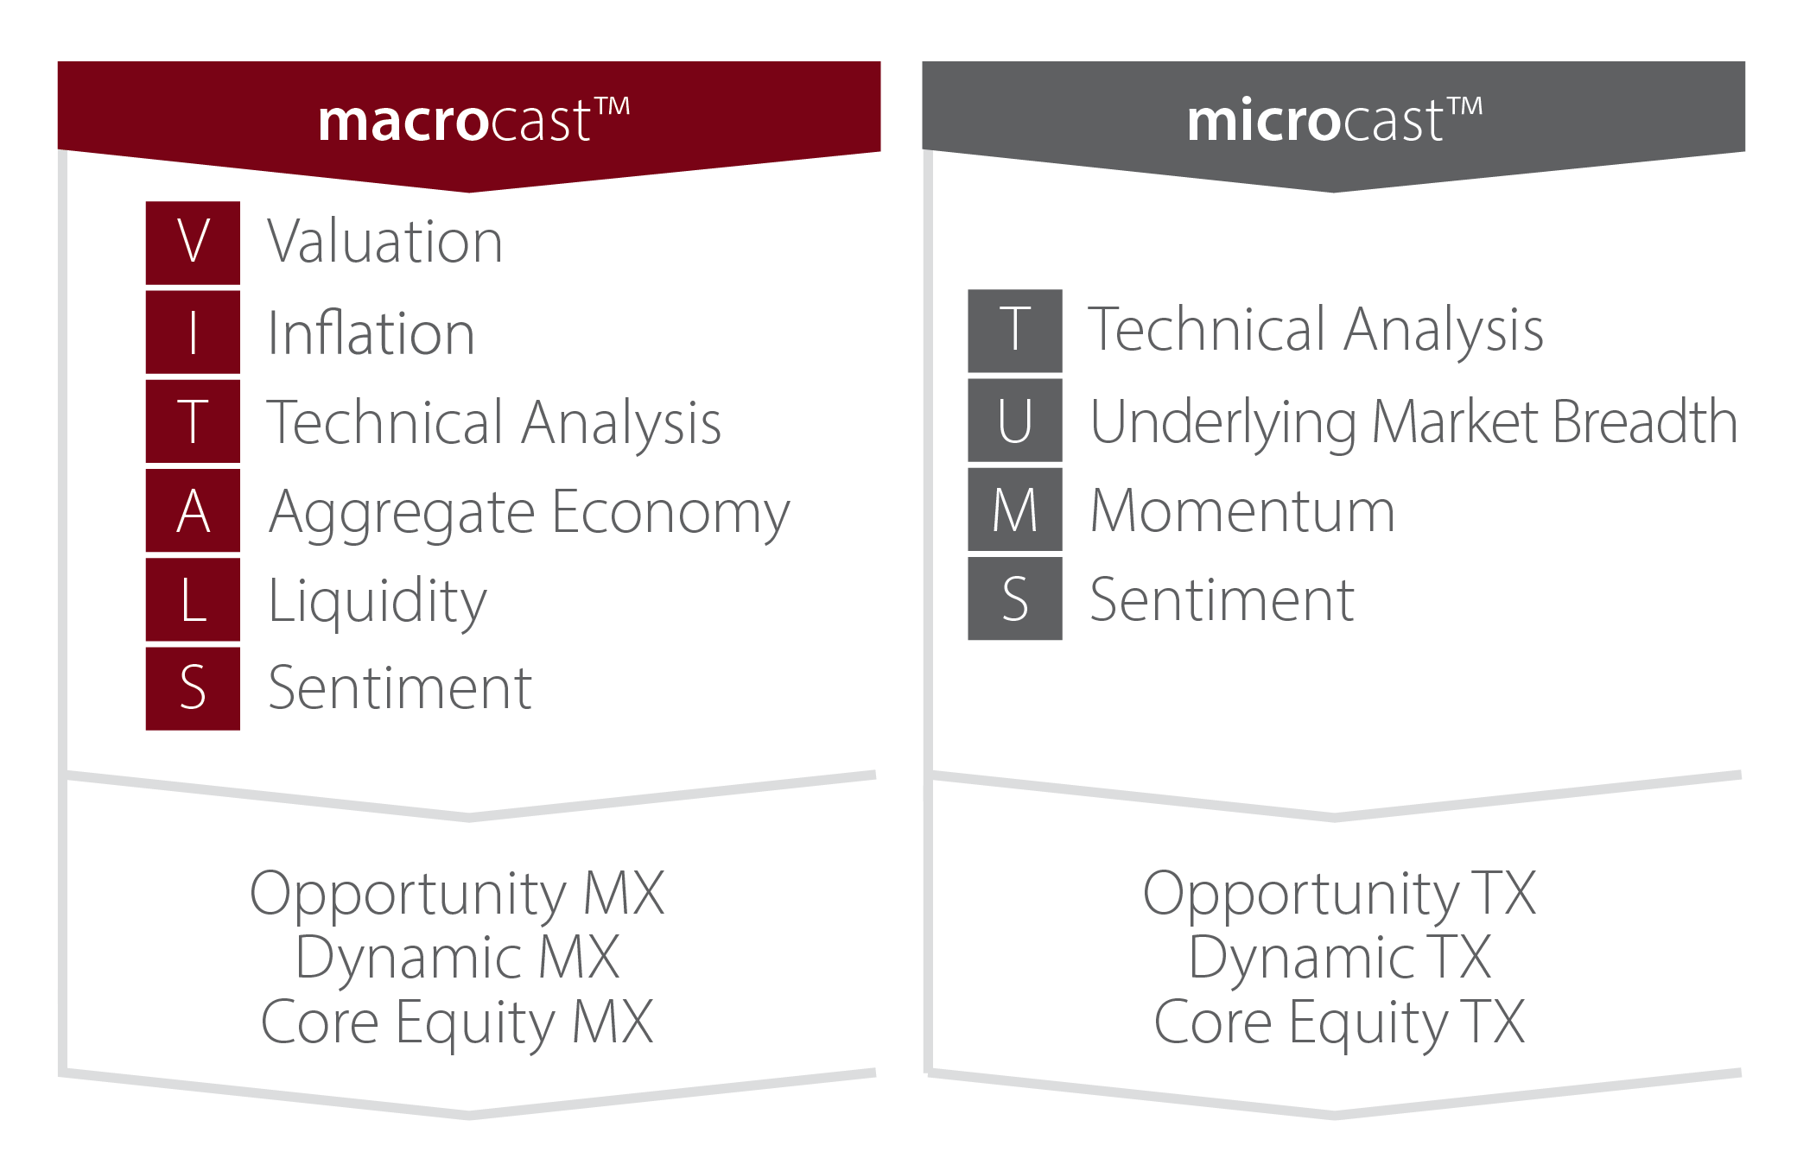
Corbett Road Tactical Solutions
Source: Corbett Road
© 2024 Corbett Road Wealth Management

Slide 39
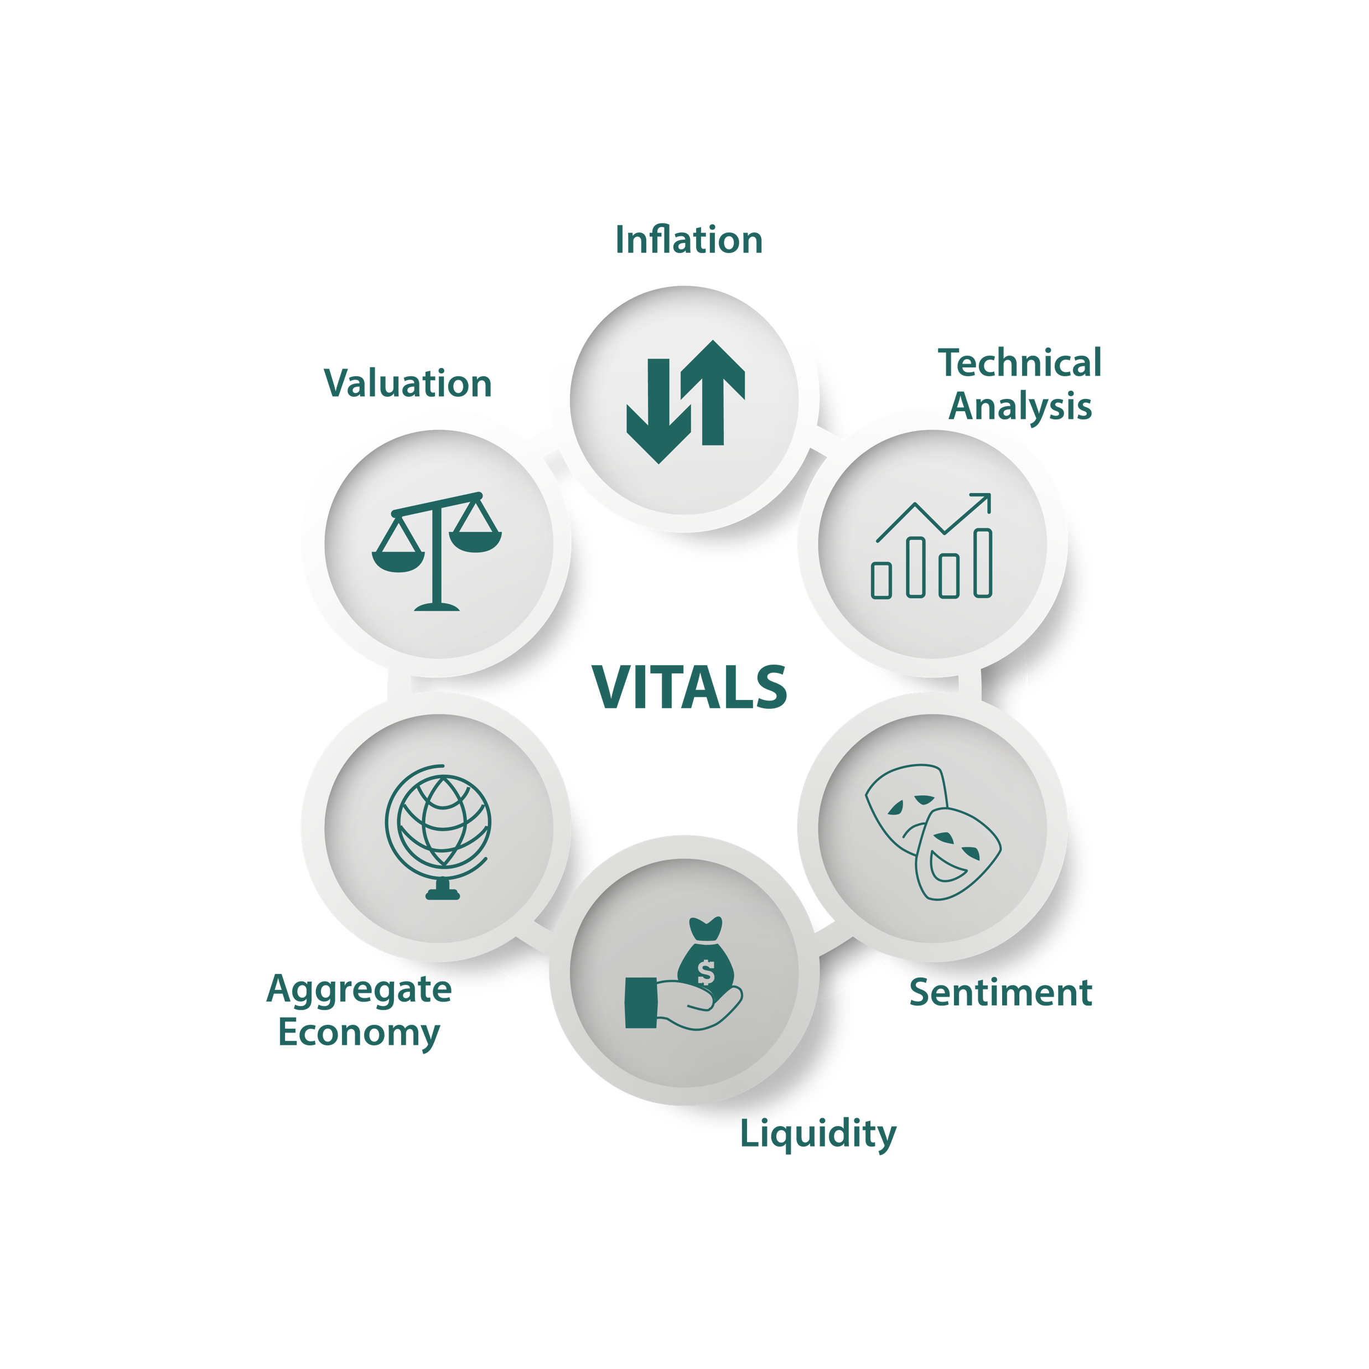
What is macrocastTM?
Corbett Road Corbett Road examines data across six categories (the “VITALS” that we believe impact market conditions. Within the VITALS, we examine more than 20 specific indicators that drive the macrocast™ Score.
These indicators are then assessed and classified as signaling a positive (+1), neutral (0), or negative (-1) trend. The final macrocast™ Score is the result of the summation of the classified indicators.
Source: Piper Sandler, Corbett Road
© 2024 Corbett Road Wealth Management

Slide 40






What is macrocastTM?
VALUATION
AGGREGATE ECONOMY
Cyclically Adjusted P/E Ratio
Corporate Profit Margins
Market Cap to GDP
Real Retail Sales
New Housing Starts
Initial Jobless Claims
INFLATION
LIQUIDITY
Consumer Price Inflation (CPI)
Industrial Metal Prices
Crude Oil
Yield Curve
Corporate Bond Spreads
Swap Spreads
TECHNICALS
SENTIMENT
Index Price Relative to LT Moving Average
% of Stocks Above 50 Day Moving Average (DMA)
Cyclical vs Counter Cyclical Performance
University of Michigan Consumer Sentiment Index
Investment Fund Flows
Investor Sentiment Surveys
© 2024 Corbett Road Wealth Management

Slide 41
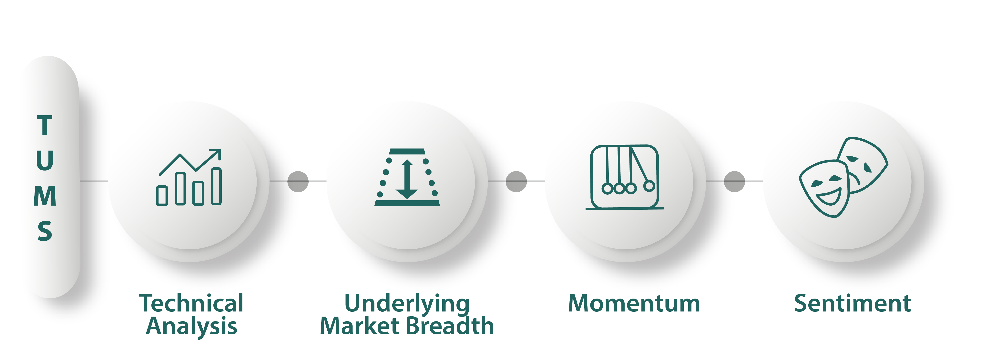
What is microcastTM?
Corbett Road examines data across four specific categories (“TUMS”) that we believe impact near to intermediate-term market conditions. microcast™ assesses more than ten specific indicators within these four categories.
Each of the indicators are designed to give positive or negative signals that, in aggregate, generate the microcast™ optimal risk allocation. This determines the allocation split between equity and defensive assets within the strategy.
Source: Piper Sandler, Corbett Road
© 2024 Corbett Road Wealth Management

Slide 42




microcastTM?
TREND
Price vs 200-dma
Price vs 50-dma
Price vs 21-dma
UNDERLYING BREADTH
% of stocks above 50-dma
Accumulation-Distribution Line
Hi/Lo Ratio
MOMENTUM
Stochastics
Relative Strength Index (RSI)
Moving Average Convergence/Divergence (MACD)
SENTIMENT
VIX Index
Equity Put/Call Ratio
Bull/Bear Ratio
© 2024 Corbett Road Wealth Management

Slide 43
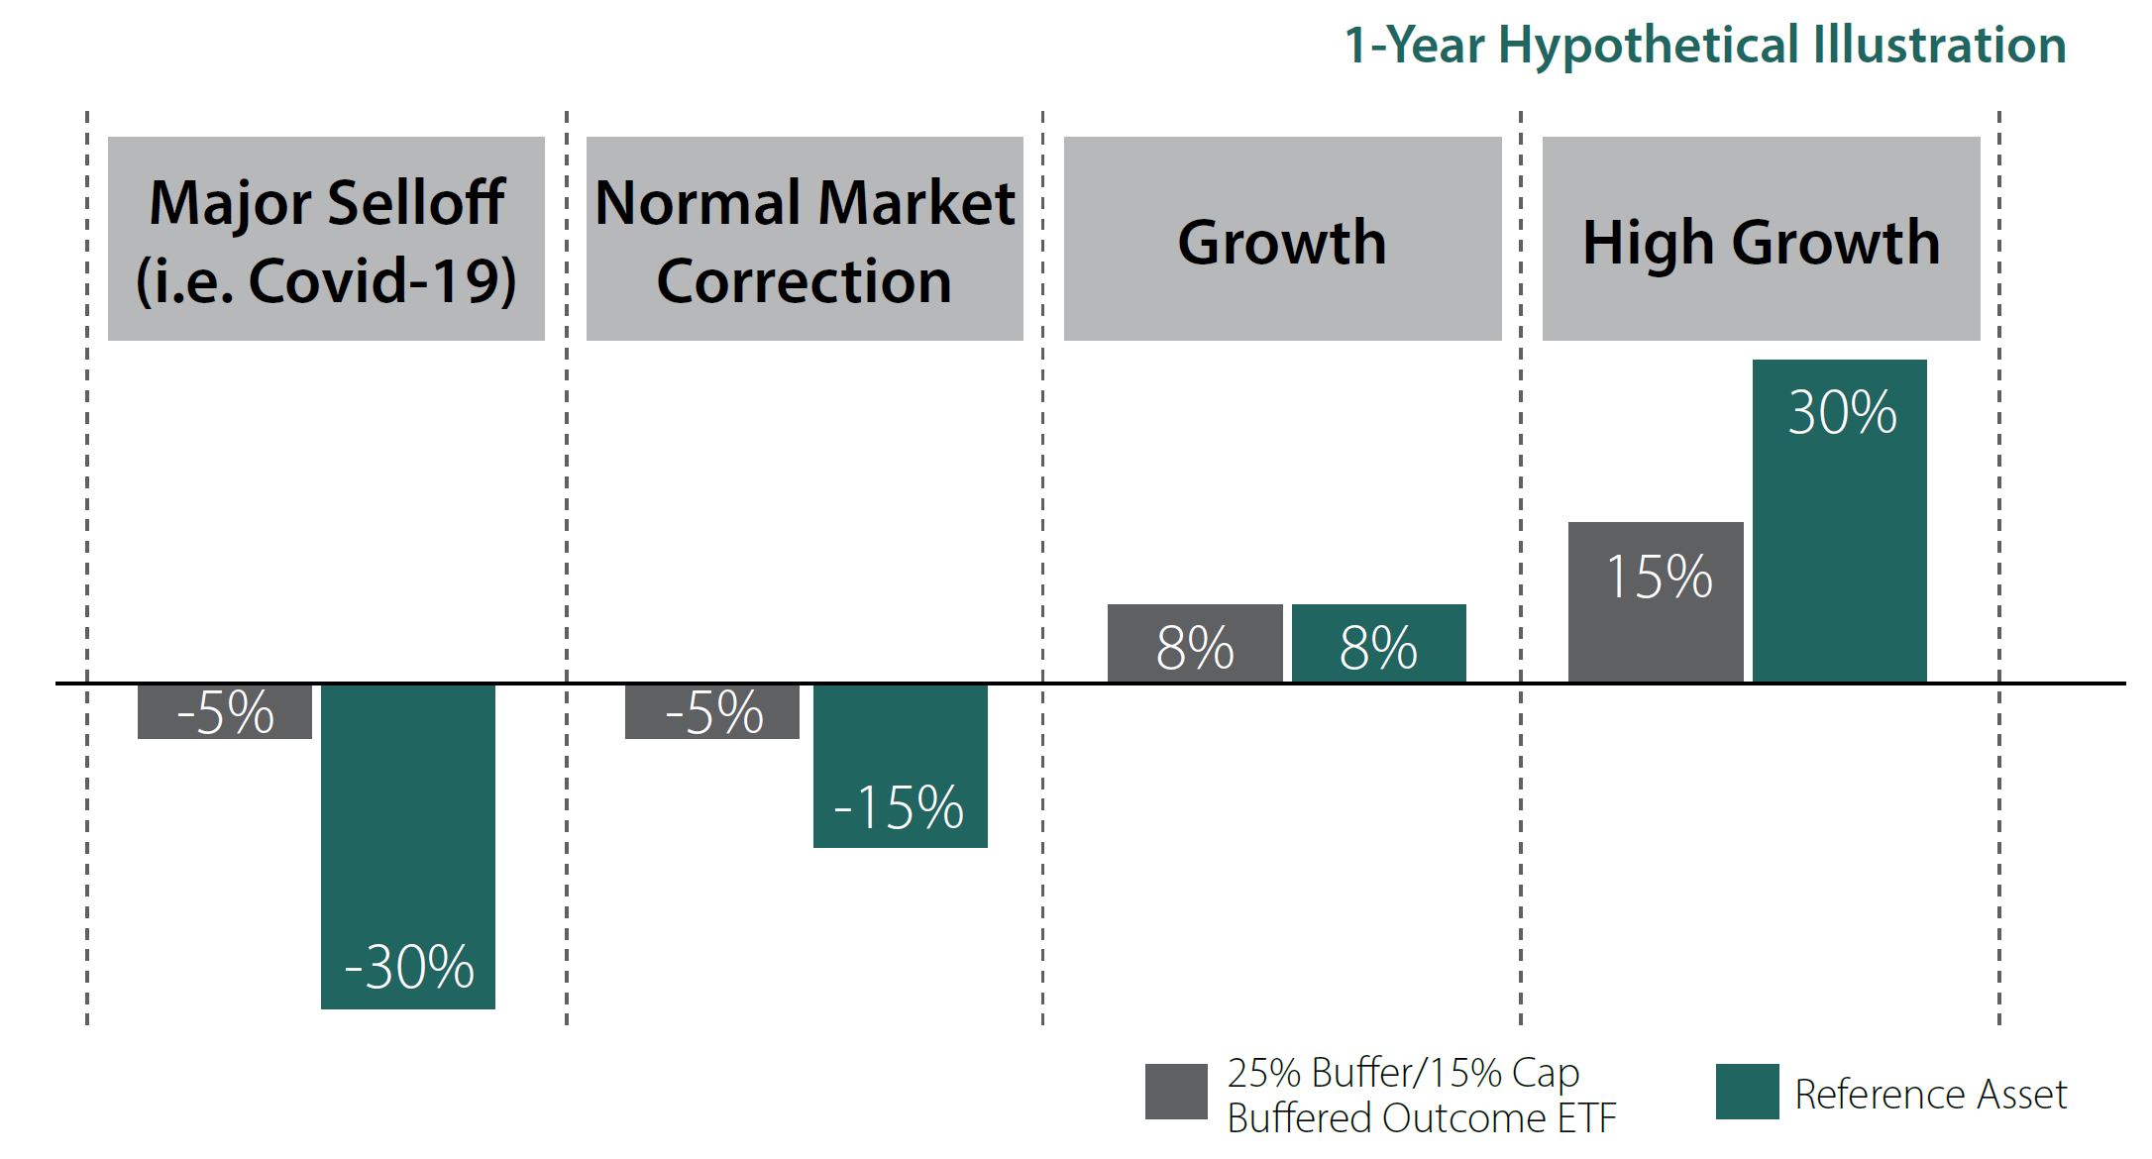
Corbett Road
Buffered Outcome Solutions
Source: Corbett Road
© 2024 Corbett Road Wealth Management

Slide 44
Asset Allocation
© 2024 Corbett Road Wealth Management

Slide 45
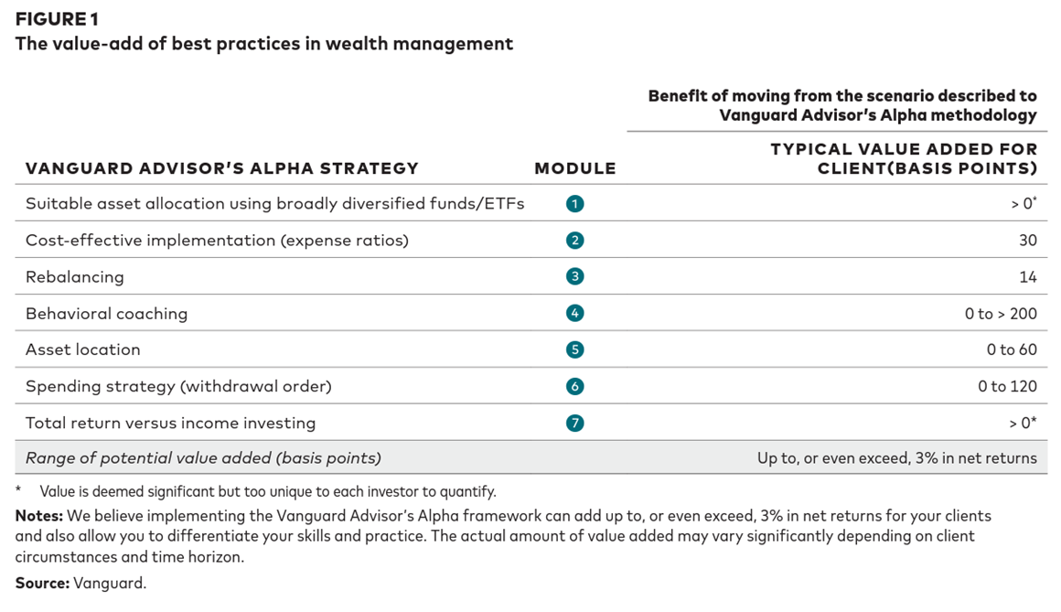
Vanguard Advisor's Alpha
Source: Vanguard
© 2024 Corbett Road Wealth Management

Slide 46
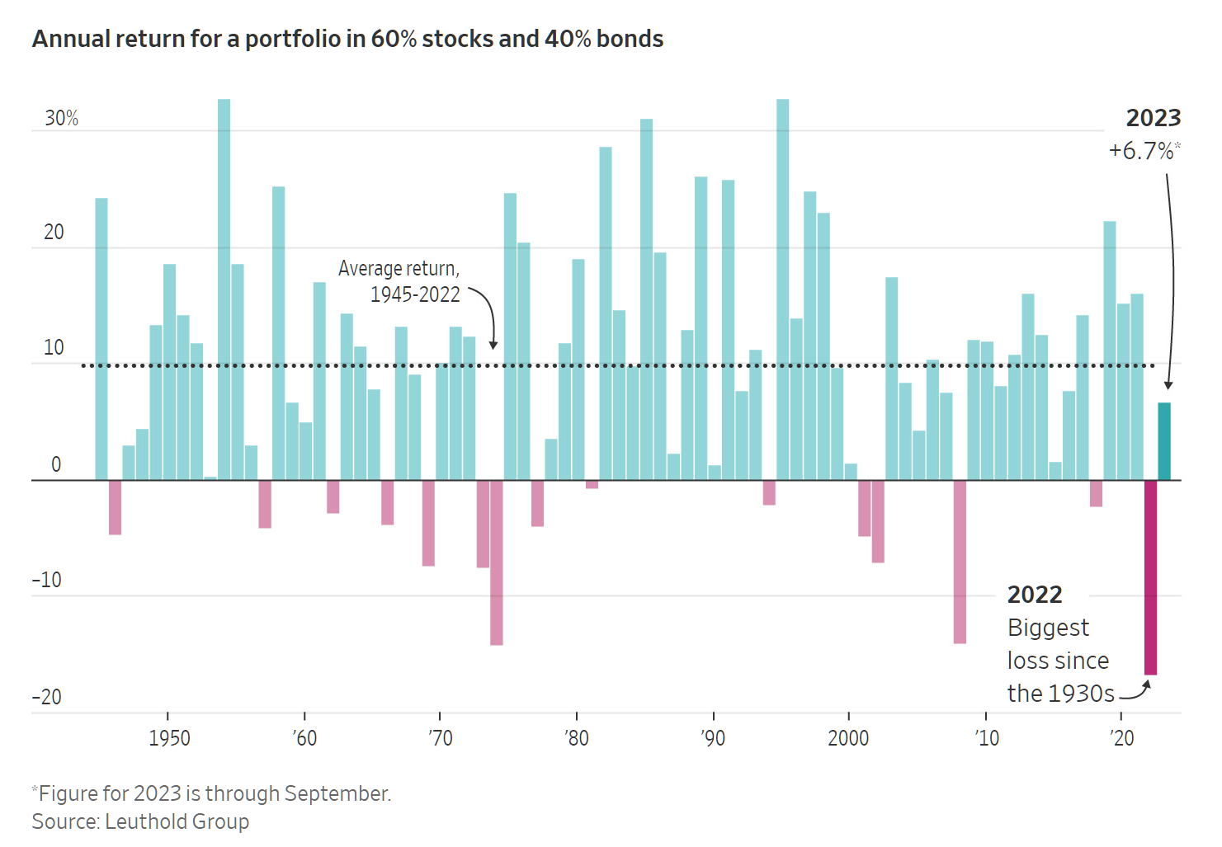
2022 Was Truly an Outlier For the 60/40 Portfolio
Source: WSJ, Leuthold Group
© 2024 Corbett Road Wealth Management

Slide 47
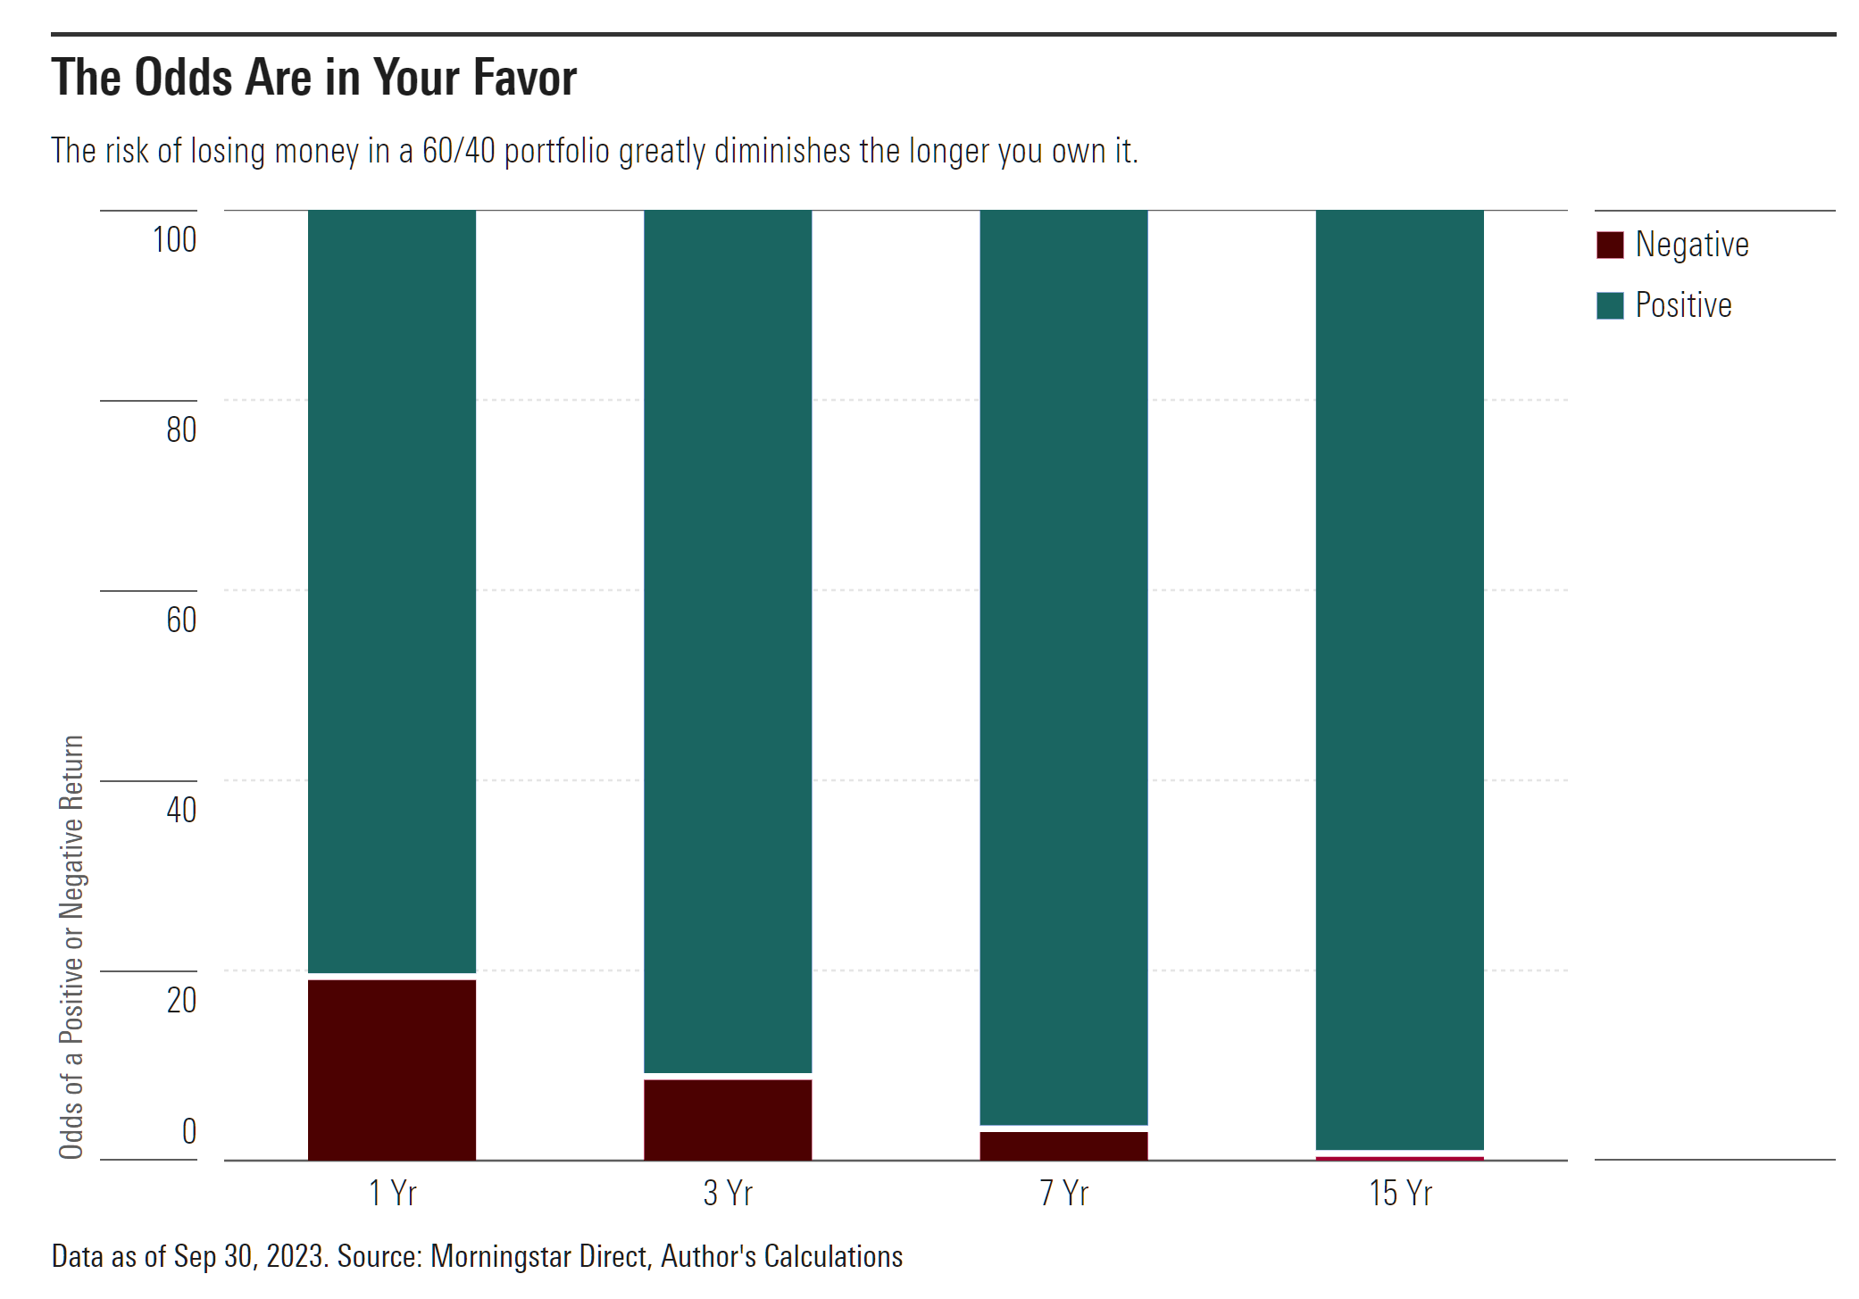
A 60/40 Portfolio Tends to Generate Positive Returns Over the Long Term
Source: Morningstar
© 2024 Corbett Road Wealth Management

Slide 48
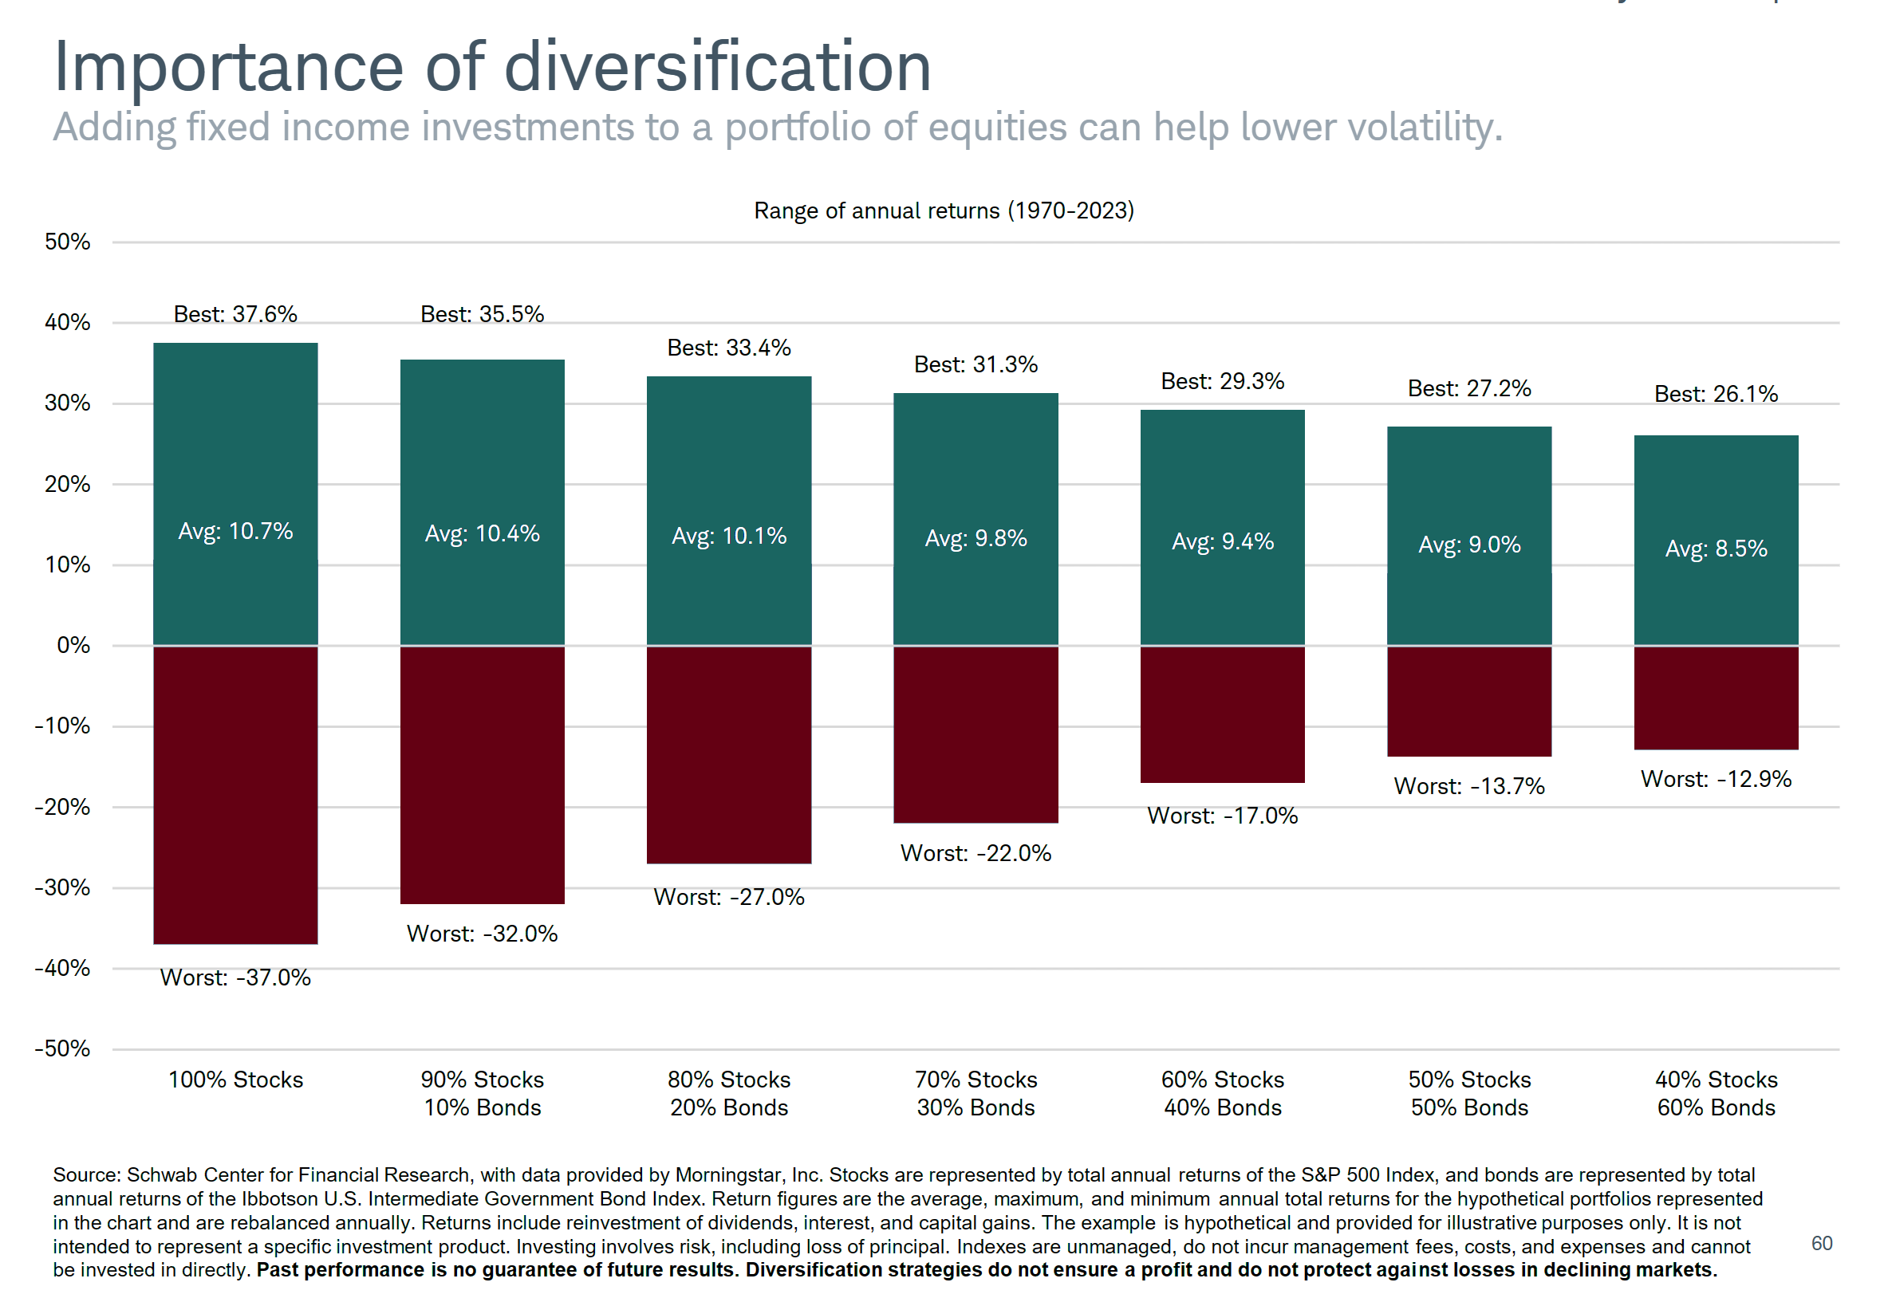
Bonds Can Help Reduce Portfolio Volatility
Source: Charles Schwab
© 2024 Corbett Road Wealth Management

Slide 49
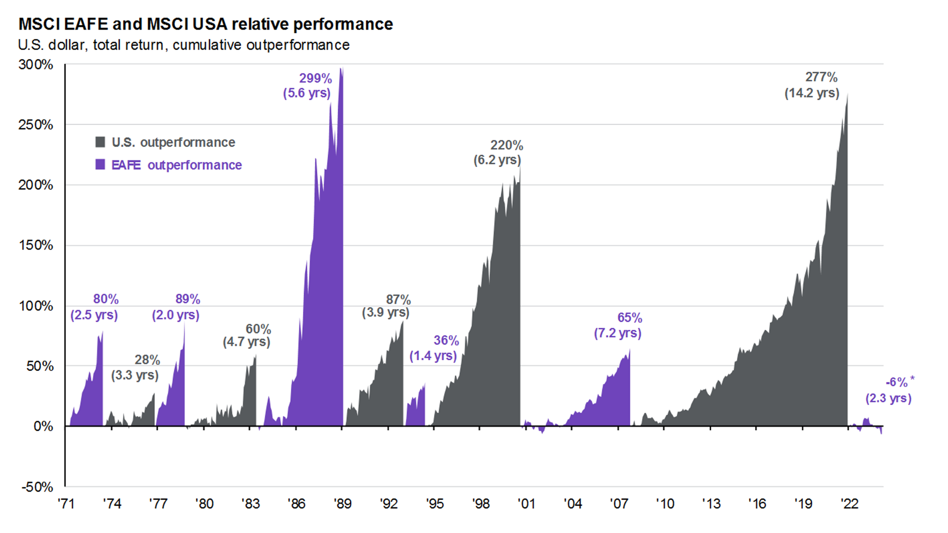
Domestic vs International
Source: JPM
© 2024 Corbett Road Wealth Management

Slide 50
History of the U.S Dollar
USD Strengthens =
Bad for Intl. Equities
USD Weakens =
Good for Intl. Equities
Disclosures: Monthly datapoints from the Federal Reserve. The U.S. Dollar Index is an index of the value of the United States dollar relative to a basket of foreign currencies, often referred to as a basket of U.S. trade partners' currencies, including the Euro, Japanese Yen, British Pound, Canadian Dollar, Swedish Krona, and Swiss Franc.
Source: MarketDesk
© 2024 Corbett Road Wealth Management

Slide 51
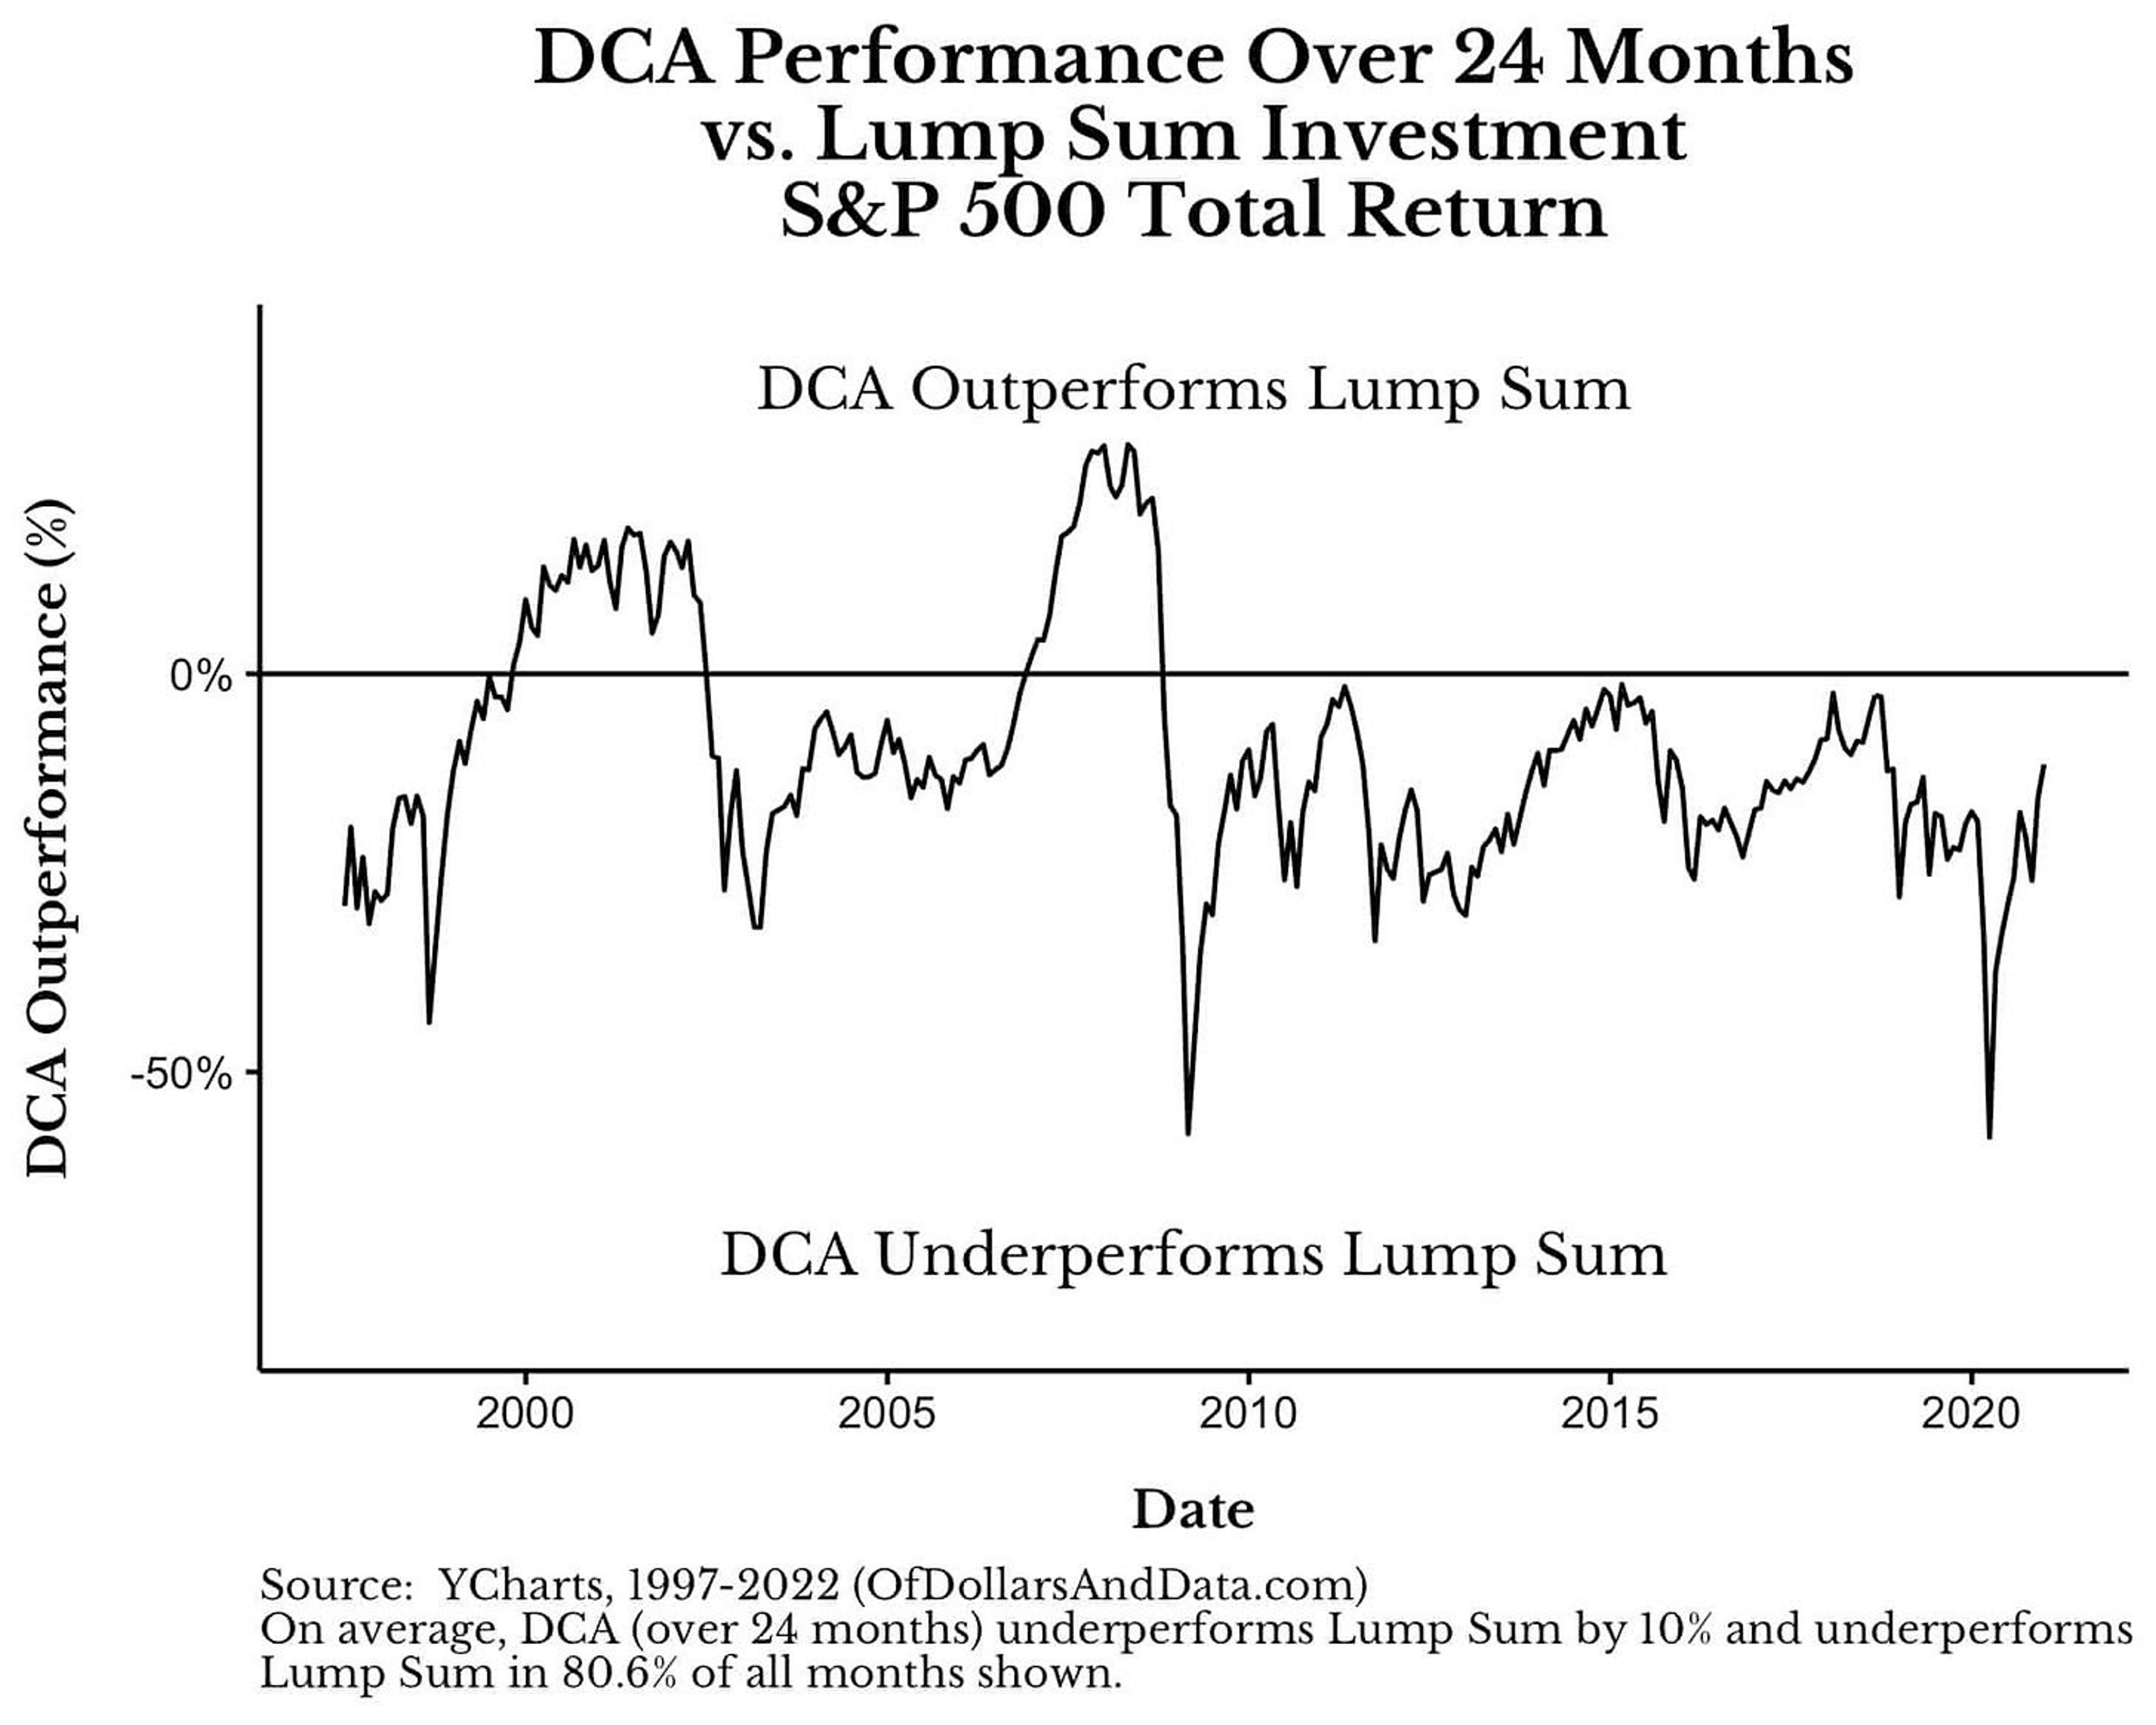
Dollar Cost Averaging vs Lump Sum
Source: OfDollarsAndData.com
© 2024 Corbett Road Wealth Management

Slide 52
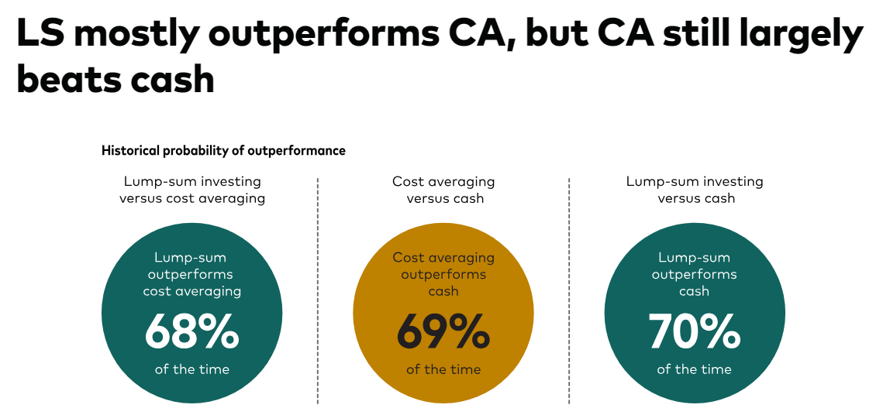
Dollar Cost Averaging vs Lump Sum
Source: Vanguard
© 2024 Corbett Road Wealth Management

Slide 53
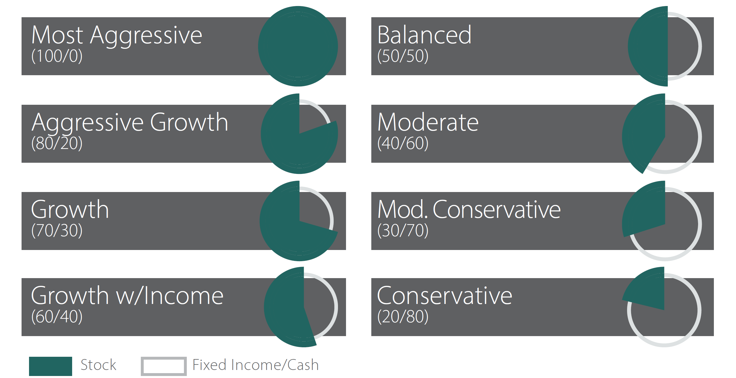
Corbett Road Asset Allocation
mypath Asset Allocation Portfolios™ (MAAP) offer a simple way to build a broadly diversified core portfolio. Available in allocation mixes spanning the target risk spectrum, our passive strategies establish a client’s long-term base portfolio using low-cost, passive exchange traded funds (ETF) products.
While strategic adjustments are made on a year-to-year, these portfolios are designed to remain invested throughout the economic cycle and market fluctuations. Providing broad exposure to global equity, fixed income, and real estate markets, our passive solutions can be used as a standalone solution or in conjunction with our other strategies.
Source: Piper Sandler, Corbett Road
© 2024 Corbett Road Wealth Management

Slide 54
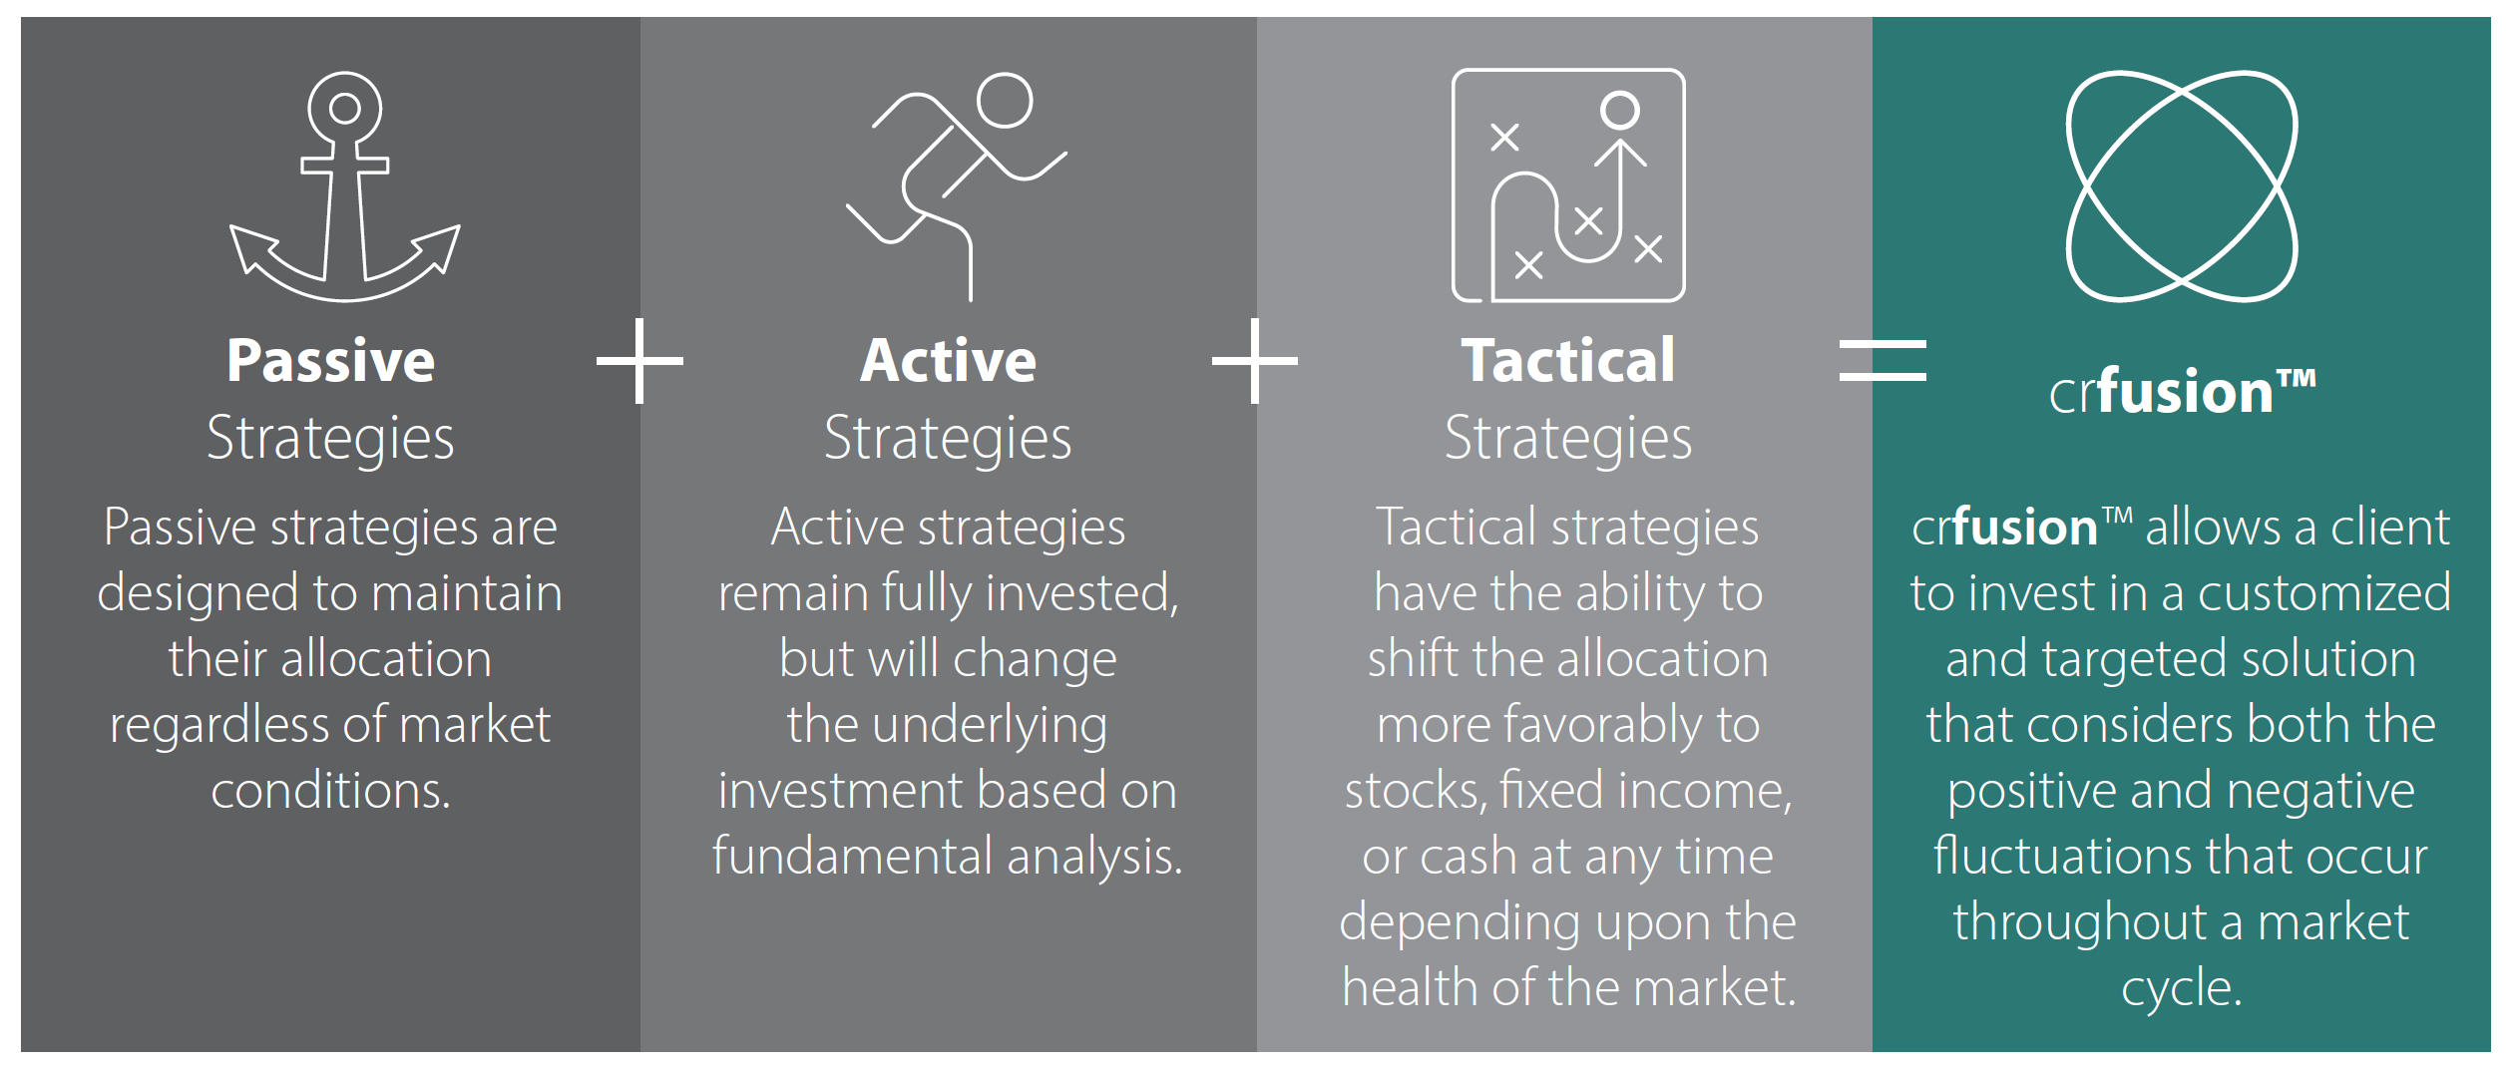
crfusionTM
Source: Piper Sandler, Corbett Road
© 2024 Corbett Road Wealth Management

Slide 55
Disclosures
The chart(s)/graph(s) shown is(are) for informational purposes only and should not be considered as an offer to buy, solicitation to sell, or recommendation to engage in any transaction or strategy. Past performance may not be indicative of future results. While the sources of information, including any forward-looking statements and estimates, included in this (these) chart(s)/graph(s) was deemed reliable, Corbett Road Wealth Management (CRWM), Spire Wealth Management LLC, Spire Securities LLC and its affiliates do not guarantee its accuracy.
The views and opinions expressed in this article are those of the authors as of the date of this publication, are subject to change without notice, and do not necessarily reflect the opinions of Spire Wealth Management LLC, Spire Securities LLC or its affiliates.
All information is based on sources deemed reliable, but no warranty or guarantee is made as to its accuracy or completeness. macrocast™ and microcast™ are proprietary indexes used by Corbett Road Wealth Management to help assist in the investment decision-making process. Neither the information provided by macrocast™ or microcast™ nor any opinion expressed herein considers any investor’s individual circumstances nor should it be treated as personalized advice. Individual investors should consult with a financial professional before engaging in any transaction or strategy. The phrase “the market” refers to the S&P 500 Total Return Index unless otherwise stated. The phrase “risk assets” refers to equities, REITs, high yield bonds, and other high volatility securities.
Corbett Road’s quantitative models utilize a variety of factors to analyze trends in economic conditions and the stock market to determine asset and sector allocations that help us gauge market movements in the short- and intermediate term. There is no guarantee that these models or any of the factors used by these models will result in favorable performance returns. Spire Wealth Management, LLC is a Federally Registered Investment Advisory Firm.
Securities offered through an affiliated company, Spire Securities, LLC, a Registered Broker/Dealer and member FINRA/SIPC. Registration does not imply any level of skill or training.

Slide 56
Thank You
© 2024 Corbett Road Wealth Management
CRWM_MttM_Q4_2024_Fid

