Slide 1


Q3 2025 MAP TO THE MARKETS
MAP TO THE MARKETS
Q3 2023
By:
Rush Zarrabian, CFA
Carmen Dello Iacono, CFA Harrison Burdge
For Investment Professional Use Only
For Internal Fidelity Use Only –
Not for Client Distribution

Slide 2


Timely Updates and Studies
© 2025 Corbett Road Wealth Management

Slide 3
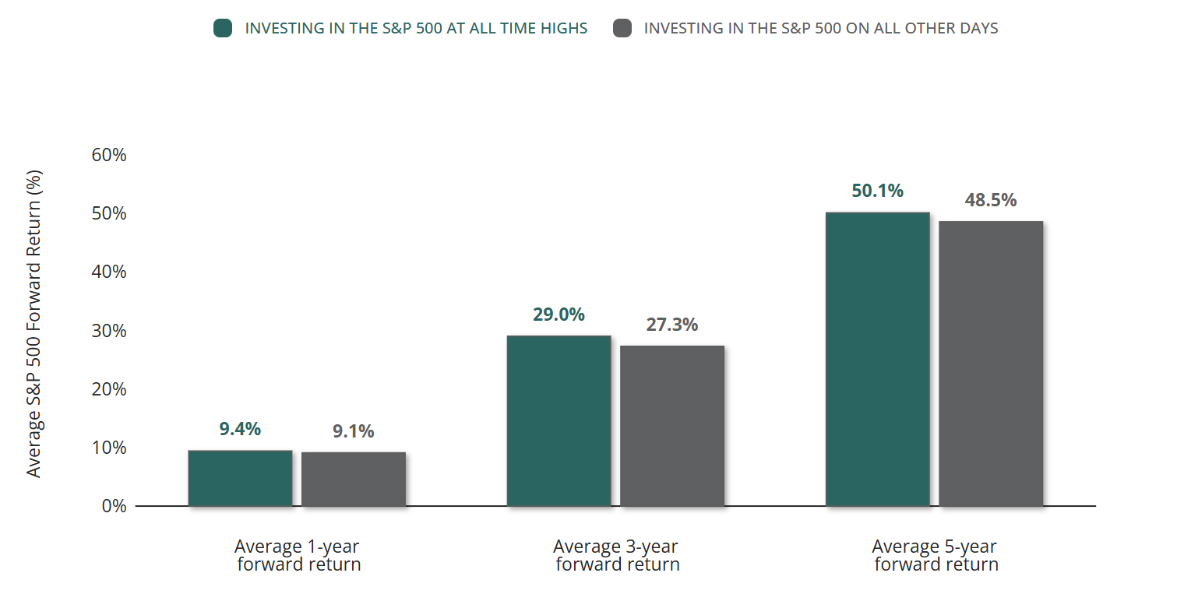
Stocks Do Quite Well After All Time Highs
Source: FactSet, S&P, Exhibit A, Data as of 7/16/25
© 2025 Corbett Road Wealth Management

Slide 4
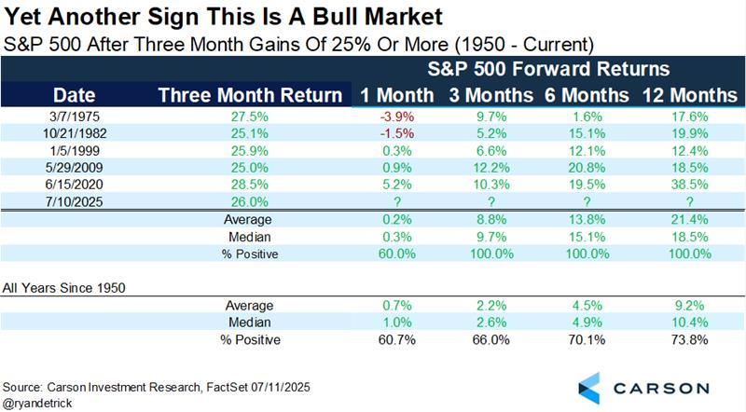
The Recent Rally is Rare and Historically Bullish
Source: Carson Group
© 2025 Corbett Road Wealth Management

Slide 5
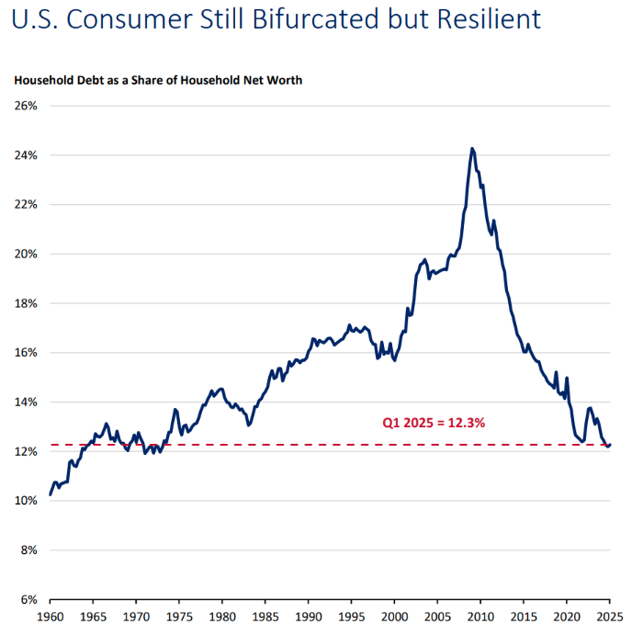
Consumer Balance Sheets Are in Good Shape
Source: Bank of America
© 2025 Corbett Road Wealth Management

Slide 6
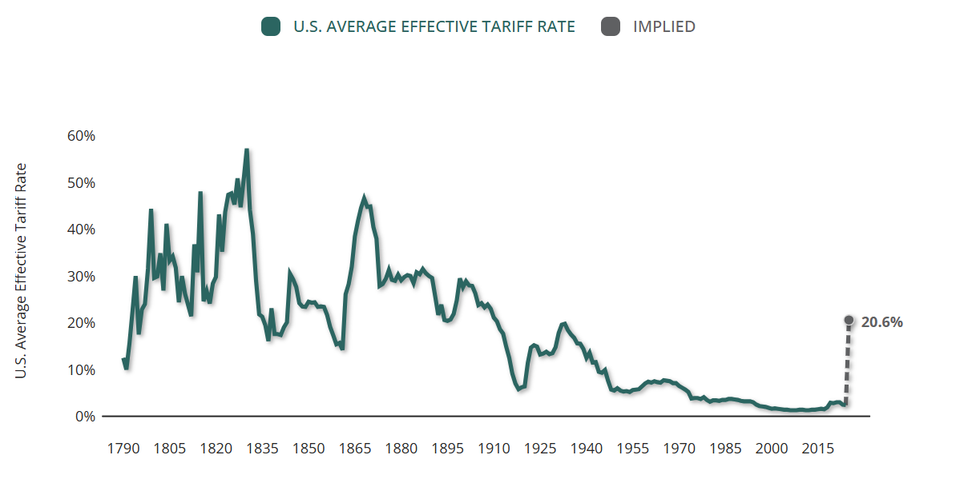
Implied Tariff Rate sitting at 100 Year Highs…
Source: FactSet, S&P, Exhibit A, Implied as of 7/14/25
© 2025 Corbett Road Wealth Management

Slide 7
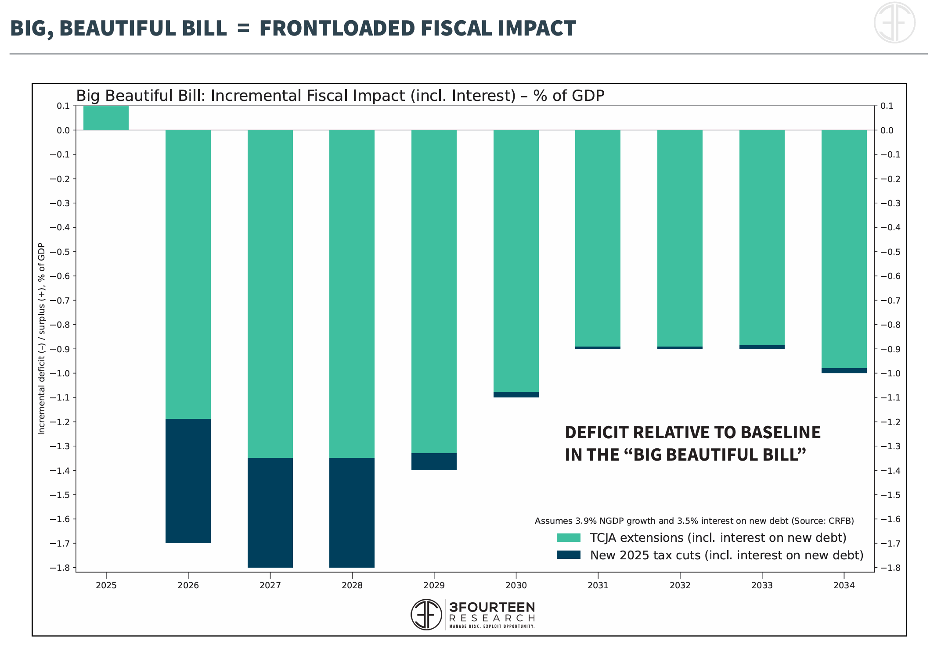
…But Deficits are Set tom Increase in the Coming Years, Helping Offset Some of the Tariff Impact
Source: 3Fourteen
© 2025 Corbett Road Wealth Management

Slide 8
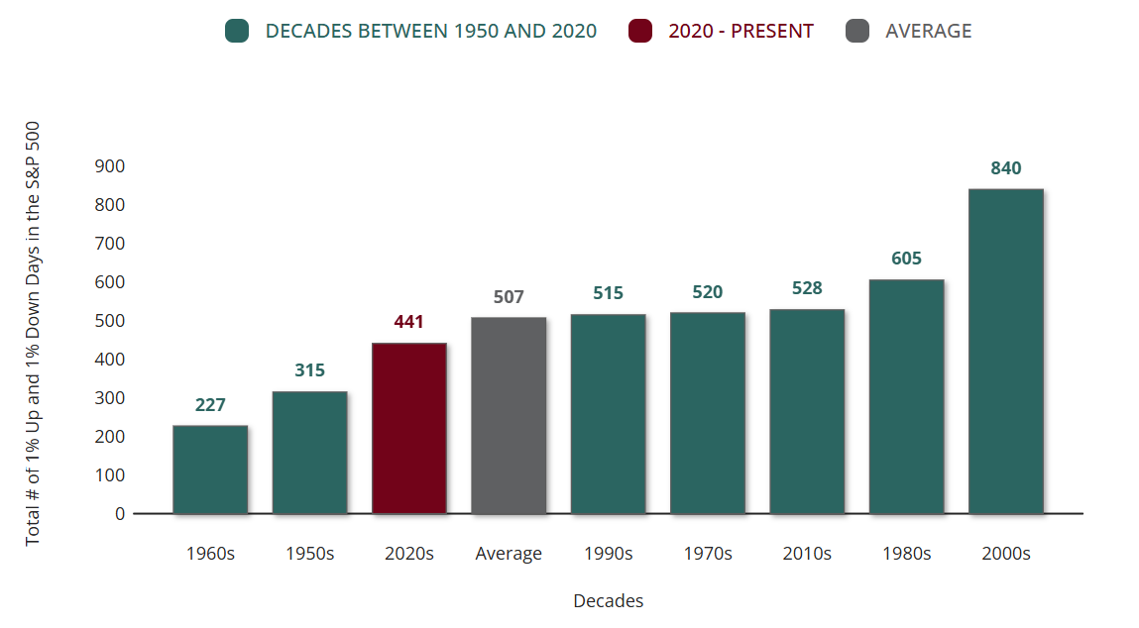
The 2020s are Shaping Up to Be on of the Most Volatile Decades Ever
Source: FactSet, S&P, Exhibit A, Data as of 7/16/25
© 2025 Corbett Road Wealth Management

Slide 9
Market Performance & Asset Class Returns
© 2025 Corbett Road Wealth Management

Slide 10
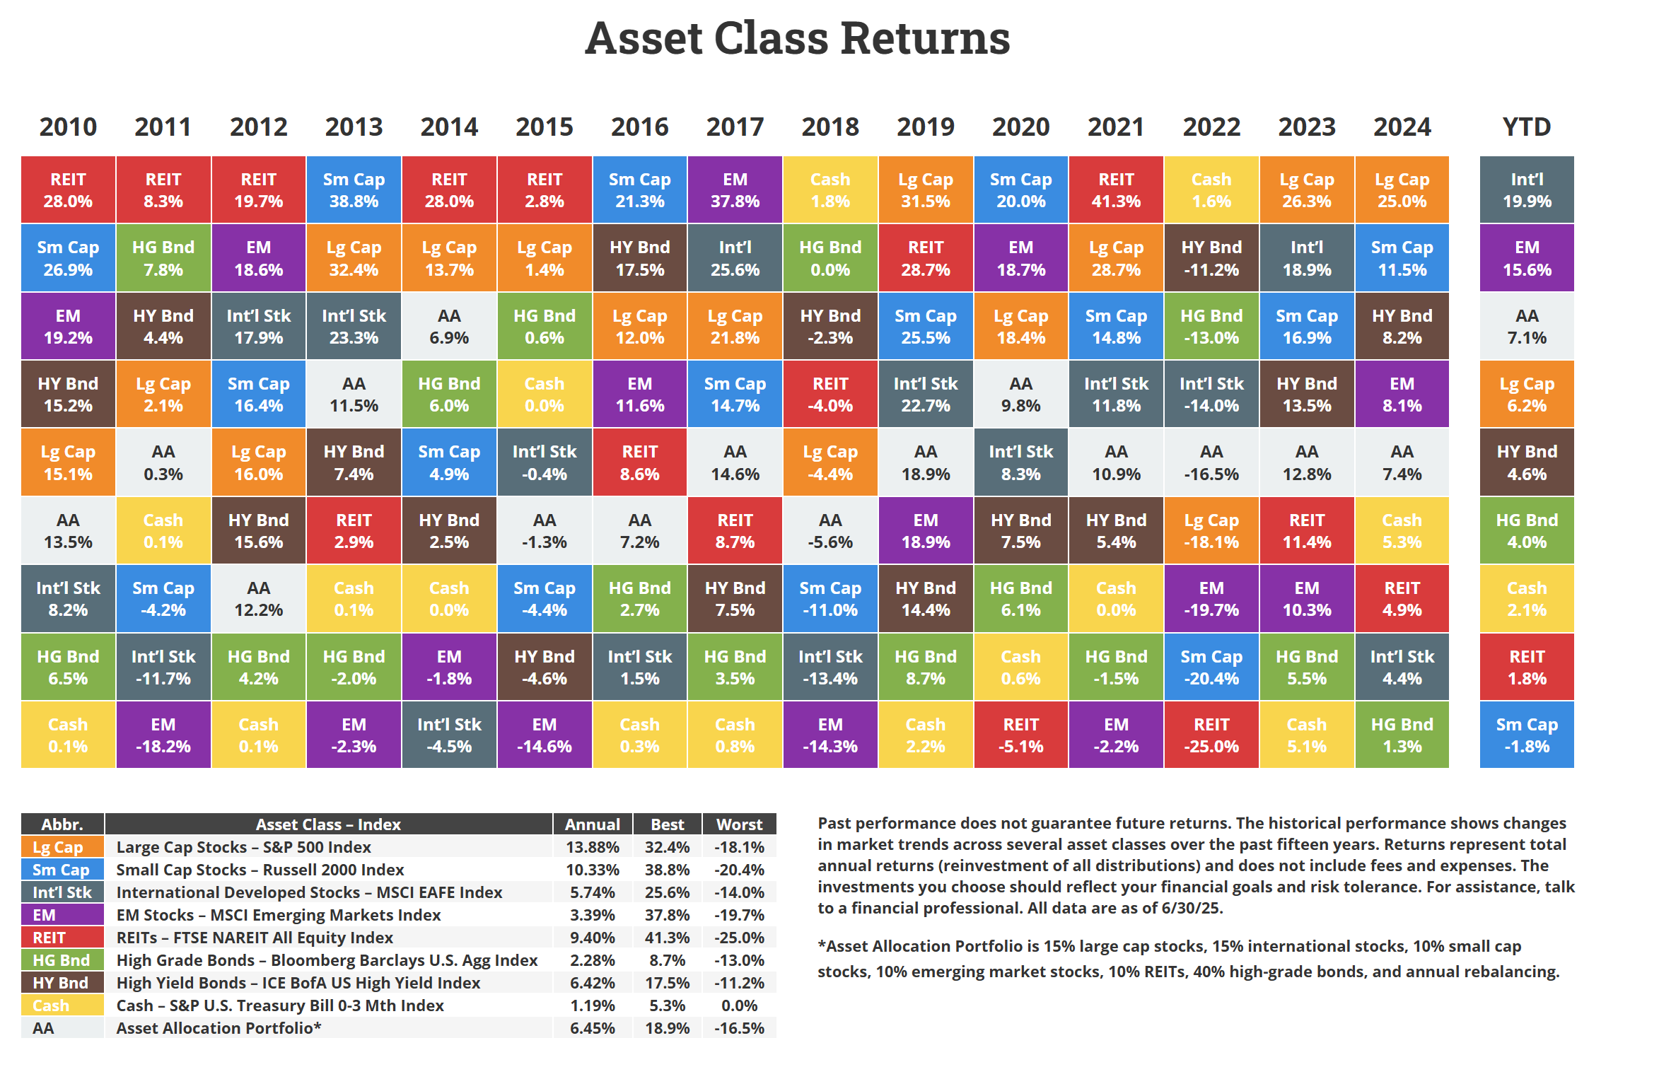
Historical Asset Class Returns
Source: Novel Investor, data as of 6/30/2025
© 2025 Corbett Road Wealth Management

Slide 11
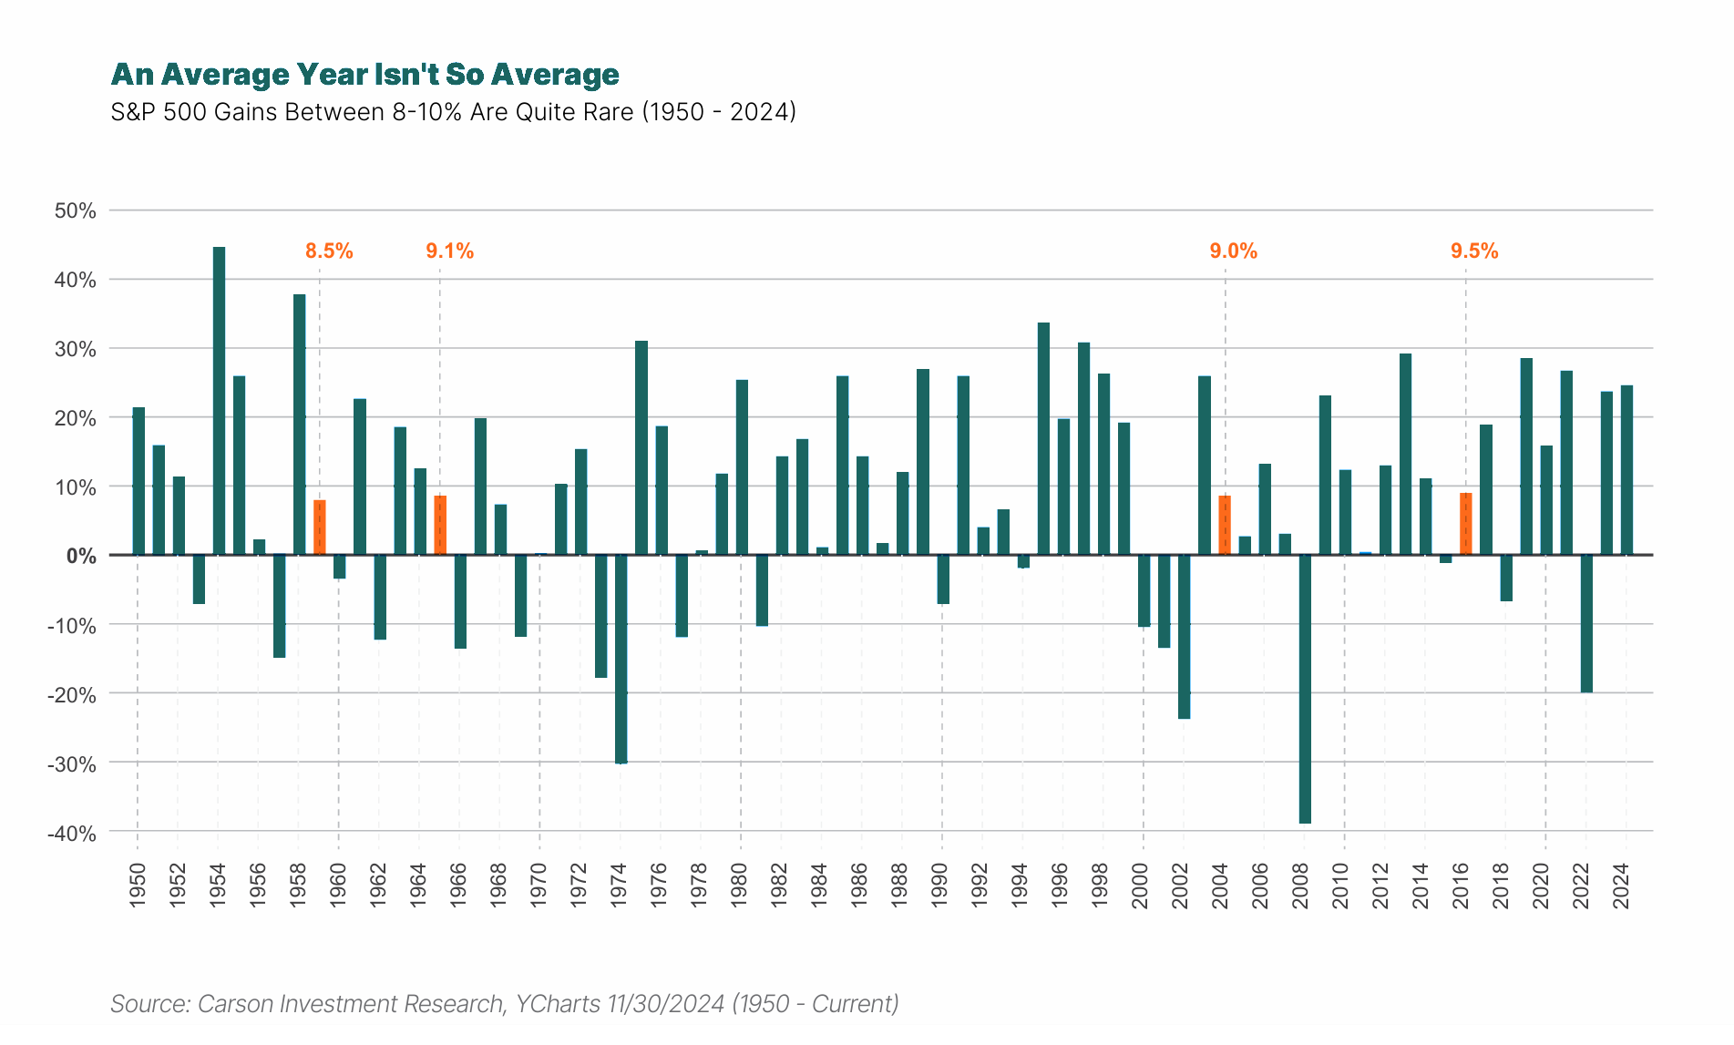
The Market Rarely Sees Average Returns in a Calendar Year
Source: Carson Group
© 2025 Corbett Road Wealth Management

Slide 12
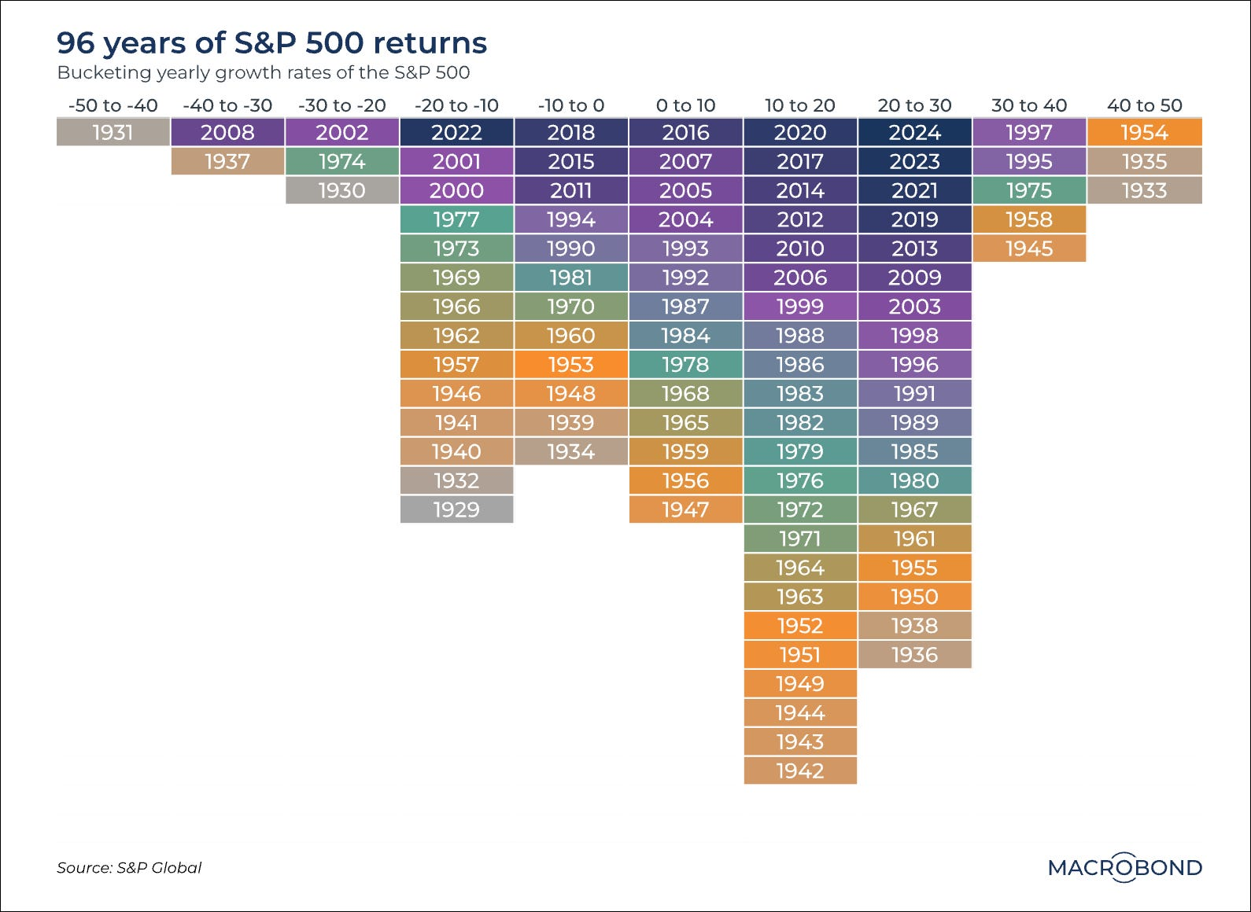
Distribution of S&P 500 Returns
Source: Macrobond
© 2025 Corbett Road Wealth Management

Slide 13
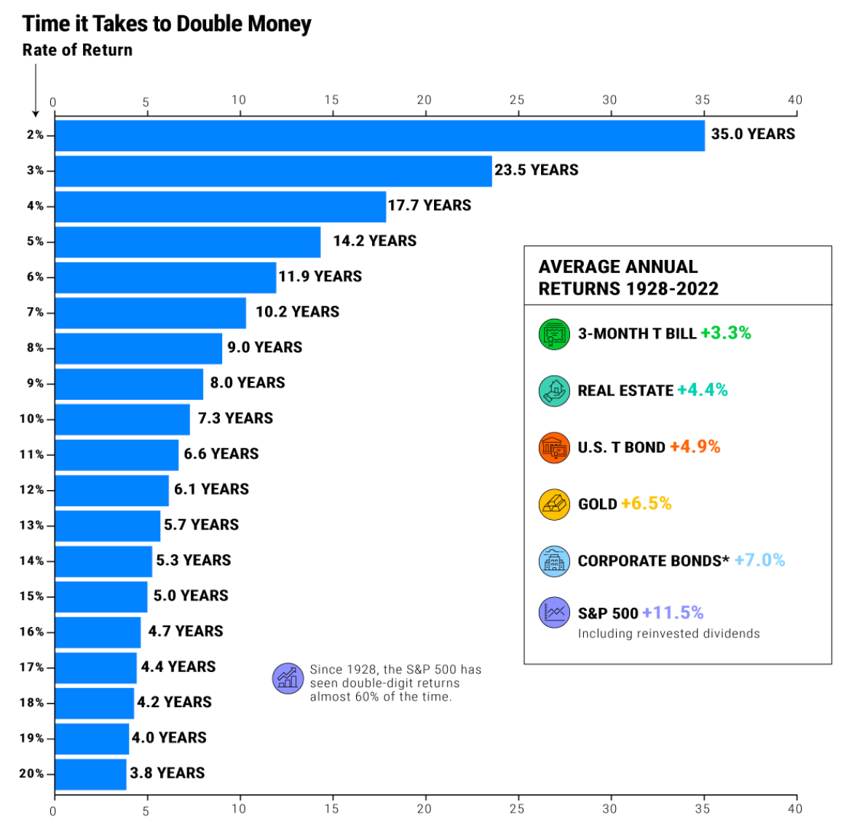
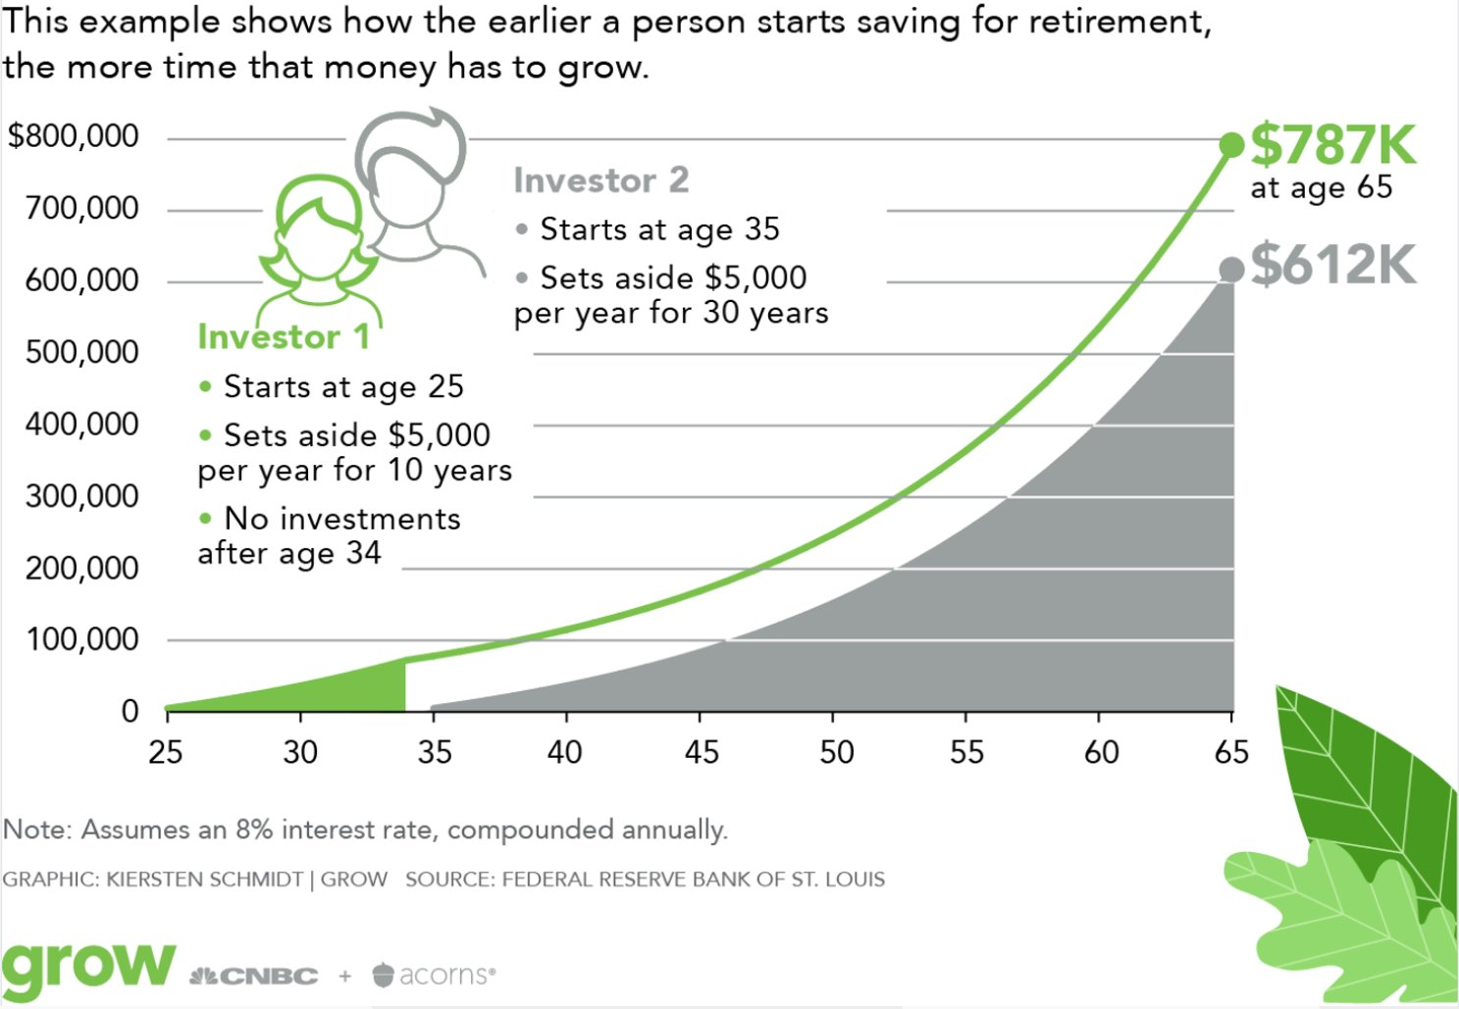
Power of Compounding
Source: Visual Capitalist (Left), Kiersten Schmidt (Grow) & Federal Reserve
© 2025 Corbett Road Wealth Management

Slide 14
Drawdowns
© 2025 Corbett Road Wealth Management

Slide 15
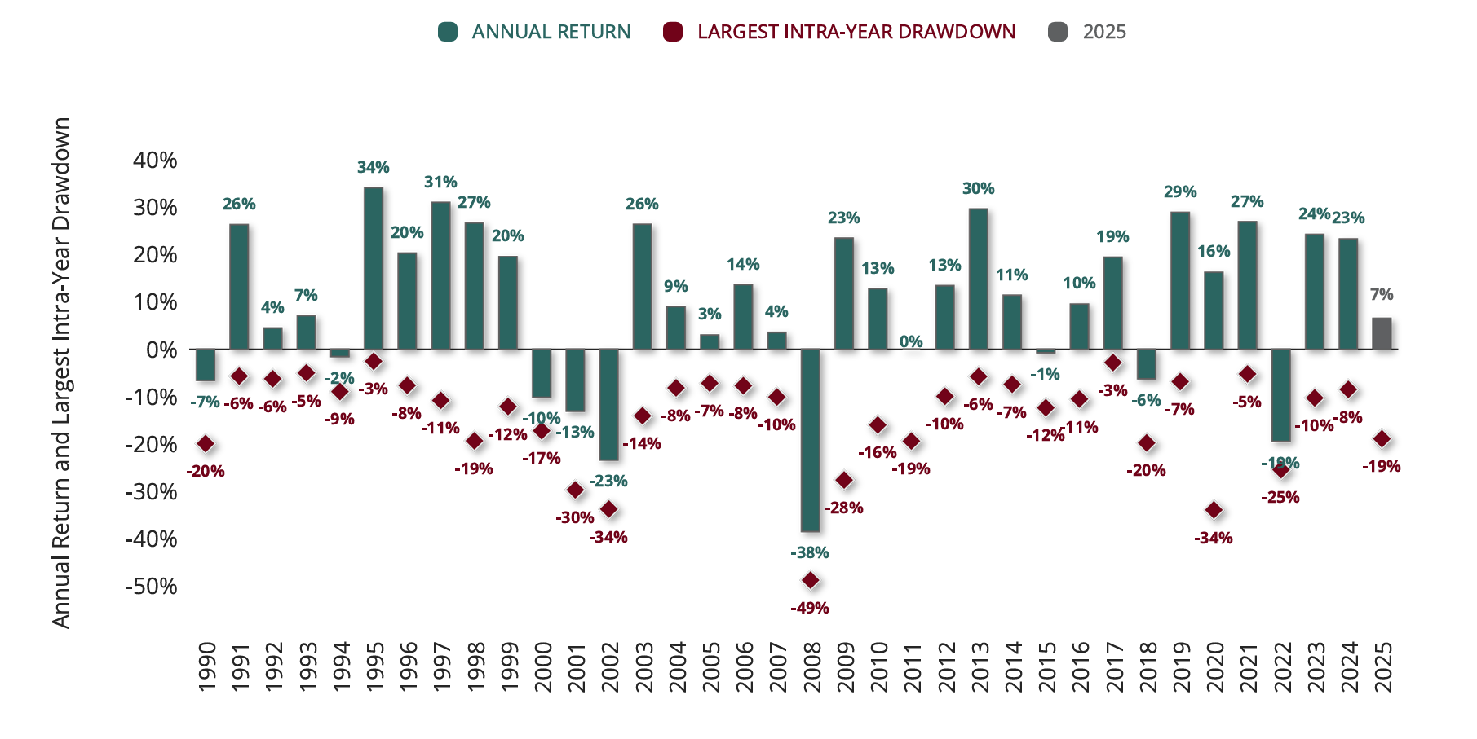
Market Corrections Happen Every Year
The average drop is 14%, but the market has been positive 75% of all calendar years since 1990.
Source: Factset, S&P, Exhibit A. 2025 data through 7/16/2025
© 2025 Corbett Road Wealth Management

Slide 16
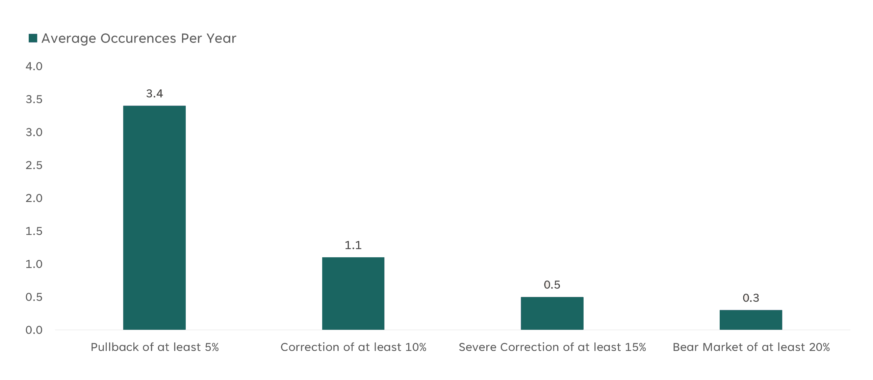
Market Corrections Happen Every Year
Pullbacks of 5% or more are frequent, and a 10% decline has historically occurred once a year.
Source: LPL
© 2025 Corbett Road Wealth Management

Slide 17
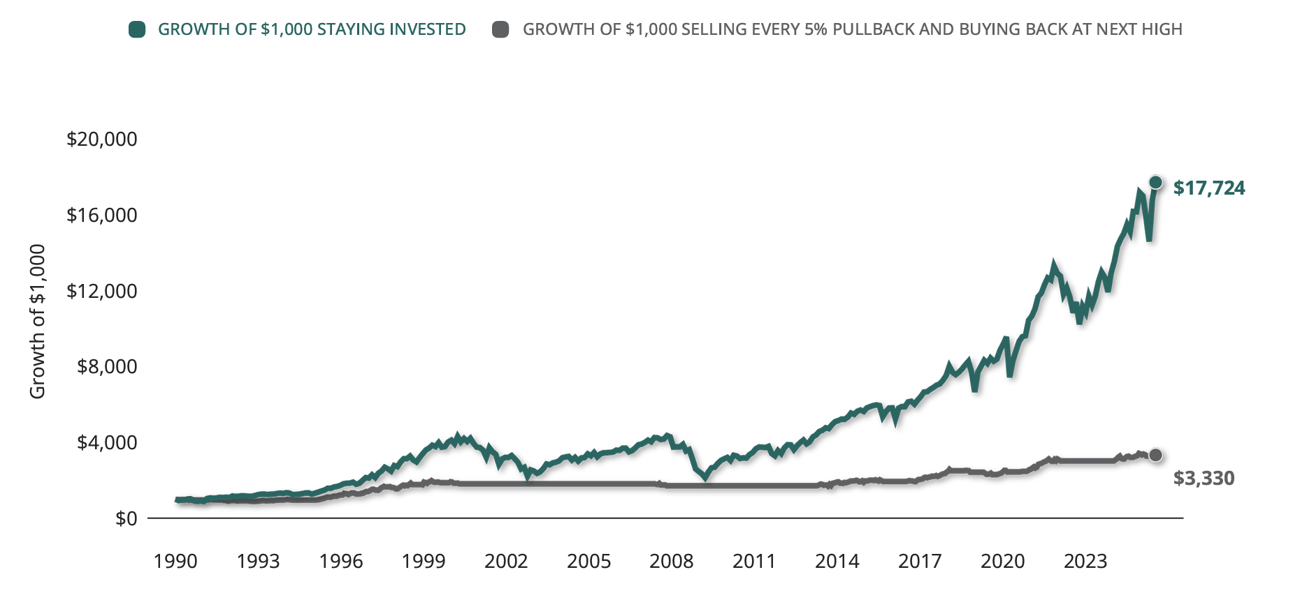
Selling Every 5% Pullback Has Not Been Rewarding
Source: Factset, S&P, Exhibit A. 2025 data through 7/17/2025
© 2025 Corbett Road Wealth Management

Slide 18
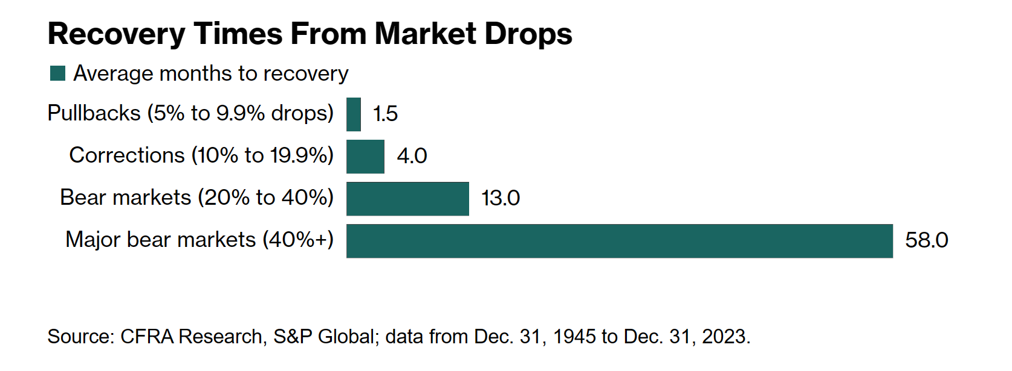
Most Market Pullbacks Resolve Within a Couple of Months
Source: Bloomberg
© 2025 Corbett Road Wealth Management

Slide 19
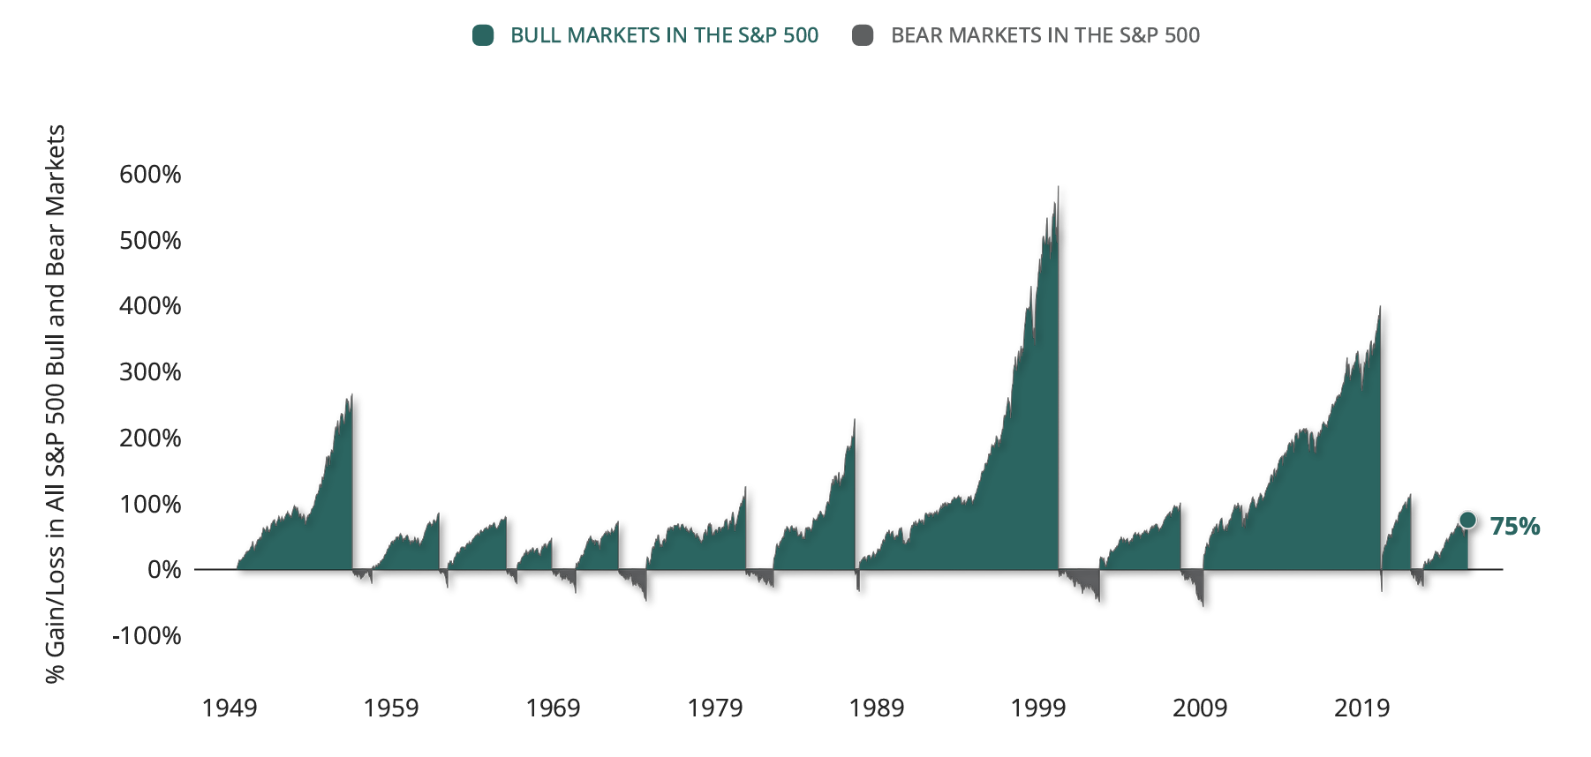
Bull Markets Tend to Last Longer than Bear Markets
Source: Factset, S&P, Exhibit A. 2025 data through 7/16/2025
© 2025 Corbett Road Wealth Management

Slide 20
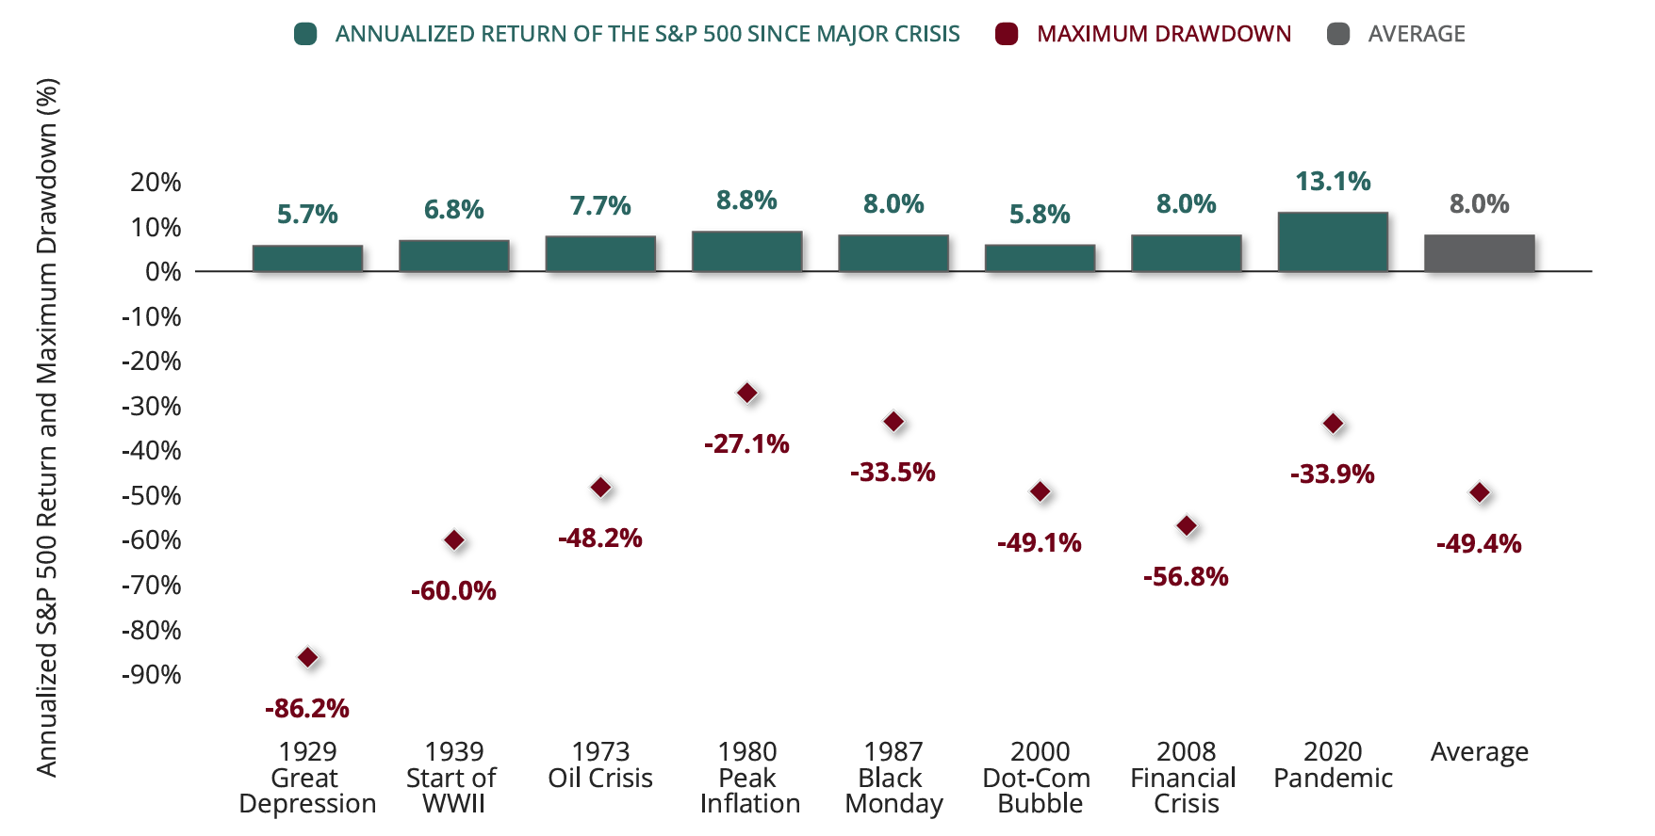
What if You Invested at the Start of Crises?
Source: Factset, S&P, Exhibit A. 2025 data through 7/16/2025
© 2025 Corbett Road Wealth Management

Slide 21
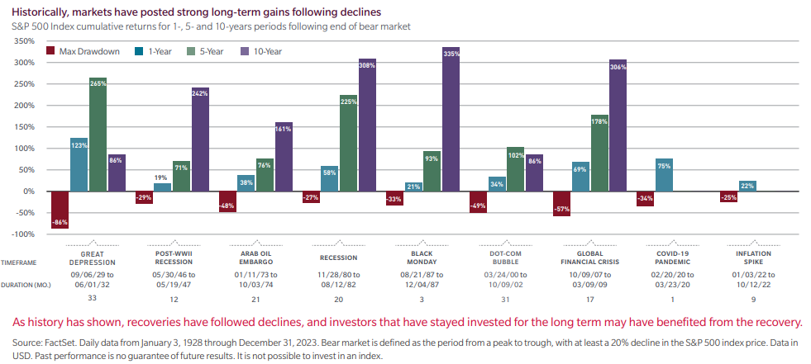
The Largest Drawdowns vs Forward Returns
Source: MFS Investment Management
© 2025 Corbett Road Wealth Management

Slide 22
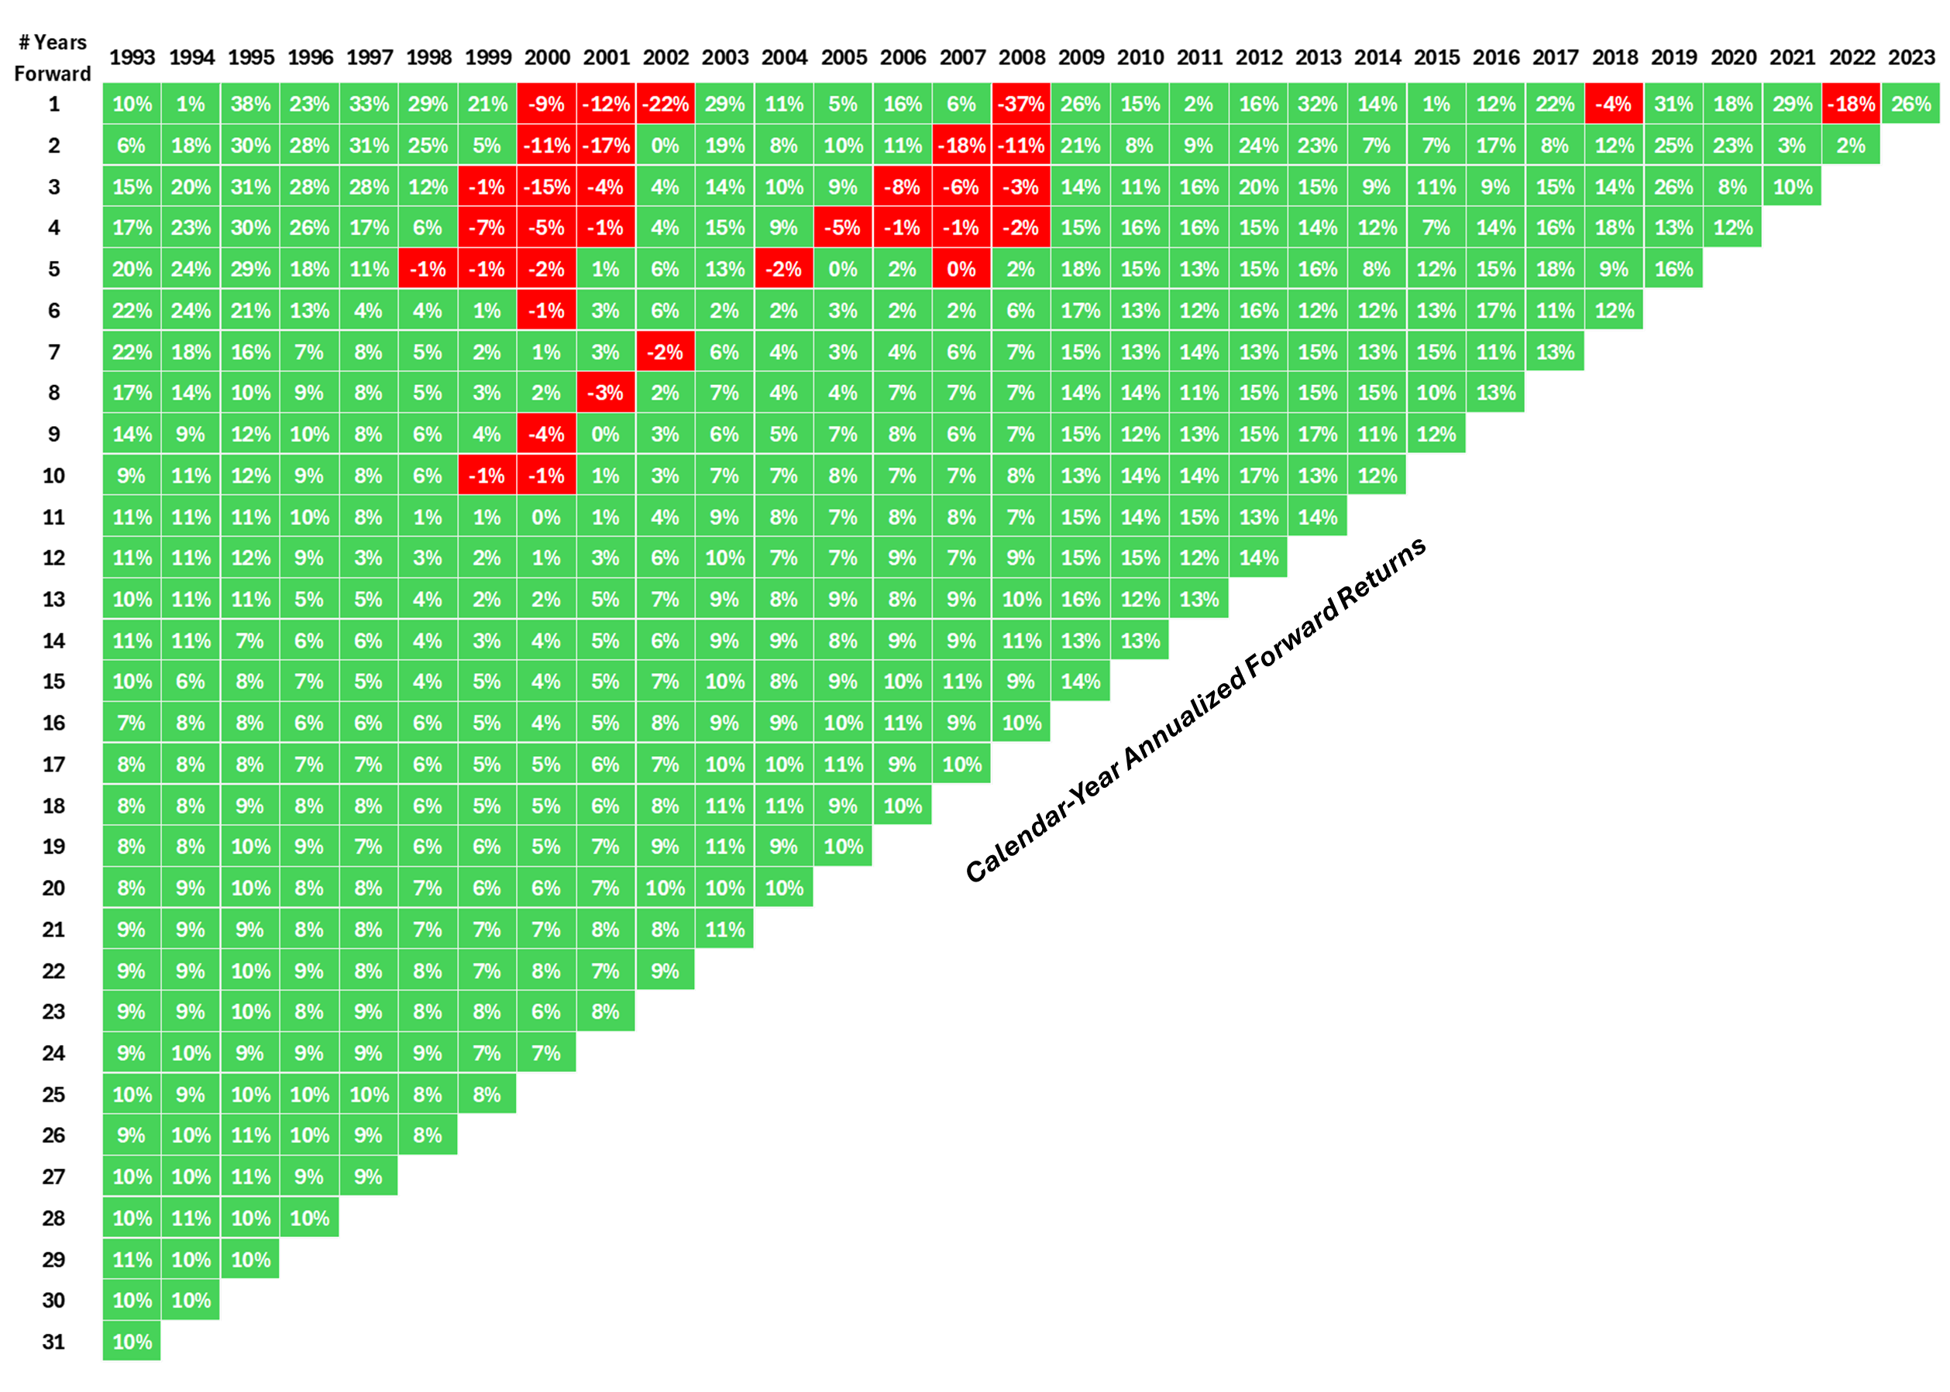
Time in the Market Matters:
Stocks Rarely Down When Held For 10+ Years
Source: A Wealth of Common Sense
© 2025 Corbett Road Wealth Management

Slide 23
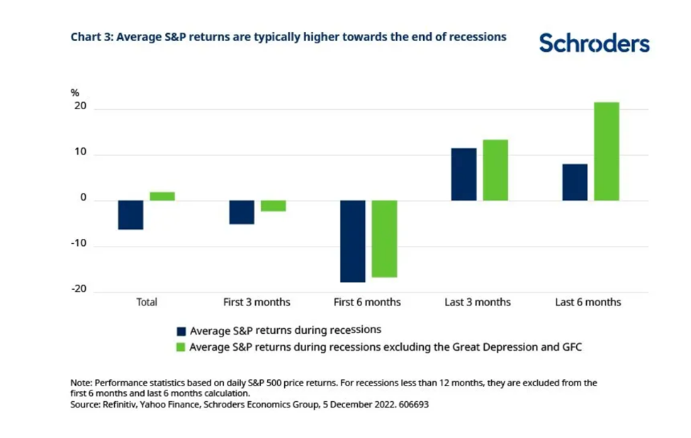
Market Returns During Recessions
Source: Schroders
© 2025 Corbett Road Wealth Management

Slide 24
Elections vs Markets
Source: LPL Financial
© 2025 Corbett Road Wealth Management

Slide 25
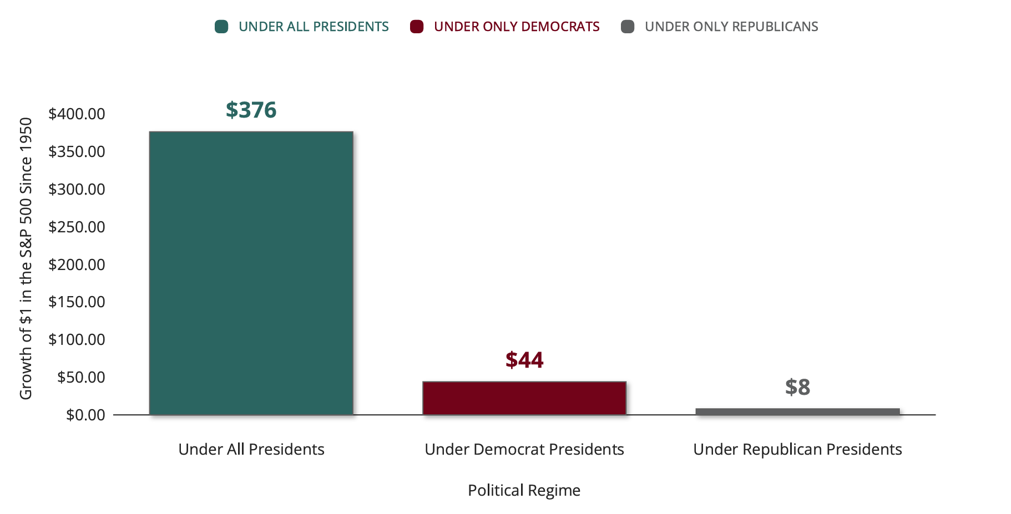
The Market Performs Better in Democratic AND Republican Administrations
Source: FactSet, S&P, Exhibit A, Data through 7/16/25
© 2025 Corbett Road Wealth Management

Slide 26
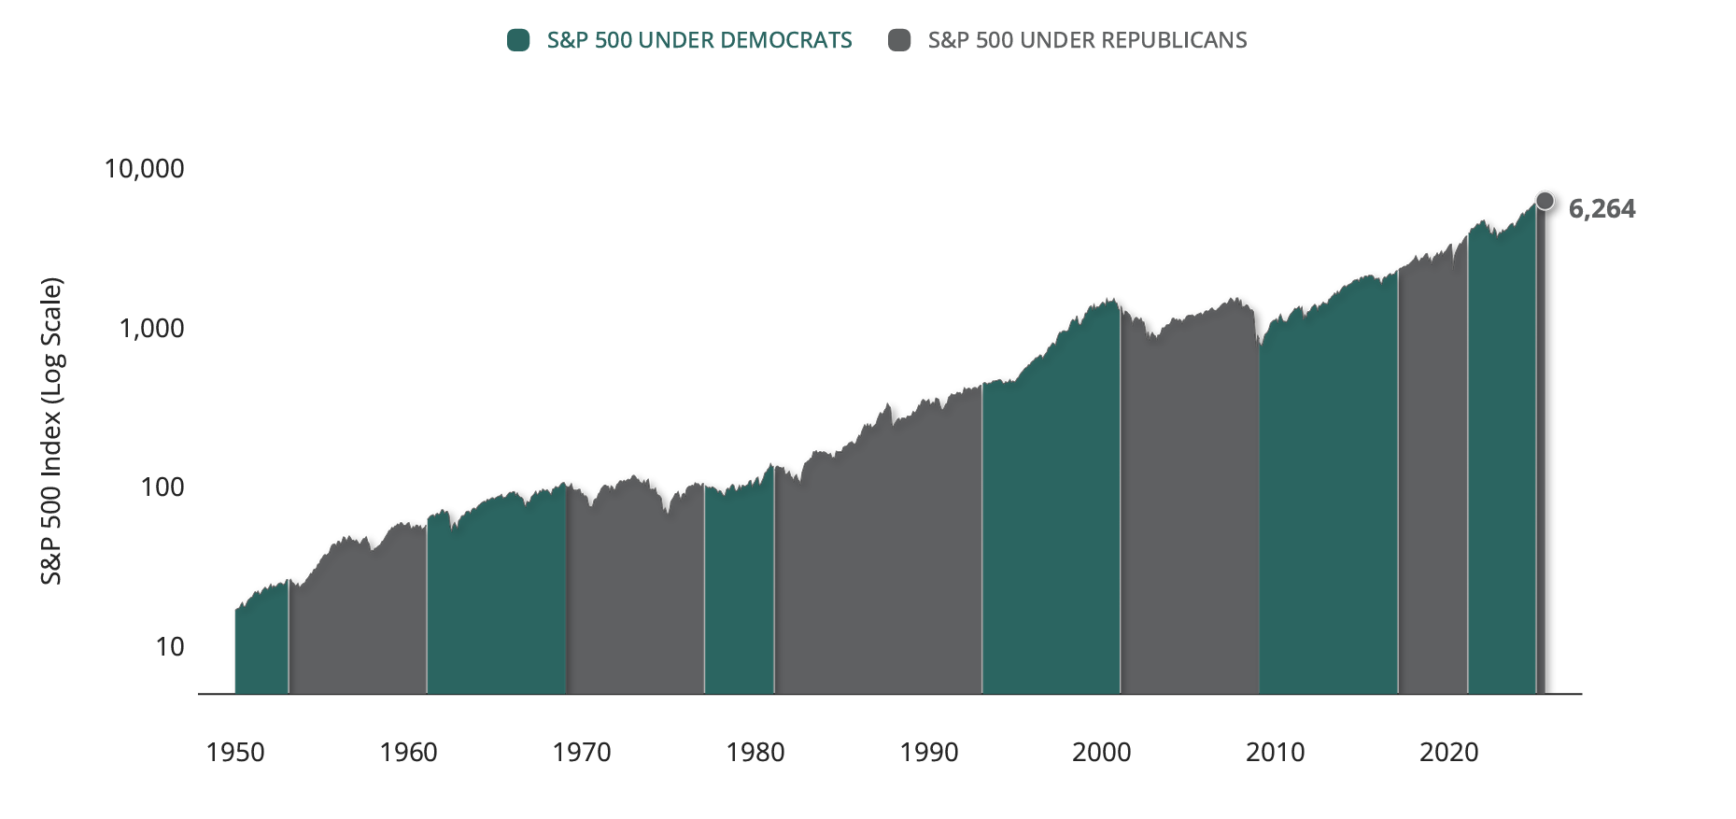
Presidential Party vs US Stocks
Source: FactSet, S&P, Exhibit A, data through 7/16/25
© 2025 Corbett Road Wealth Management

Slide 27
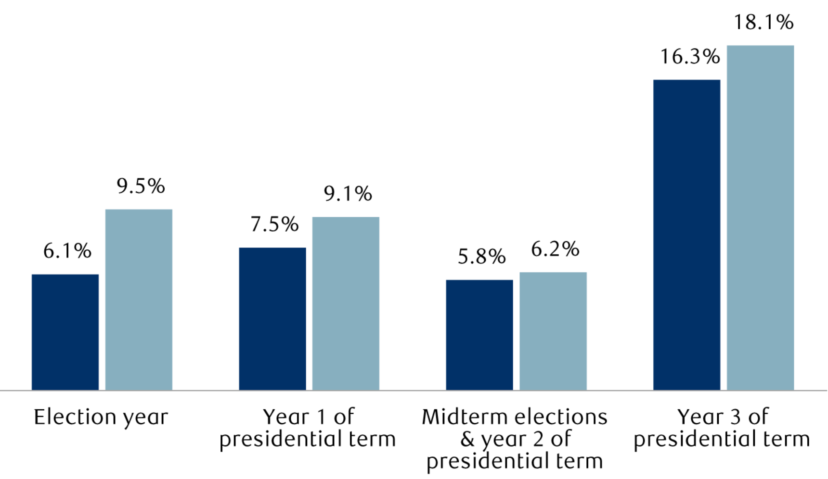
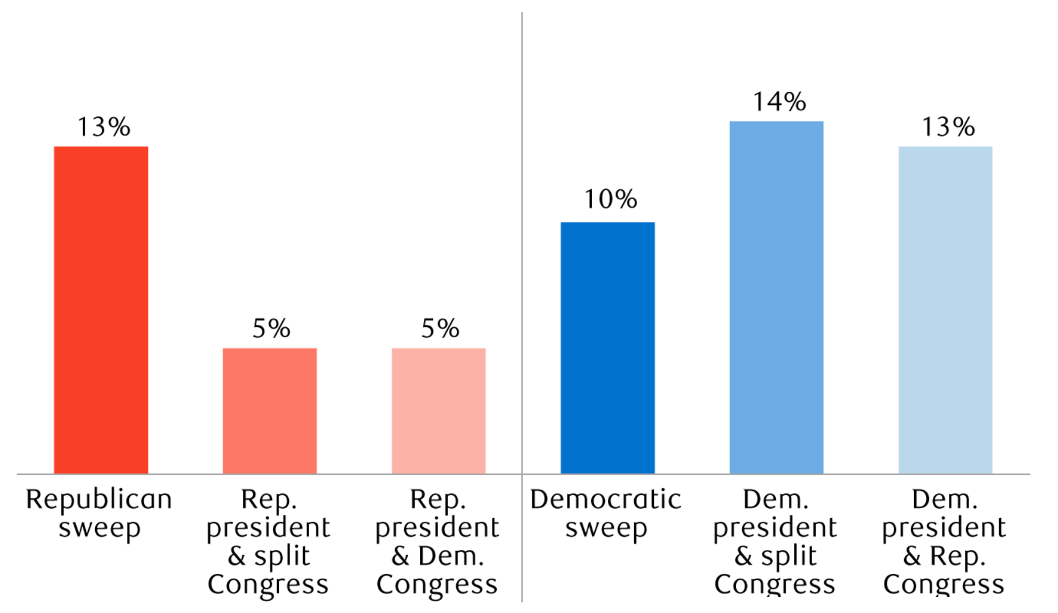
Election Cycles & Government Composition
S&P 500 Performance During Election Cycles (Since 1932)
Average Annual S&P 500 Returns by Government Makeup (Since 1932)
Source: RBC
© 2025 Corbett Road Wealth Management

Slide 28
Corbett Road Risk Models
© 2025 Corbett Road Wealth Management

Slide 29
Recessionary vs
Non-Recessionary Bear Markets
Type of Bear Market | # Since 1928 | Avg Drawdown | Avg Duration (Peak-to-trough)
Recessionary | 14 | -39.4% | 13 months (390 days)
Non-recessionary | 11 | -26.1% | 7 months (202 days)
Average Bear Market (All) | 25 | -33.5% | 10 months (307 days)
Source: Corbett Road
© 2025 Corbett Road Wealth Management

Slide 30
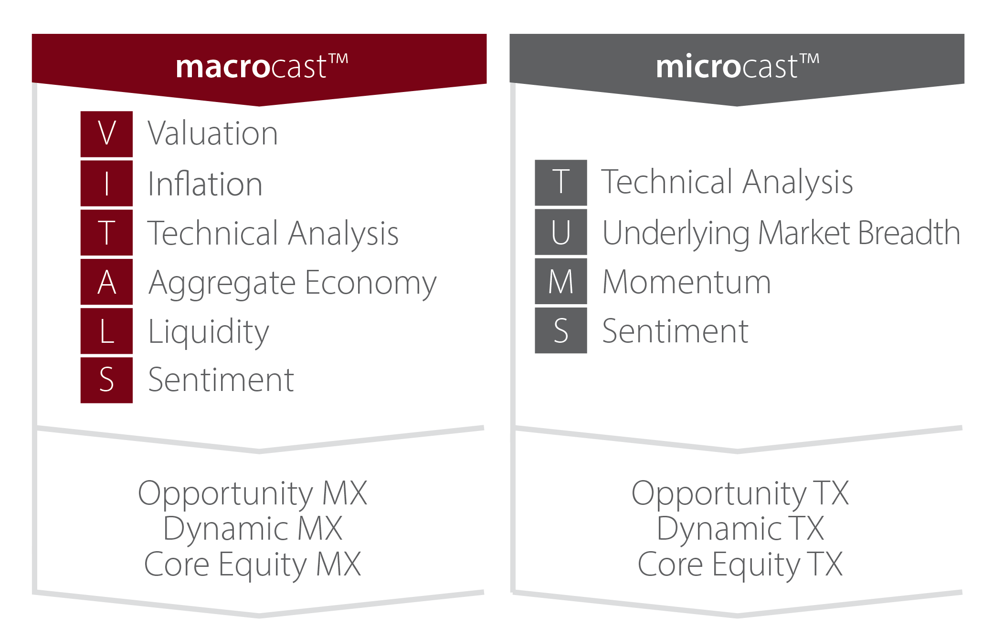
Corbett Road Tactical Solutions
Source: Corbett Road
© 2025 Corbett Road Wealth Management

Slide 31
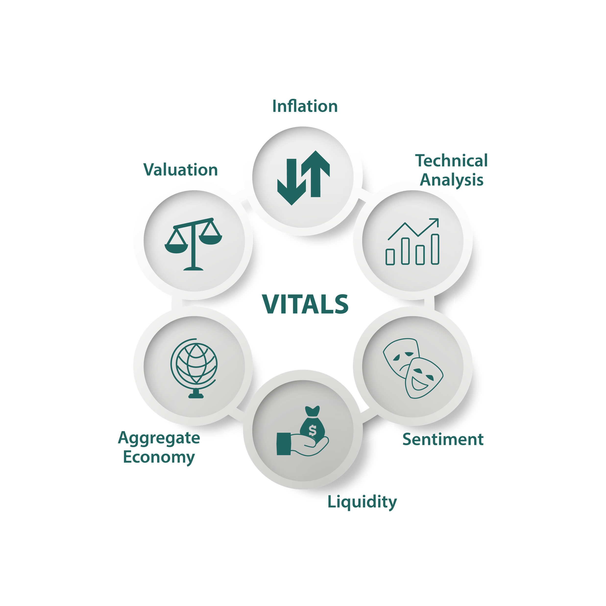
What is macrocastTM?
Corbett Road Corbett Road examines data across six categories (the “VITALS” that we believe impact market conditions. Within the VITALS, we examine more than 20 specific indicators that drive the macrocast™ Score.
These indicators are then assessed and classified as signaling a positive (+1), neutral (0), or negative (-1) trend. The final macrocast™ Score is the result of the summation of the classified indicators.
Source: Corbett Road
© 2025 Corbett Road Wealth Management

Slide 32






macrocastTM?
VALUATION
AGGREGATE ECONOMY
Cyclically Adjusted P/E Ratio
Corporate Profit Margins
Market Cap to GDP
Real Retail Sales
New Housing Starts
Initial Jobless Claims
INFLATION
LIQUIDITY
Consumer Price Inflation (CPI)
Industrial Metal Prices
Crude Oil
Yield Curve
Corporate Bond Spreads
Swap Spreads
TECHNICALS
SENTIMENT
Index Price Relative to LT Moving Average
% of Stocks Above 50 Day Moving Average (DMA)
Cyclical vs Counter Cyclical Performance
University of Michigan Consumer Sentiment Index
Investment Fund Flows
Investor Sentiment Surveys
© 2025 Corbett Road Wealth Management

Slide 33
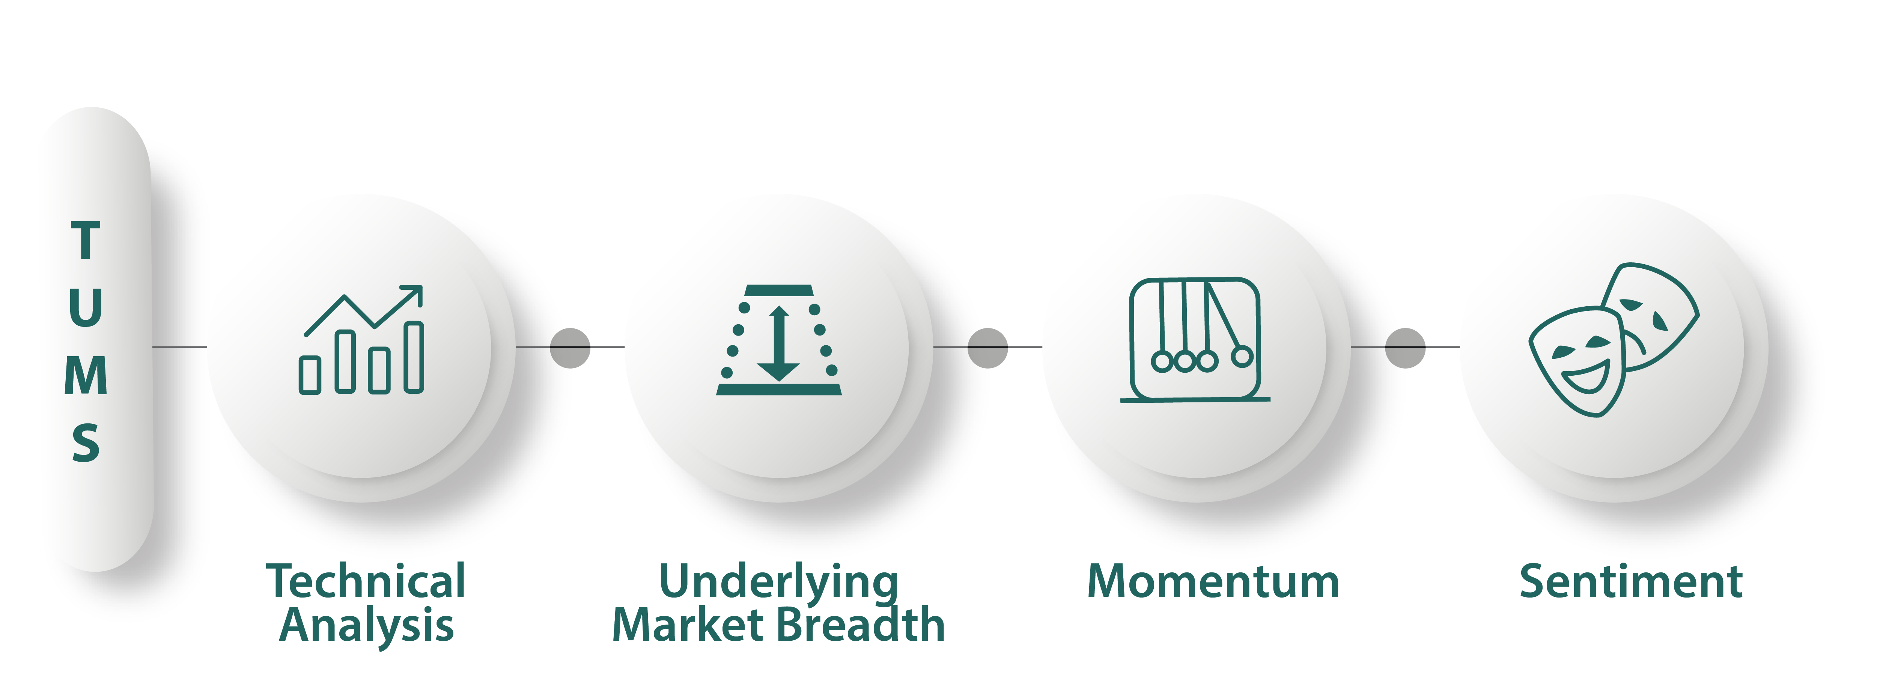
What is microcastTM?
Corbett Road examines data across four specific categories (“TUMS”) that we believe impact near to intermediate-term market conditions. microcast™ assesses more than ten specific indicators within these four categories.
Each of the indicators are designed to give positive or negative signals that, in aggregate, generate the microcast™ optimal risk allocation. This determines the allocation split between equity and defensive assets within the strategy.
Source: Piper Sandler, Corbett Road
© 2025 Corbett Road Wealth Management

Slide 34




microcastTM
TREND
Price vs 200-dma
Price vs 50-dma
Price vs 21-dma
UNDERLYING BREADTH
% of stocks above 50-dma
Accumulation-Distribution Line
Hi/Lo Ratio
MOMENTUM
Stochastics
Relative Strength Index (RSI)
Moving Average Convergence/Divergence (MACD)
SENTIMENT
VIX Index
Equity Put/Call Ratio
Bull/Bear Ratio
© 2025 Corbett Road Wealth Management

Slide 35
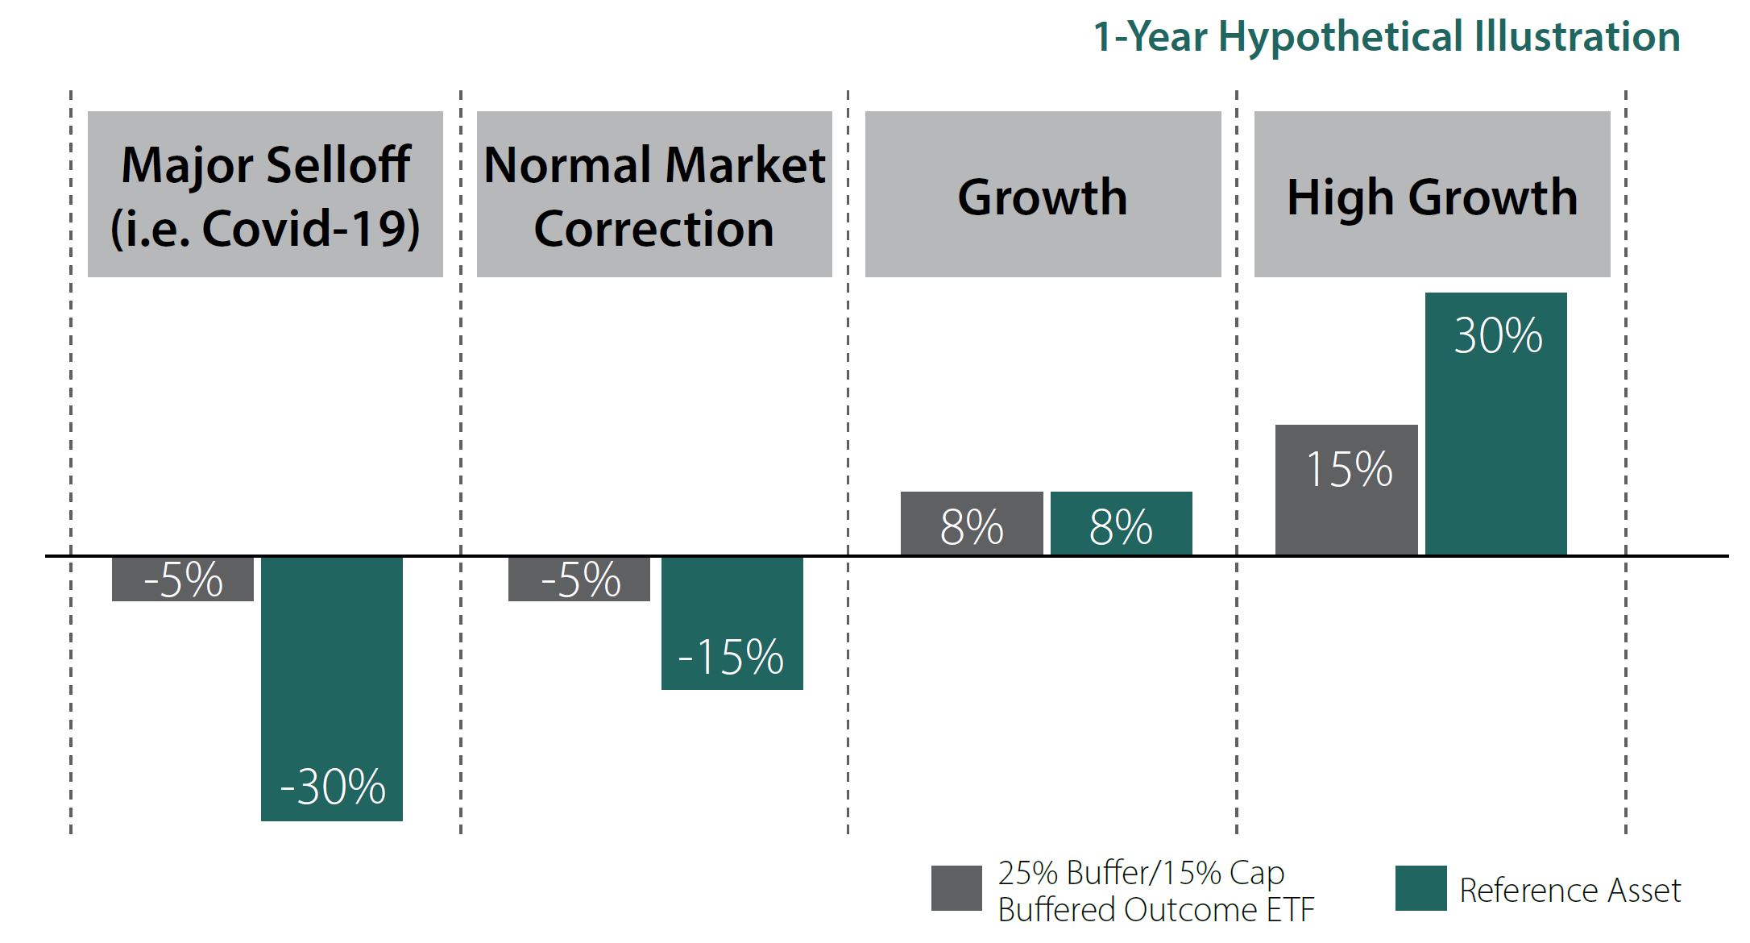
Corbett Road
Buffered Outcome Solutions
Source: Corbett Road
© 2025 Corbett Road Wealth Management

Slide 36
Asset Allocation
© 2025 Corbett Road Wealth Management

Slide 37
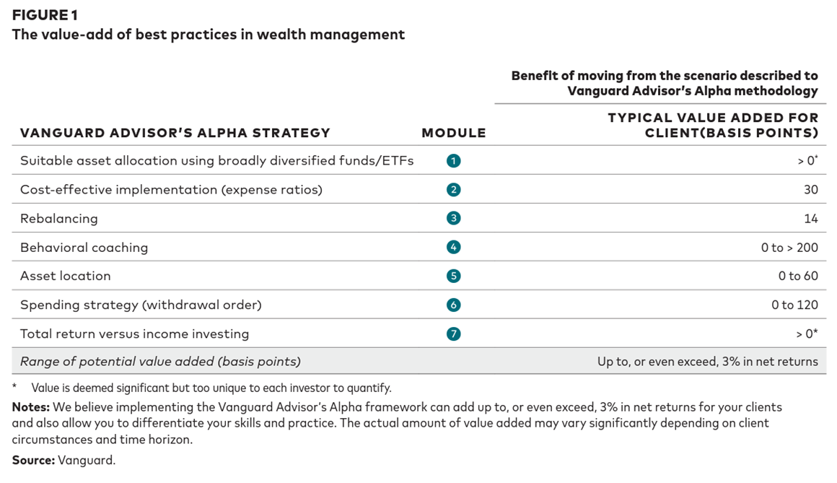
Vanguard Advisor's Alpha
Source: Vanguard
© 2025 Corbett Road Wealth Management

Slide 38
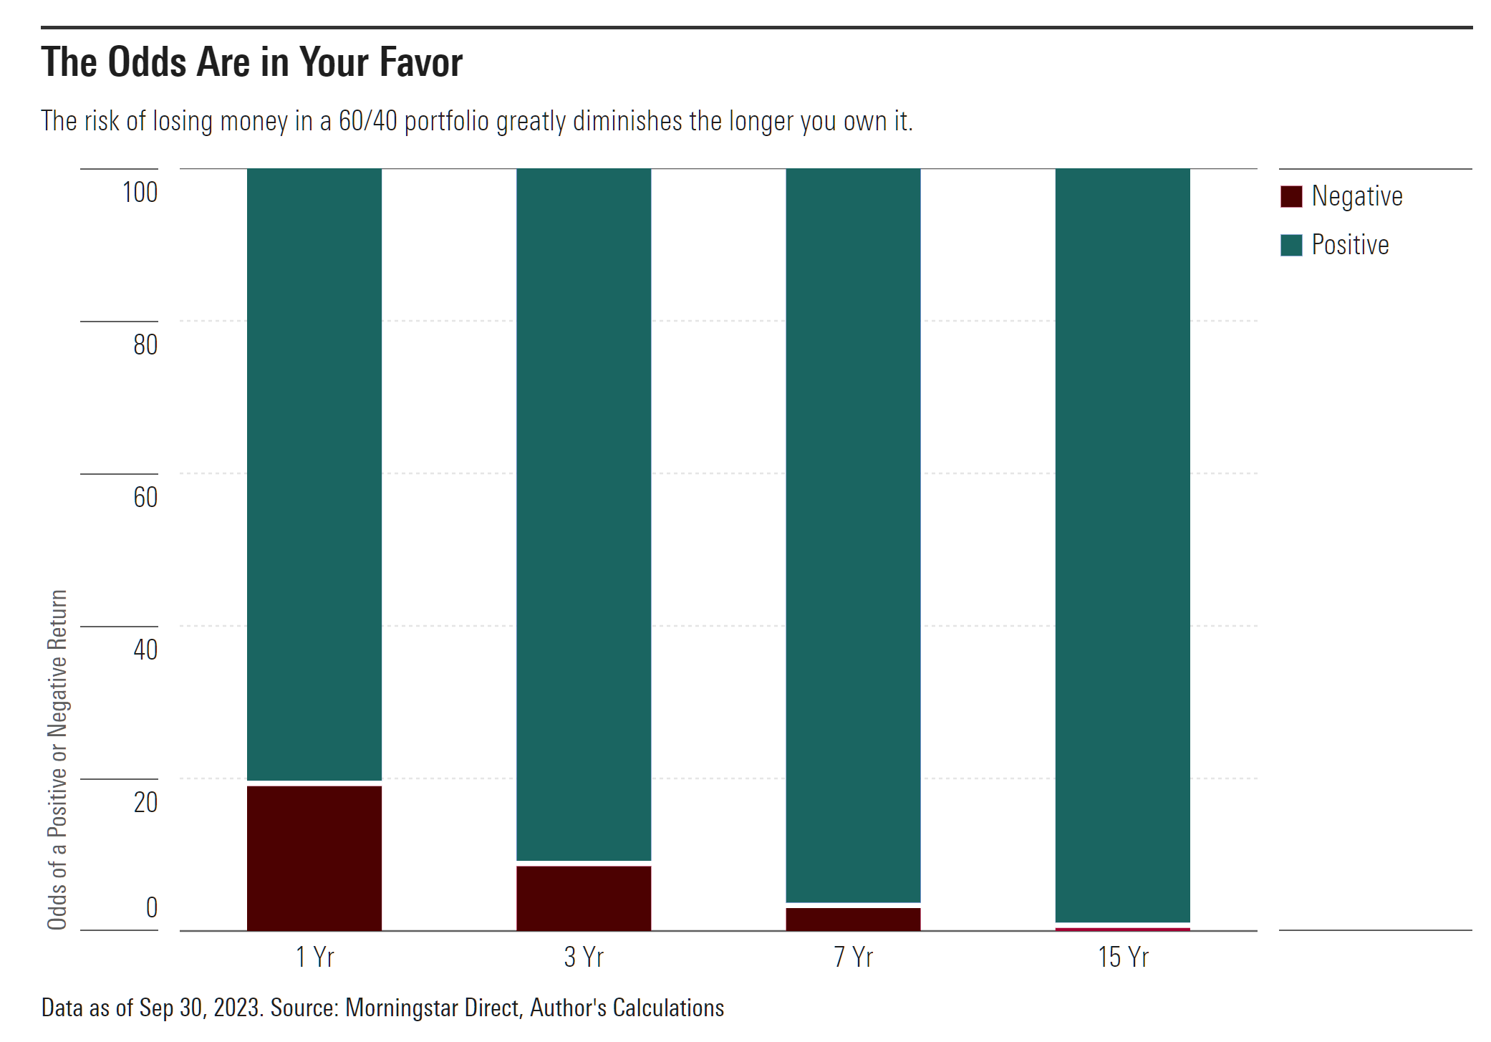
A 60/40 Portfolio Tends to Generate Positive Returns Over the Long Term
Source: Morningstar
© 2025 Corbett Road Wealth Management

Slide 39
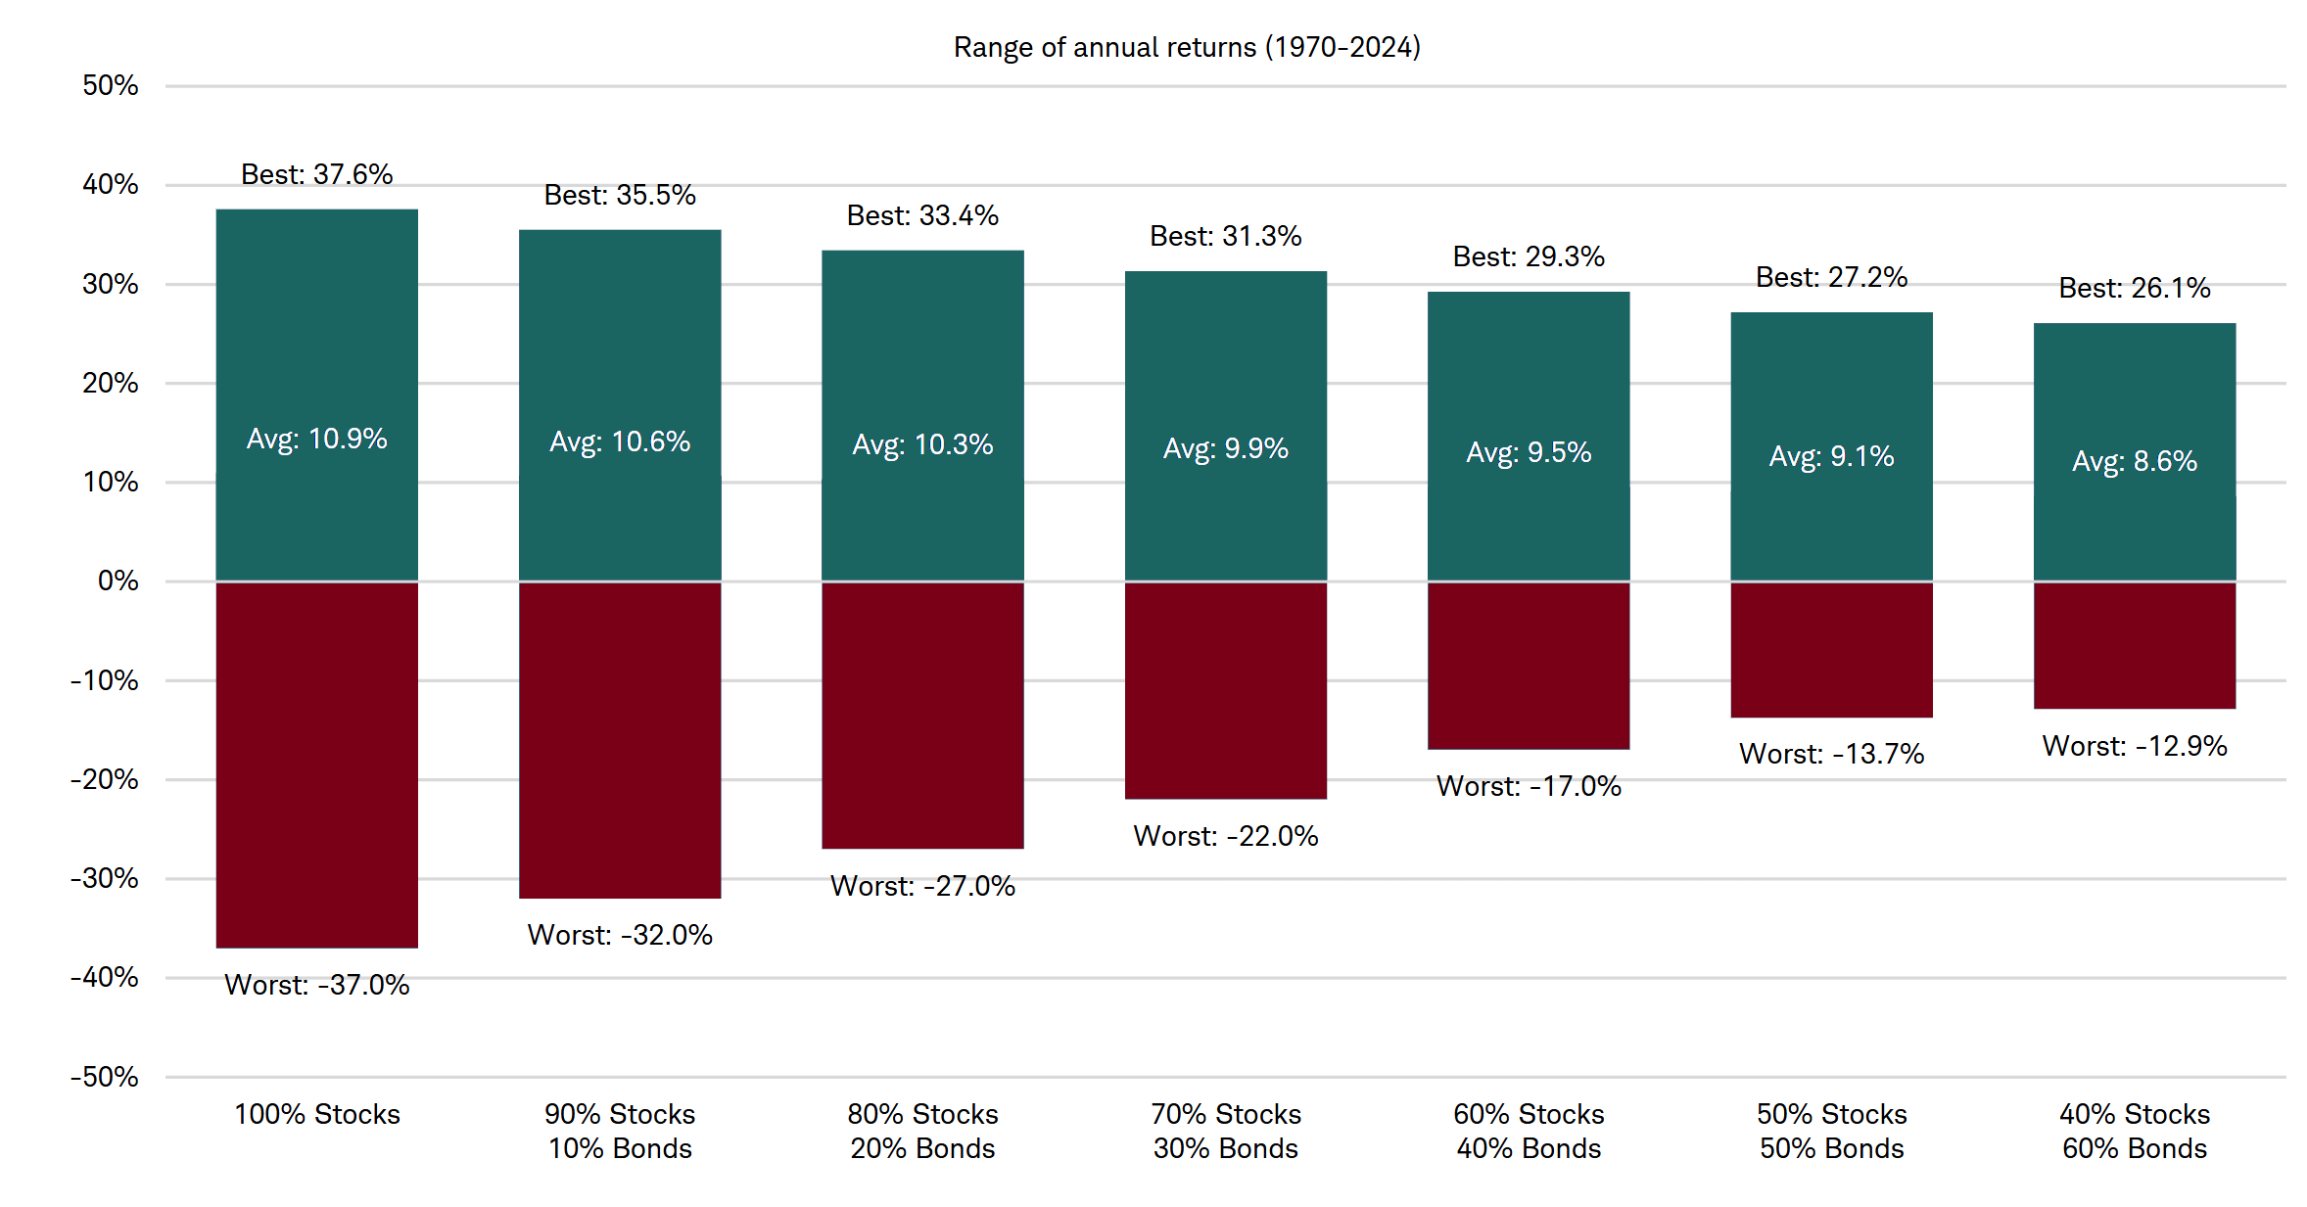
Bonds Can Help Reduce Portfolio Volatility
Source: Charles Schwab
© 2025 Corbett Road Wealth Management

Slide 40
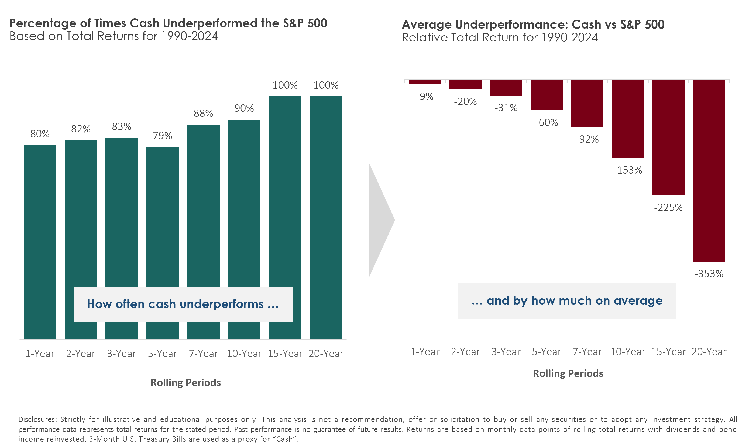
The Odds of Cash Underperforming Are High
Source: Charles Schwab
© 2025 Corbett Road Wealth Management

Slide 41
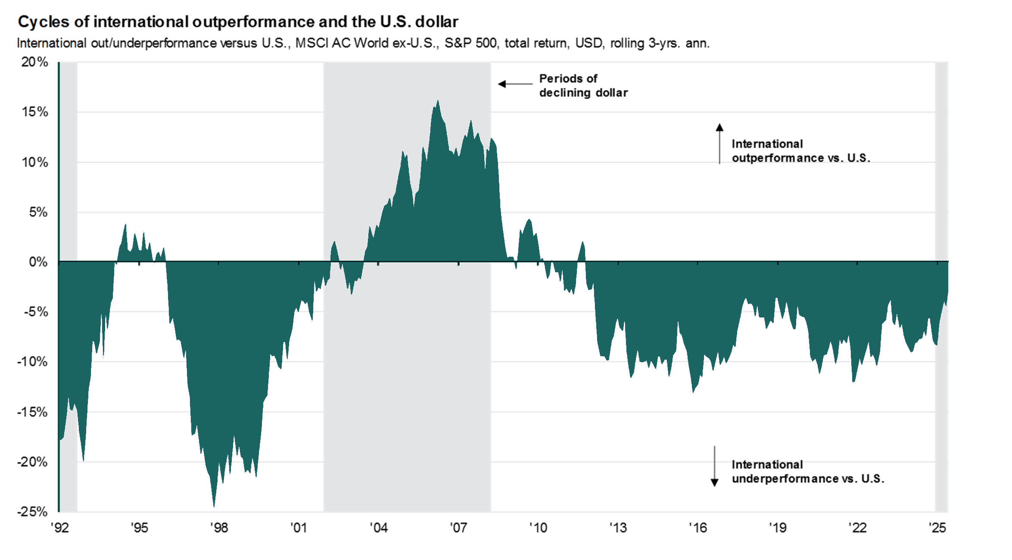
Domestic vs International
Source: JPM
© 2025 Corbett Road Wealth Management

Slide 42
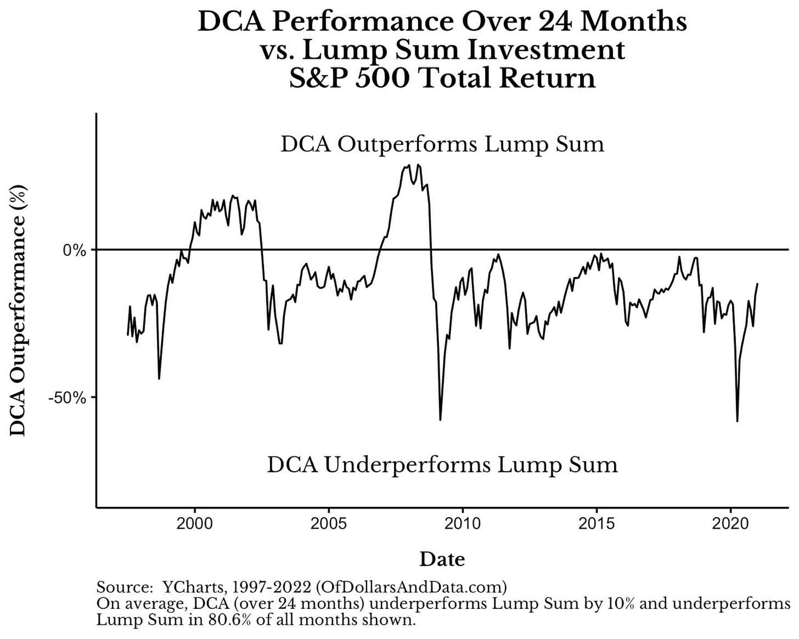
Dollar Cost Averaging vs Lump Sum
Source: OfDollarsAndData.com
© 2025 Corbett Road Wealth Management

Slide 43
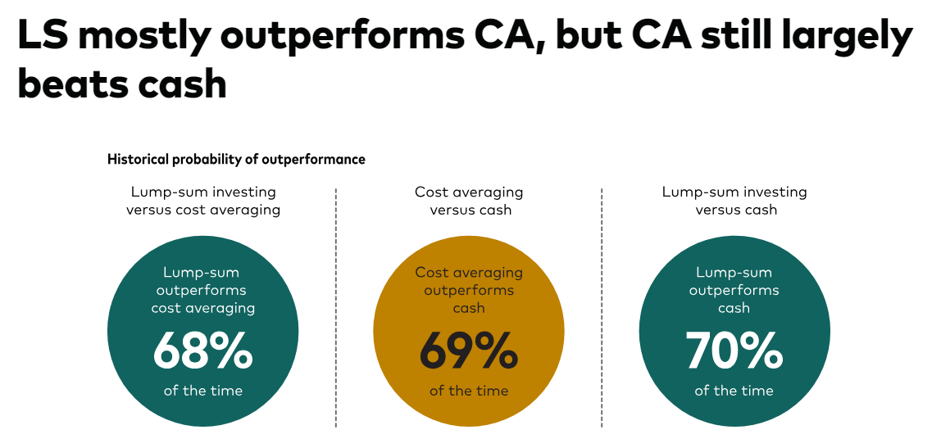
Dollar Cost Averaging vs Lump Sum
Source: Vanguard
© 2025 Corbett Road Wealth Management

Slide 44
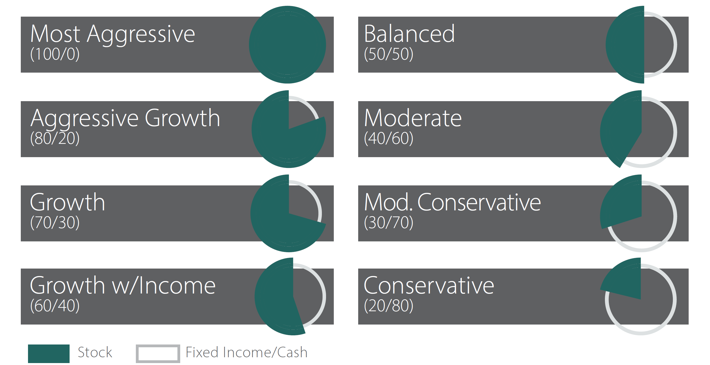
Corbett Road Asset Allocation
mypath Asset Allocation Portfolios™ (MAAP) offer a simple way to build a broadly diversified core portfolio. Available in allocation mixes spanning the target risk spectrum, our passive strategies establish a client’s long-term base portfolio using low-cost, passive exchange traded funds (ETF) products.
While strategic adjustments are made on a year-to-year, these portfolios are designed to remain invested throughout the economic cycle and market fluctuations. Providing broad exposure to global equity, fixed income, and real estate markets, our passive solutions can be used as a standalone solution or in conjunction with our other strategies.
Source: Piper Sandler, Corbett Road
© 2025 Corbett Road Wealth Management

Slide 45
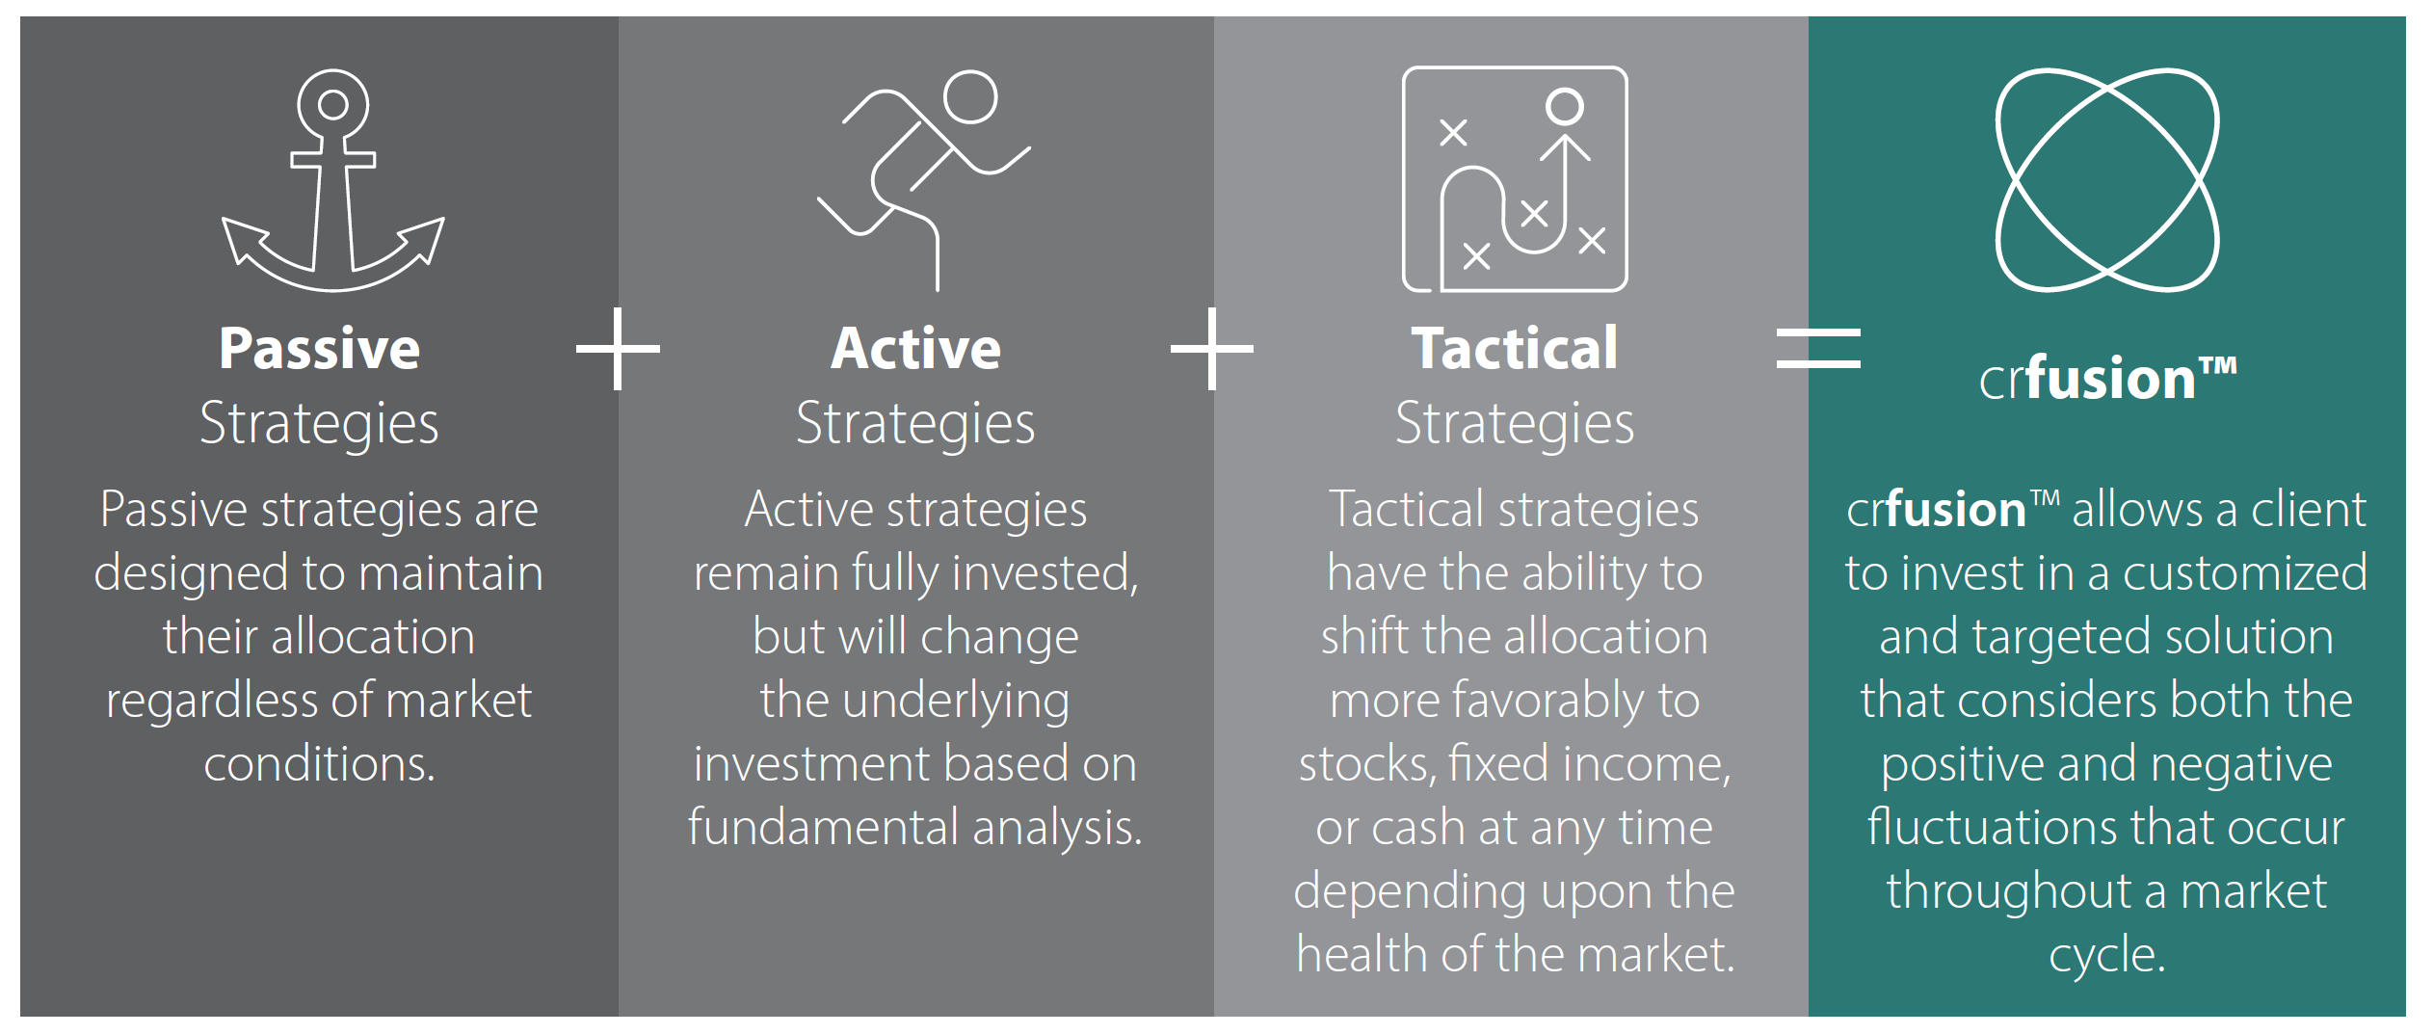
crfusionTM
Source: Piper Sandler, Corbett Road
© 2025 Corbett Road Wealth Management

Slide 46
Disclosures
The chart(s)/graph(s) shown is(are) for informational purposes only and should not be considered as an offer to buy, solicitation to sell, or recommendation to engage in any transaction or strategy. Past performance may not be indicative of future results. While the sources of information, including any forward-looking statements and estimates, included in this (these) chart(s)/graph(s) was deemed reliable, Corbett Road Wealth Management (CRWM), Spire Wealth Management LLC, Spire Securities LLC and its affiliates do not guarantee its accuracy.
The views and opinions expressed in this article are those of the authors as of the date of this publication, are subject to change without notice, and do not necessarily reflect the opinions of Spire Wealth Management LLC, Spire Securities LLC or its affiliates.
All information is based on sources deemed reliable, but no warranty or guarantee is made as to its accuracy or completeness. macrocast™ and microcast™ are proprietary indexes used by Corbett Road Wealth Management to help assist in the investment decision-making process. Neither the information provided by macrocast™ or microcast™ nor any opinion expressed herein considers any investor’s individual circumstances nor should it be treated as personalized advice. Individual investors should consult with a financial professional before engaging in any transaction or strategy. The phrase “the market” refers to the S&P 500 Total Return Index unless otherwise stated. The phrase “risk assets” refers to equities, REITs, high yield bonds, and other high volatility securities.
Corbett Road’s quantitative models utilize a variety of factors to analyze trends in economic conditions and the stock market to determine asset and sector allocations that help us gauge market movements in the short- and intermediate term. There is no guarantee that these models or any of the factors used by these models will result in favorable performance returns. Spire Wealth Management, LLC is a Federally Registered Investment Advisory Firm.
Securities offered through an affiliated company, Spire Securities, LLC, a Registered Broker/Dealer and member FINRA/SIPC. Registration does not imply any level of skill or training.

Slide 47
Thank You
© 2025 Corbett Road Wealth Management

